Slide 1
Lesson 2: Project: Evaluation, Monitoring, Auditing
Macerata, 22nd October
Alessandro Valenza, Director, t33 srl

Slide 2
AGENDA (1 hour)
Rationale of project: theory of change and logical framework
Evaluation, Monitoring and Auditing
Criteria of evaluation
Timing of evaluation

Slide 3
What do we need from the last lessons
The Project / Program cycle
The Chain of Public Interventions
Identification
Formulation
Evaluation and review
Implementation
Policy
Program
Project (1)
Project (2)
Other delivery policy tools: law, tax, agency, campaign.

Slide 4
Why do we need a project?
To make a change…
The project is …..
To…
Project vs. routine
Project is limited in time
Resources are defined
Beneficiary identified
Solve a problem / social need / change a behaviour:
Economic growth
Accessibility
Social inclusion
…..

Slide 5
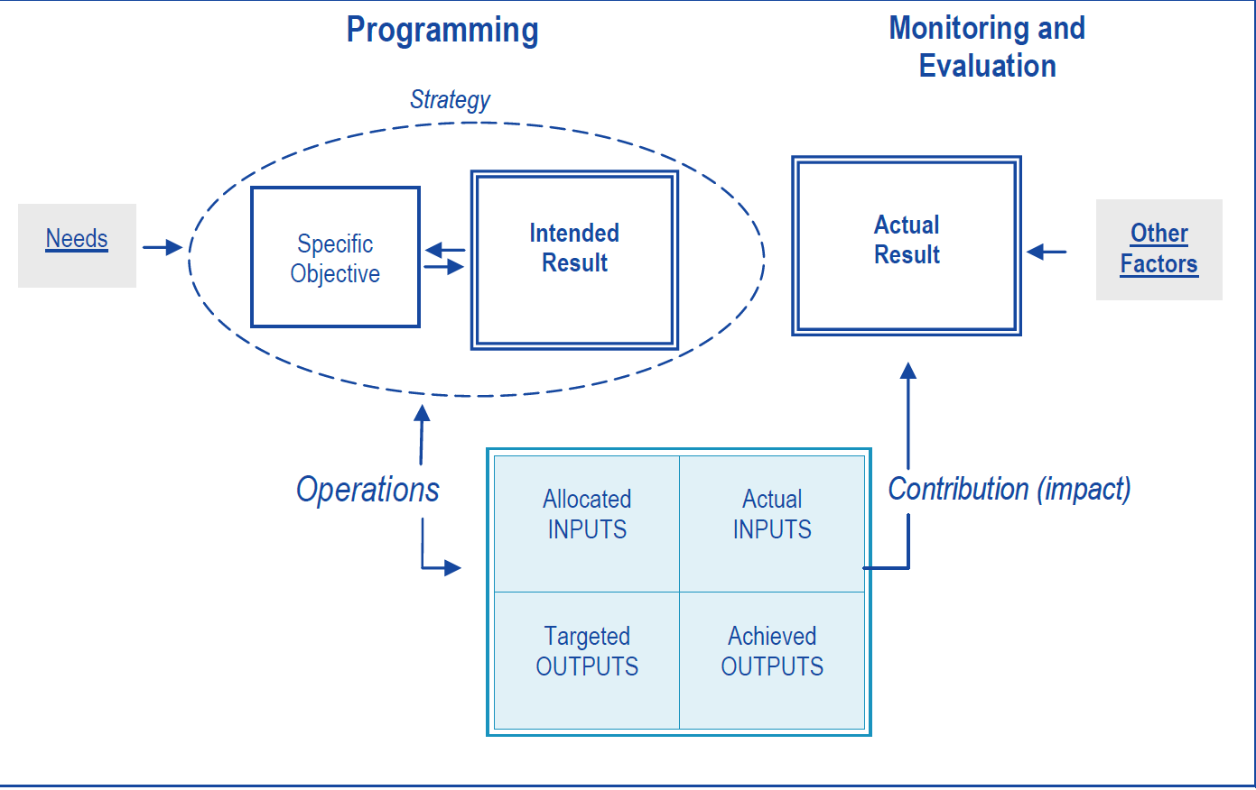
Build project’s rationale : theory of change (1)
Source: DG REGIO MONITORING AND EVALUATION OF EUROPEAN COHESION POLICY 2014 -2020 ERDF
- EUROPEAN REGIONAL DEVELOPMENT FUND AND COHESION FUND –

Slide 6
Build project’s rationale: Logical Framework (2)
Logic of intervention | Indicator
General Objective | Impact - Outcome
Specific Objective | Result
Realisation | Ouput
Activity | Input ( resources)

Slide 7
Monitoring
To monitor means to observe.
Monitoring is the regular observation and recording of activities taking place in a project or program. It is a process of routinely gathering information on all aspects of the project.
To monitor is to check on how project activities are progressing. It is observation; ─ systematic and purposeful observation.
Monitoring also involves giving feedback about the progress of the project to the donors, implementers and beneficiaries of the project.
Reporting enables gathered information to be used in making decisions for improving the project performance.

Slide 8
Evaluation
Based on monitoring, evaluation is the systematic collection and analysis of data needed to make decisions, a process in which most well-run programs engage from the outset ( American Evaluation Society)
Evaluation tries to answer two distinctive questions:
Did the public intervention have an effect at all and if yes, how big – positive or negative – was this effect. The question is: Does it work? Is there a causal link? This is the counterfactual question
Why an intervention produces intended (and unintended) effects. The goal is to answer the “why and how it works?” question. To answer this question is the aim of the theory-based impact (European Commission – DG REGIO)
An evaluation is an assessment, as systematic and objective as possible,of an on-going or completed project, programme or policy, its design, implementation and results. The aim is to determine the relevance and fulfilment of objectives, developmental efficiency, effectiveness, impact and sustainability. An evaluation should provide information that is credible and useful, enabling the incorporation of lessons learned into the decision-making process of both recipients and donors ( OECD/DAC)

Slide 9



Monitoring, Auditing and Evalaution
Monitoring: observing and collecting data form the project.
  What time is it? 12,34
  At what time is the train ? 11,50
Auditing: judgement against a rule/ standard
  The train is at 11,50 and you missed it
  Evaluation: interpeting data to provide a subjuctive judgement for accountability and learning:
    You did not catch the train because of…..
    An alternative can be……..

Slide 10
Project development
Resources (inputs)
Realisation (output)
Result / outcome
Impact
Needs
SELECTION
Identification and Formualtion
Implementation
END OF PROJECT
After Conlcusion

Slide 11
Project development and Evaluation
Resources (inputs)
Realisation (output)
Result / outcome
Impact
Needs
Ex ante Evaluation
On going Evaluation
Monitoring
Ex Post Evaluation

Slide 12
Relevance and Coherence
Resources (inputs)
Output (implementation)
Result
(Specific Objective)
Impact ( general Objective)
Needs
Relevancece
Program / policy
Internal
Coherence
External coherence

Slide 13
Performance, Efficiency, Impact, Sustainibility, Effectiveness
Resources (inputs)
Output (implementation)
Result
(Specific Objective)
Impact ( general Objective)
Needs
Performancece
Efficiencyce
Effectivenessce
Sustainibilityce
Impactce

Slide 14
Definitions
Relevance : the project results and Impact CAN produce a change
External Coherence: the project is strategically aligned with the concerning policy (vertical) – the program works in synergy and complementarily with other contextual intervention (horizontal)
Internal coherence: the project objectives, activities, output, results, impacts are logically connected
Performance: the project activities are delivered on time, the outputs respect the targets, the resources are duly absorbed, the procedures are done according to the rules.
Effectiveness: the project achieves results / Impact accordingly with the targets
Efficiency: the project achieves results / Impact accordingly with the targets with the minor costs and in the shorter time.
Impact: the project is capable to contribute significantly to the change
Sustainability: the project changes can last after the conclusion
Utility: Impacts obtained by the intervention correspond to society needs

Slide 15
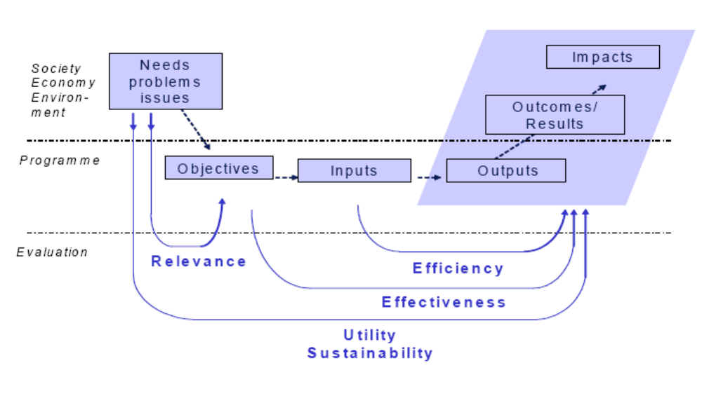
Other prospective….
Monitoring =information about the ongoing situation
Evaluation = analysis (using monitoring and additional data)

Slide 16
Phases of evaluation and Criteria
 | EX ANTE | ON GOING | EX POST
Relevance
Internal coherence
External Coherence
Performance
Efficiency
Effectiveness
Impact and Utility
Sustainibility

Slide 17
Evaluation from different prospectives
Prospectives and approaches |  | Key difference
Summative: the evaluation provide a judgement | Formative: evaluation is for learning and changing the project | Status Evaluator: - summative, shall be independent - formative, he can be from the organisation implementing the project (auto - evaluation)
Qualitative: analysis of intangible effect (opinions, perceptions, facts) and narrative approach | Quantitative: analysis of tangible effects by sharp measurement. | Methods: Qualitative: case studies, interviews, focus group Quantitative: statistical analysis, cost and benefit analysis, counterfactual
Counterfactual: identify what is the impact (net effect) | Theory based: identify the casual effects linked the impact/ effect to the project | Type of projects: Counterfactual: the impact shall be quantifiable and easy to be identify Theory based: type of impact is not relevant
Participative: involvement of the stakeholders during the whole evaluation process ( data collection, analysis, assessment, dissemination) | Top down: technically driven and detached from the project actors | Approach to the Project actors.

Slide 18
See you
www.t33.it
a.valenza@t33.it

