Slide 1
Lesson 8: Efficiency, Impact and sustainibility
Macerata, 11 December
Alessandro Valenza , Director, t33 srl

Slide 2
Agenda
What does Efficiency mean? What Impact and sustainability?
Cost/ effectiveness analysis
CBA analysis
Custumer satisfaction analysis

Slide 3
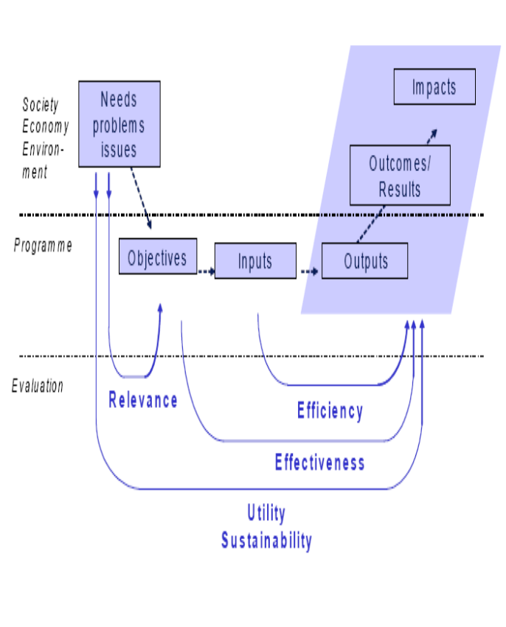
Efficiency, Impact and sustainibility in the evalaution Process
Effectiveness: which result?
Project
Result 1
Result 2
Result 3
Efficiency
At what cost?
Sustainibility: Will they last?
Impact:
Are they directily related?

Slide 4
Efficiency
Definition
Type of Questions
OCSE: the project results have been achieved at reasonable cost with minimum waste of effort, time, money and skills.
European Commission: obtaining a given output at the minimum cost or, equivalently, with maximizing output for a given level of resources.
1. Was the budget adequate? Was the spending commensurate with the delivery of activities and achieving results?
2. Were the human, financial, material resources adequate in terms of quality and quantity to achieve the project results?
3. To what extent were costs of the project justified by the benefits in comparison with similar projects or known alternative approaches?

Slide 5
Sustainibility
Definition
Type of Questions
OCSE: Will the political, institutional, managerial, and technical, change last beyond the initiative
1. Are the results likely to be sustained in the future?
2. Did national/regional/local authorities, civil society take ownership of the results of the project?
3. Are changes in attitudes, behaviour patterns and institutional arrangements likely to last once the project is closed?

Slide 6
Impact
Definition
Type of Questions
OCSE: Did the project bring real change objective/outcome
European Commission:The change that can be credibly attributed to an intervention.
1. To what extent was the project objective achieved? How did the results influence the indirect beneficiaries?
2. Did the project produce unintended effects? Why did these unintended results (positive or negative) happen?
3. What was the influence of external factors (negative, positive, little/no influence) such as changes in policy legislation, general economic and financial conditions?

Slide 7
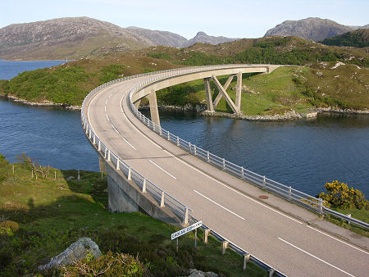
Example
Effectiveness: Does the new project (road) produce the positive result (objective) of a better accessibility?
Yes, now 10.000 people more can get the island saving 2 hours and 3 millions of euros
Efficiency: was it the cheapest solution?
No a ferry boat would have been cheaper
Sustainability: will the result last?
Yes
Impact: Are the effect directly connect?
Yes

Slide 8
THE ANALYSIS
Comparing cost and outcome
Cost - effectiveness
Comparing Cost and Benefit
Cost and Benefit
Comparing perception
Custumer satisfaction

Slide 9
Work out
 | Answers
Objectives of the project
Output of the project
Outcome of the project
How can you measure the efficiency?
.. And the sustainibility

Slide 10
See you
www.t33.it
a.valenza@t33.it

