Slide 1


The Hansa Cultural Route
Atzori Susanna, Forconi Selene, Pennacchioni Adriana, Priore Michele, Suarez Jimenez Martha Cecilia

Slide 2
Outline
Territory analyzed
The Hansa Cultural Route project
    Description/implementation period/funding sources
    Participants
    Objectives
    Implemented activities
    Achievements/ Impact
Conclusions

Slide 3
Territory analyzed

Slide 4
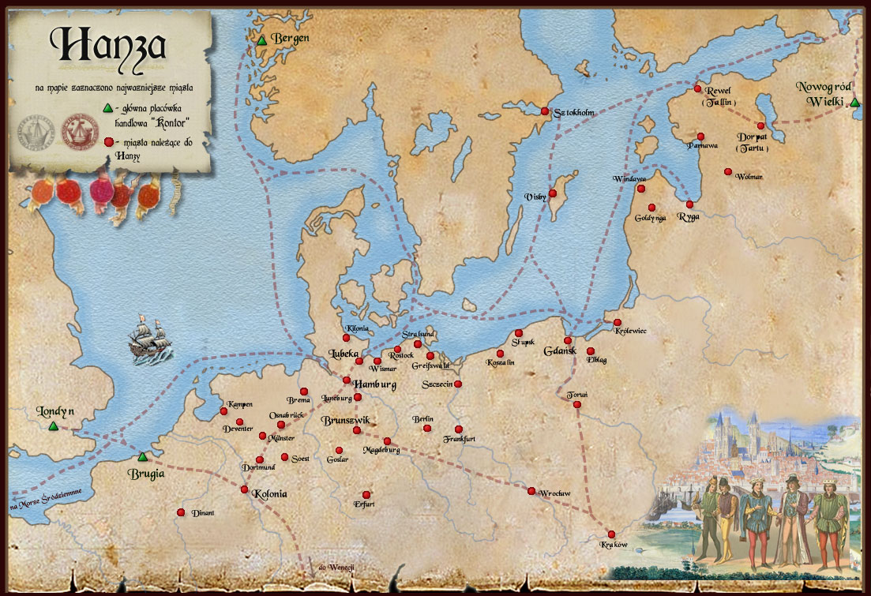
Historical background
The Hansa Route was a medieval network of merchants that from 1161 to 1358 held power and control over trade and markets related to the Baltic Sea
In 1356 formalized as a league of Hanseatic cities

Slide 5
Demographic/economic data
Main Countries of the Hansa Cultural Route | Population (inhabitans) | Population density (inhabitans/km²)
Germany (101 cities/towns) | 81 843 743 | 229
Poland (22 cities/towns) | 38 538 447 | 122,1
Netherlands (15 cities/towns) | 16 730 348 | 492,2
Russia (13 cities/towns) | 143 056 382 | 8
Latvia (8 cities/towns) | 2 041 763 | 36
Estonia (5 cities/towns) | 1 339 662 | 30,9
Main Countries of the Hansa Cultural Route | Governement Expenditure on culture (€) | Share of spending on culture by central government (%)
Germany | 9 127 300 000 | 13,42
Poland | 1 960 226 181 | 17,61
Netherlands | 2 981 000 000 | 35
Russia | 5 528 894 778 | 29,27
Latvia | 251 446 310 | 45,85
Estonia | 250 300 000 | 54,90

Slide 6
The Hansa Cultural Route project

Slide 7
Description of the project: | The new HANSE consists of a network of 181 member towns and cities in 16 European countries, making it the largest voluntary association of towns and cities in the world. The members comprise not only the Hanseatic towns and cities, but also some of the former large depots in north-west Russia, as well as some of the smaller trading posts.
Programme participation period: | 1991 – present 2004: certified as a major Cultural Route
Funding sources: | Members contribute a small fee (€ 80 + € 30 p. a.) towards the website www.hansa.org No other funding has been received and each town is responsible for funding its own activities

Slide 8
Participants
Participating countries:
Belarus, Belgium, England, Estonia, Finland, France, Germany, Iceland, Latvia, Lithuania, Netherlands, Norway, Poland, Russia, Scotland, Sweden
Main Partners:
Local municipalities
A few corporate sponsors: Air Baltic, Die Hanse Publishing House
Private Tour operators: Via Hansa
Institution: University of Applied Sciences in Munster (for the research)
NGOs (e.g.: Bonifatius Guild in Estonia) and SMEs (e.g.: Emajoe Barge Society in Tartu, Estonia; Het Hanze Huis foodstore in Amsterdam) participating in Hansa Days

Slide 9
Stated objectives
Encouraging transnational collaboration and the promotion of the region’s common cultural heritage
Reviving the spirit and the ideas of the European city/municipality
Promoting the self-awareness of the Hanseatic cities
Developing cooperation with the goal of making a contribution to the economic, cultural, social and governmental unification of Europe

Slide 10
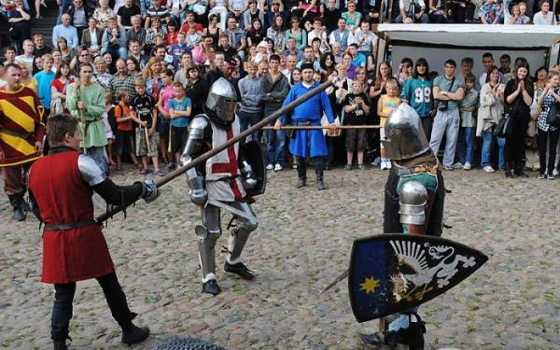
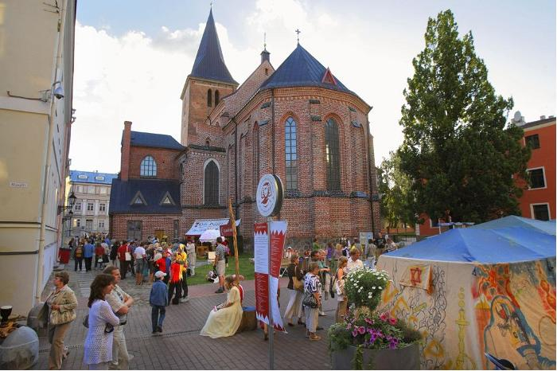
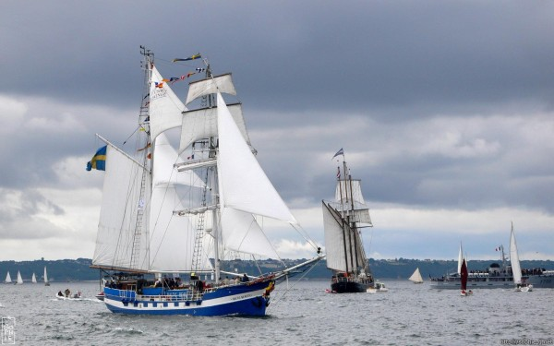
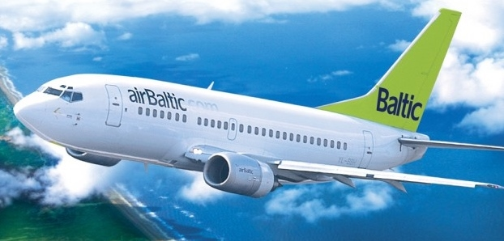
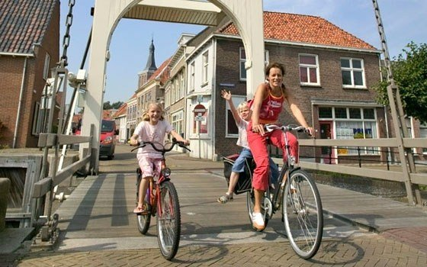
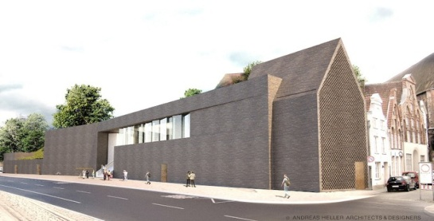

Implemented activities
Annual Hansa Day and Convention
http://www.hanse.org/en/international-hanse-days/the-traditional-hanseatic-days/
Local Hansa Days
www.hansebund.org – www.medeltidsveckan.se
Hansa Youth League
www.hanse.org/en/die-hanse-today/organisation/youth-hansa/
Promotion
http://www.airbaltic.com/en/index - http://www.hanse.org/en/tourism/#
Business Region Hanse
http://www.hanse-business-reloaded.eu/

Slide 11






The Hansa Brand
A well-established free brand, which has been in widespread use long before the revival of the Hanseatic League.
Part of the promotional strategy of many corporate businesses, SMEs, cultural attraction and even towns throughout the Baltic Region
Issue of the competing brands in the main cities (e.g. World Heritage Status)

Slide 12
Achievements/Impacts
Cultural impacts
Greater cultural co-operation between member towns
Greater awareness of their common cultural heritage
Economic impacts
Hansa days attract increased visitors number over the three-day period
Visitors spend money on food, products, like handicrafts, tours and cultural attractions, and services, like accomodation
Hansa Days raise the profile of host towns, stimolating new cultural attractions

Slide 13
Conclusions

Slide 14

What have we learnt?
It can really be an effective tool to promote and value the territory and its cultural heritage even with minimal external investment
It offers several examples of best practices which may be transferable to others Cultural Routes
It seems to have developed mostly on the voluntary work and time offered to the project
It relies too much upon the ancient and well-established historical tradition
At the moment most of the appeal which cities and countries perceive and that can drive them to take part in the project seems to come from the Hansa Days incomes

Slide 15




What/how can we improve?
Creation of joint products or joint marketing developed through international collaboration
Use of social networks
Creation of a system of monitoring and collection/analysis of the impact’s data
Integrated promotion of the whole route rather than of its single activities
Participation as a Route to European projects (e.g.: CERTO project) http://www.culture-routes.lu/php/fo_index.php?lng=en&dest=bd_ac_det&id=00003424
Creation of a web platform in order to boost dialogue and cooperation between members of the Hansa Route
Wider spread of package tours

Slide 16

Web Sources
http://www.hanse.org/en/
http://www.culturalpolicies.net/web/statistics-resources.php
http://www.coe.int/t/dg4/cultureheritage/culture/routes/hansa_en.asp
http://www.culture-routes.lu/php/fo_index.php?lng=en

Slide 17
Thanks!
s.atzori@email.it, pennacchioni.adriana@gmail.it, seleneforconi@hotmail.it, prior_michle@libero.it, martikamor2009@gmail.com

