Slide 1



Caruso Antonela
Gaudioso Francesco
Lopez Marco
Pesce Daniela

Slide 2
OUTLINE
What is the Transromanica?
Territory
Participants and logic of the project
Stakeholders
The Transromanica Network
Transromanica & CrossCulTour
Aims
Structure of the project
Marketing activities
Training and Seminaries
Conclusions

Slide 3
WHAT IS TRANSROMANICA ?
The transromanica cultural route is a
international non-profit organisation for
supporting and fostering Europe’s Romanesque
Cultural heritage.
The transromanica route brings together and
number of regions accross europe that house
monuments related to the romanesque period.

Slide 4
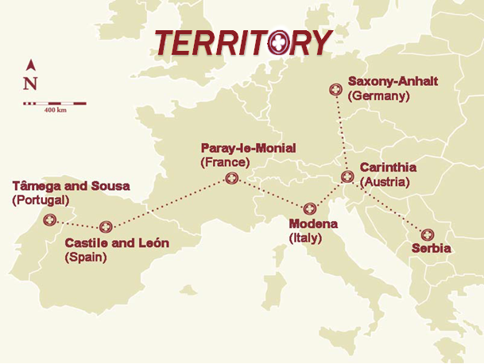

Slide 5
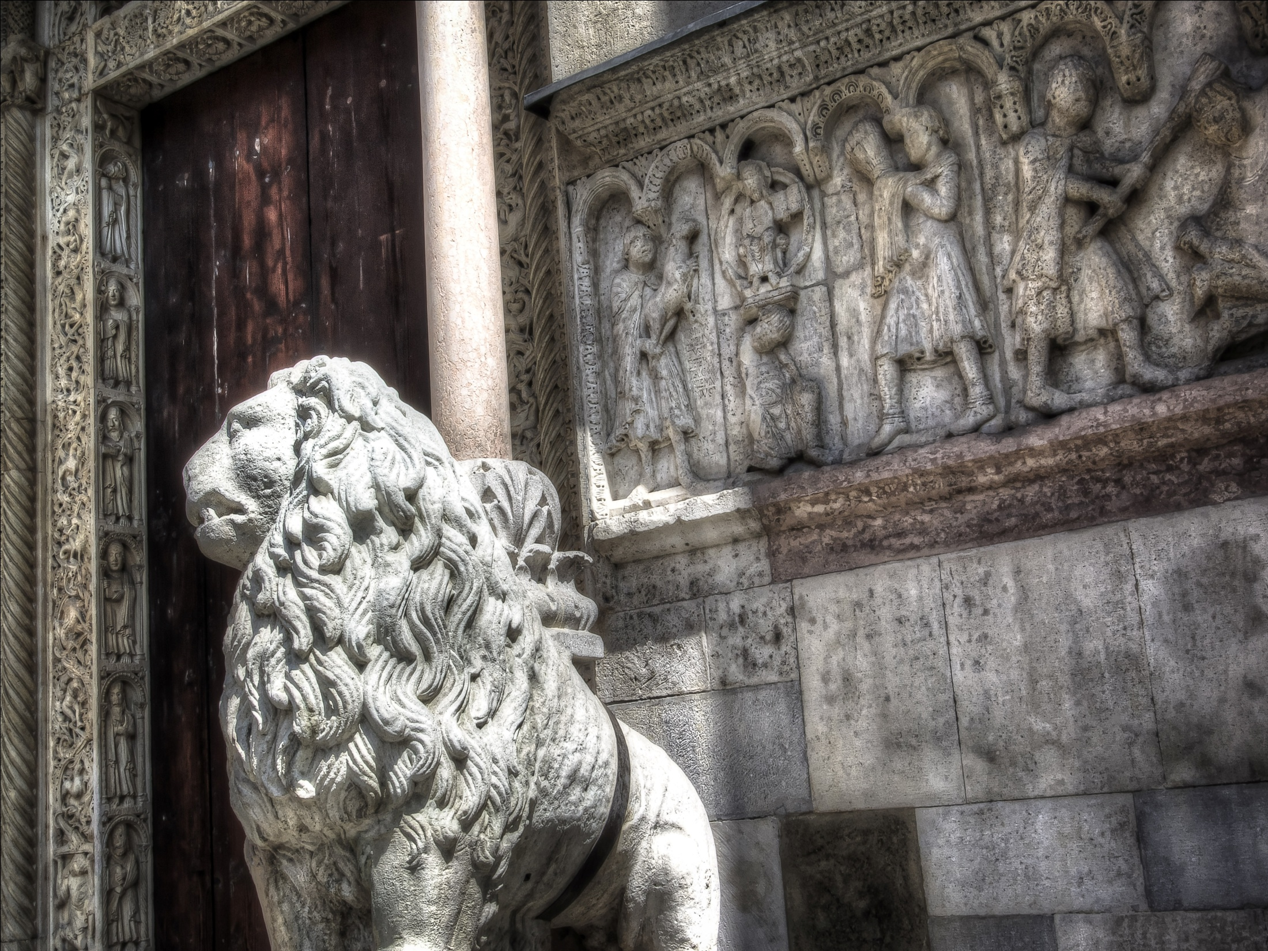
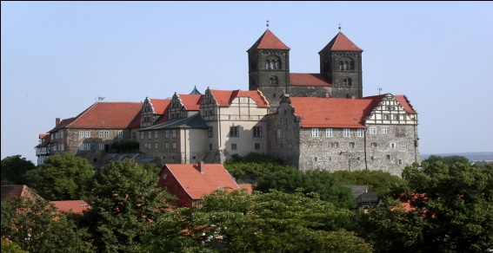
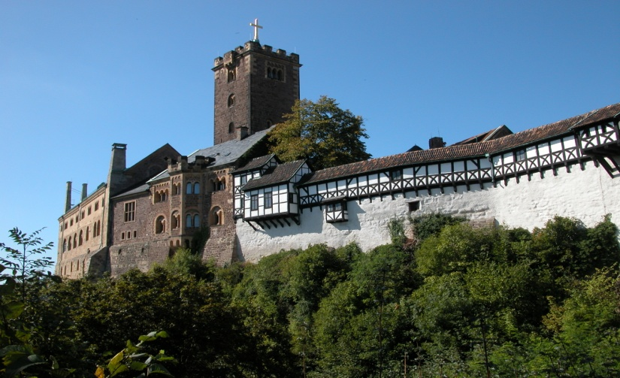
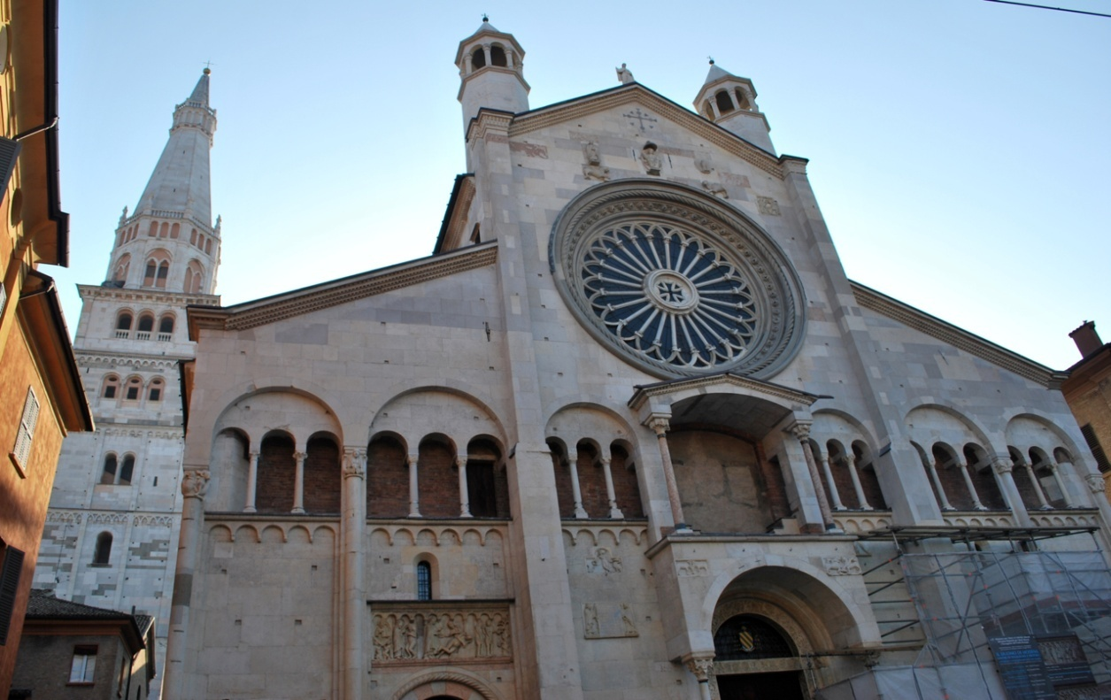
Collegiate Church of St Servantius in Quedlinburg
Wartburg Castle in Eisenach
Modena Cathedral

Slide 6
PARTECIPANTS
Austria, France, Germany, Italy, Portugal (from 2009), Slovenia (until 2010), Spain and Serbia.
logic of the project
The Transromanica route contains more than 45
romanesque highlights and cover 400 monuments in
total spread across eight countries. Their logic is to
develop cultural tuorism for enhancing the
attractivenes of cities and regions as member of the
network.

Slide 7
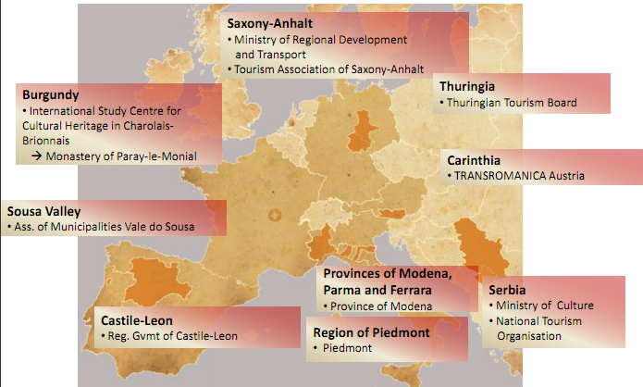
THE TRANSROMANICA NETWORK

Slide 8
STAKEHOLDERS
The cultural itinerary is developed in two phases:
Public sector Funding
Development of tourism, alliance between public and private sector.

Slide 9
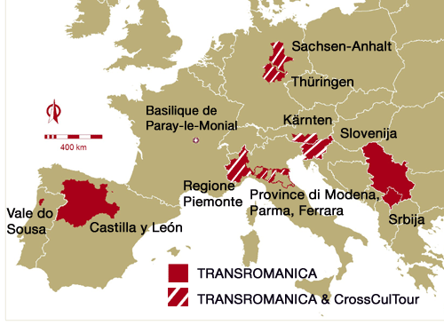
TRANSROMANICA & CROSSCULTOUR
CrossCulTour includes Tranromanica members in
Austria, Germany, Italy and Slovenia.
France, Spain, Portugal and
Serbia are not eligible to
princitate in this project
since funding is provided
under the Central Europe programme of the ERDF.
Period :
December 2008 -November 2011

Slide 10
AIMS
Grow the Transromanica network;
Use new forms of tourism marketing;
Opening of buildings;
Qualification of members / (honorary) employees;
Revival of traditional products;
Create identity and promote volunteering;
Cultural Events / initiate art projects;
Publications, public relation and lobbying;
Use of new media;
Thematic education of children, youth and adults;

Slide 11
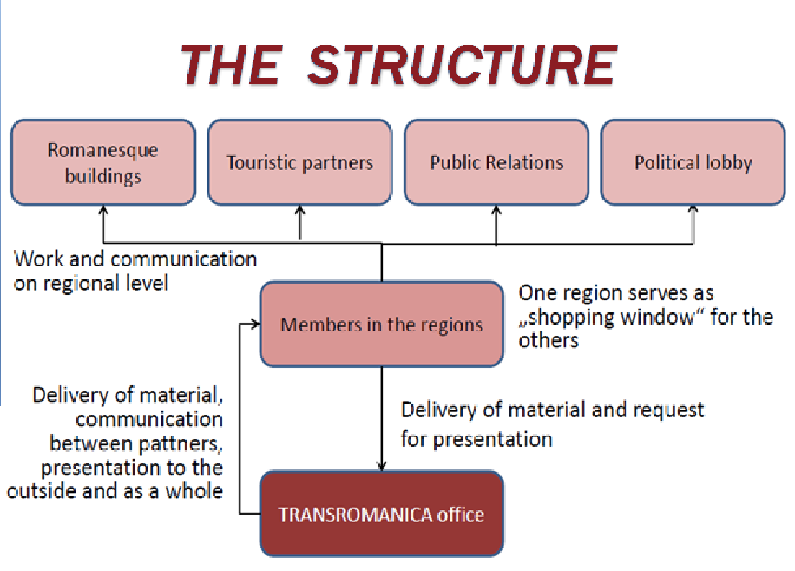
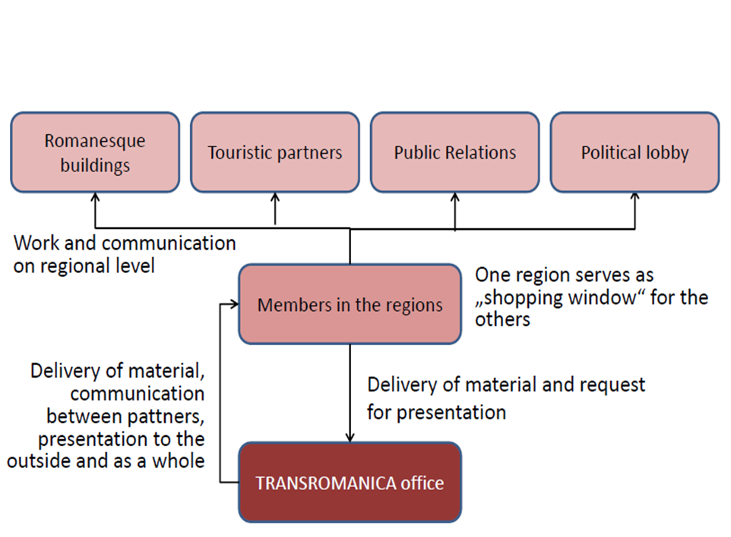
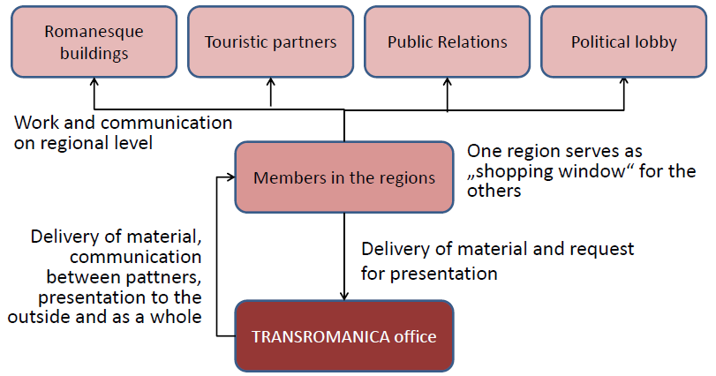
THE STRUCTURE

Slide 12


MARKETING ACTIVITIES
The Transromanica’s sites offers:
Interactive maps
Audio guides in three different languages
Special edition for children
Publications :
Just Transromanica brochure material ;
Concerning Flyer (English, German , French, Italian , Slovenian, Serbian and Spanish);
Booklet with the image (English, German , French, Italian and Slovene) ;
Project leaflet (English, German , French, Italian and Slovene) ;
Manual for sale ( in English).
Through the use of facebook and youtube were able to reach a wider audience.
In 2011 was made a sales manual, with the service offered by the regional tourism.

Slide 13
TRAININg & SEMINARIES
Transromanica has developed programs and training seminars.
Seminars organized by Transromanica include :
TRANSROMANICA Congress 2005 , Magdeburg ;
Romanesque art as the origin of modern creativity 2008 Ejea de los Caballeros ;
Roman art in the exemple de quelques buildings travers du harolias -en - Brionnais ", 2008, Charolais en Briomiais ;
Romanesque Architecture , 2008 La Clayette ;
Making Visible the Holy 2008 Merseburg ;
The Cathedral of Magdeburg, in the European context , 2009, Magdeburg ;

Slide 14
TOPICS COVERED IN THE SEMINARS ARE
Animation
Entrepreneurship
Arts and crafts
Web design
There were also a number of specific activities in favor of SMEs , particularly in the tourism sector :
Tourism Exchange
Meeting to create itineraries in 2010
The training of tourist guides of Saxony - Anhalt in 2011

Slide 15
MERCHANDISING ACTIVITIES
Products included in the range of souvenirs include:
Books
T-shirts
DVDs
Flax-growing kits
Local companies involved belong to a limited group of sectors:
Crafts
Hotels
Restaurants
Designers

Slide 16
METHODOLOGY
The information of this project were collected through bibliographic research, a website analysis and interviews.
The website analysis was conducted using the website www.alexa.com

Slide 17
CONCLUSIONS
The distance between the regions of the project limits their cooperation.
Brochures and pamphlets are written in local languages.
There are few data on tourist flows and therefore it is difficult to verify the effciency of the path.
The Italian project on social media has remained a unique concept that quickly found a new audience.
Much of the founding its various has come from the EU.
SMEs should be more involved in the project

Slide 18
Thanks!
antoncaruso@hotmail.com
danielapesce90@libero.it
francescogaudioso@hotmail.it
lpzmarco@hotmail.it

