Slide 1


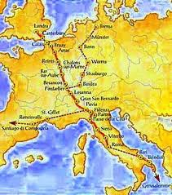
The cultural routes of the council of europe
Via Francigena
Claudia Mancini
Eleonora Magnarello
Maria Elena Uranoliti
Nicoletta Petrelli

Slide 2
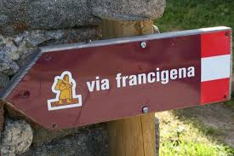
OUTLINE
INTRODUCTION
THE BEGINNING OF VIA FRANCIGENA
ACTIVITIES IN SWITZERLAND AND ITALY
MAIN FINDINGS
DISCUSSION
6. CONCLUSIONS AND RECOMMENDATIONS

Slide 3
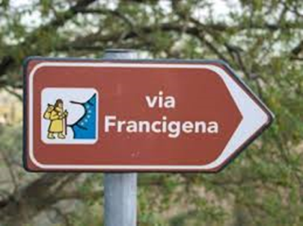

INTRODUCTION
The Via Francigena is a road of 1800 km that rediscover the journey of pilgrims through England, France, Switzerland and Italy.
To valorize of the millenary pilgrimage route
To promote measures for the development of the Via Francigena:
.
genuine tourist and cultural product
potential role as a catalyst for local development

Slide 4

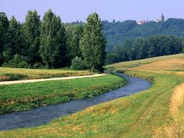

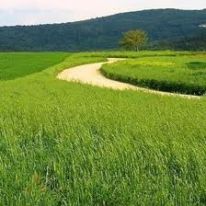
The Canton of Valais (Switzerland) established a touristic infrastructure and products
The Tuscany region is equally determined to further develop cultural tourism (best example)

Slide 5
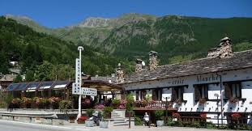
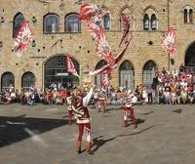
The Swiss programme focuses on history and culture with a satisfactory level of accomodation along the Route.
Additionally, the tourism SMEs and all tourism-related in the regions will benefit.

Slide 6


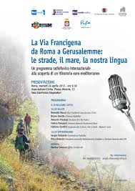
THE BEGINNING OF THE VIA FRANCIGENA
European Cultural Route
Italian Associazione dei Comuni Italiani
European Association of the Via Francigena (AEVF)
It attracted the interest of regional and local authorities along the Route

Slide 7
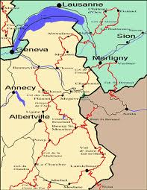
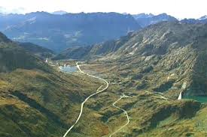
ACTIVITIES IN SWITZERLAND AND ITALY
2000
It’s a passage from Martigny to The Great St Bernard Pass that was signposted in the Via Francigena

Slide 8
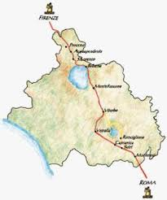
The Via Francigena is officialy part of the Cultural Routes of Switzerland programme.
The Tuscany region, has developed a regional MASTER PLAN:
sustainable regional development through tourism
the aim is to set itself up as a model for the European regions

Slide 9
MAIN FINDINGS
The final results derived from the analysis of the questionnaire and direct phone contacts with the European Cultural Routes’ authorities.
RESULTS:
MAJOR COUNTRY
Via Francigena Route connects England, France, Switzerland, and Italy and the Vatican;
PROGRAMM PARTECIPATION PERIOD
Since 2007, Via Storia organized the tourist offers in Switzerland.
Earlier experiences from other Routes influenced the design of the Via Francigena.
In 2001, in Italy the Associazione dei Comuni Italiani sulla Via Francigena was founded to promote this Route.

Slide 10
SECTORS COVERED
Accommodation, attractions, archaeological sites, creative industries, tours and visitor services.
FOCUS
The pilgrimage follows the journey of Archbishop Sigeric from Canterbury to Rome. The Via Francigena was very important for military and strategic purposes and this Route was the connection between the Jura and the Alps.
The main activity are: walking, hiking, trekking, pilgrimage, religion, cultural and natural heritage, historical paths and environment conservation, agriculture and regional development, culture and tradition of local people.
MAIN PARTNERS
Tour operators, tourist offices, SMEs, Swiss hiking trails, non-profit
organizations, educational institutions, regional political bodies, national government and European network partners.

Slide 11
MANAGING ORGANISATION
In Italy, the Tuscany region has developed a regional master plan and there are individual community that create important elements for development.
In Switzerland at local level, the Via Francigena is managed by both the Abbey St-Maurice and the Compagnons.
FUNDING SOURCES
In Switzerland, the Via Francigena is financed by both the Valais and Vaud cantons and by the Swiss Government.
In Italy, the communities are involved in funding. There are also governmental sources.

Slide 12
PRINCIPAL IMPACT
 | Bookable package | Total
Accomodations | 18 | 86
Transport | 4 | 6
Restaurants | 18 | 139
Food supply | 22 | /
Agriculture/agriturism | 3 | n.s.
Attractions | 4 | 22
Retail, services | n.s. | 192
Tourist offices | - | 6

Slide 13
QUALITY CERTIFICATION
In Switzerland, many companies on the Via Francigena try to raise the standard of quality with national quality labels.
In Italy, Via Storia, tour operators and some companies are using computerised reservation system.
The work on an indicator system for “sustainable tourism destinations”, set up by NECSTouR, is in progress.
A first draft was presented at the Workshop on Innovation and
Competitiveness in the Programme of Cultural Routes, held at the European Institute of Cultural Routes in Luxembourg.

Slide 14
Innovative planning process
ITALY
SWITZERLAND
The Tuscany region want to create more offerings in hiking, biking, horseback riding and motorised visits of the Route, using sustainable tourism as a tool for regional development in rural regions.
An INTERREG IVA project, 360°, aims to develop cross-border tourism communication and education infrastructure, both in the Valais region and on the italian side (Aosta valley). The purpose is to develop cultural tourism, to promote cross-border movements of customers, to increase the offer of accomodation, and so on.

Slide 15
EDUCATION AND INTERPRETATION
ITALY
SWITZERLAND
Italy aims to set up the «Via Francigena Festival» in autumn 2011. The idea is to promote every event on the Via Francigena, and all events have to be financed by the participating communities.
The Swiss partners developed school materials and guided walks about the Cultural Routes, and have placed communication panels along the Via Francigena.

Slide 16
INFORMATION AND PUBLICATION
ITALY
SWITZERLAND
The website of the Via Francigena, www.viafrancigena.eu, was set up as a result of a co – operation between the Italian Ministry of Cultural Heritage and Activities, the Italian regions of the interregional project Via Francigena, and the local governement.
The Via Francigena magazine is a biannual publication that gives information about the activities of the European Association of the Via Francigena. The magazine will later include other pilgrimage Routes.
Information is provided on the multilingual Cultural Routes of Switzerland website, www.kulturwege-schweiz.ch.
The Via Francigena is also promoted on the national platform for slow mobility, SwitzerlandMobility. Both of the platforms provide information and maps for visitors.
The Via Francigena packages are also promoted by local tour operators and tourist offices.

Slide 17
CONTRIBUTION TO CULTURAL AND NATURAL HERITAGE CONSERVATION
ITALY
SWITZERLAND
About 30 different voluntary associations are involved in Via Francigena development, but individual actions are not specified.
Regional partners of the Cultural Routes of Switzerland and Heritage Trust organisations are committed to maintaining the walking paths in collaboration with Swiss Hiking; to prevent damage to natural sites.

Slide 18
CONTRIBUTION TO SOCIO – ECONOMIC BENEFITS
ITALY
SWITZERLAND
The tourism offerings on both the Swiss and the Italian sections of the Via Francigena attract visitors and generate income for the local population in various sectors, like accomodation, transport, gastronomy, and so on.
Tours are organised through locally based agencies and tourism offices. Another positive effect is the sensitisation of both visitors and locals.

Slide 19
RESEARCH
ITALY
SWITZERLAND
The University of Architecture, Venice, is carrying out research on landscape, ecology, enviromental impact and planning.
The Via Francigena has been developed as part of the Inventory of Historical Traffic Routes in Switzerland (IVS), which was elaborated in the framework of the Federal Law on the Protection of Nature and Cultural Heritage. The IVS is a valuable tool for the preservation of important elements of the landscape.

Slide 20
DISCUSSION
The survey is conducted in close co-operation with regional partners of the European Association of the Via Francigena and ViaStoria.
The limited resources have made the gathering of data and the search for collected information impossible.
The case study shows:
No data on the Via Francigena are available that would allow scientifically proved conclusions, in particular regarding the economic impact on SMEs along the Route;
Absence of scientific approaches in establishing Cultural Routes;
Lack of effective management structures to maintain cultural tourism projects;
Lack of interconnection between SMEs and vertical organisation;
Lack of internal co-ordination leading to disadvantages for pilgrims.
No standards for Cultural Routes and quality criteria for services;

Slide 21
VIA FRANCIGENA
No central authority and all actions are regional, which leads to a very unequal standards of information quality and accommodation.
Different levels:
LOCAL
REGIONAL
NATIONAL
EUROPEAN
INTERNATIONAL

Slide 22
CONCLUSIONS AND
RECOMMENDATIONS
Necessity for new approaches in regional Cultural Routes management;
Local bodies establish the co-cordination regional activities;
Local bodies acting as mediators between SMEs and the European Association of the Via Francigena;
Higher frequency of visitors (increasing number of bookings);
Pilgrimage is a valuable motivation;
Tuscany master plan: initiative aimed at developing the Via Francigena in a planned manner;
Cultural Routes: provide oppurtunities for thematic and geographicaly clustering to expand the market and optimise resources.

Slide 23
The processes that favour the creation and survival of clusters are:
Clear understanding by the SMEs of the importance and potential of a Cultural Route;
Identification of the SMEs with the Route and adapting the business;
Understanding of individual and mutual benefits through clustering.
SMEs
Use networks for improve the quality of services;
Interconnect with established channels for communication, marketing and promoting.
http://www.youtube.com/watch?v=Im4rUZdTrf4

Slide 24
CRITERIA TO BE GIVEN CULTURAL ROUTE STATUS
Includes the Inventory of Historical Traffic Routes in Switzerland;
Includes the network of official hiking trails;
Incorporates public transport;
Includes the UNESCO World Heritage sites;
Considers protected areas;
Includes regional and local specialities.
TOURSIST OFFER:
Is based on the Cultural Route;
Meets certain quality criteria;
Has a professional project management.

Slide 25
WEBSITES
http://www.coe.int/t/dg4/cultureheritage/culture/Routes/default_en.asp
http://www.viefrancigene.org/en/
http://www.youtube.com/watch?v=Im4rUZdTrf4
http://www.youtube.com/watch?v=E2TL6zeho7U

Slide 26

Thanks for your attention!
Claudia Mancini
claudiamancini88@gmail.com

