Slide 1
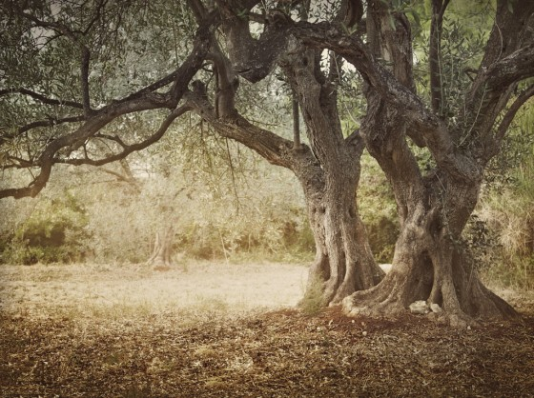



‘‘ THE ROUTES OF THE OLIVE TREE ’’
Naciye GENCESMEK
Gıulıa VALLORANI
Marıa Paola PARAGGIO
Mıchela MORETTI
2013
Notes:
When you start the presentation, present yourself, the course/faculty you attend in your country and the area of Europe where you come from

Slide 2
Outline
The Routes of Olive Tree
Participating Countries
History of the Route and Nature of the organization
Management Structure of the Routes of the Olive Tree
Summery Objectives
Summary Actions
Budget of the foundation
Conclucion

Slide 3
The Routes of the Olive Tree
It’s a field of study,
Reasons WHY?
It causes, leads to new work areas for companies.
It shapes the cultural feature of civilisation and causes peace, humanity and heritage as well.
At last, it has an effect on tourism by modern elements.

Slide 4
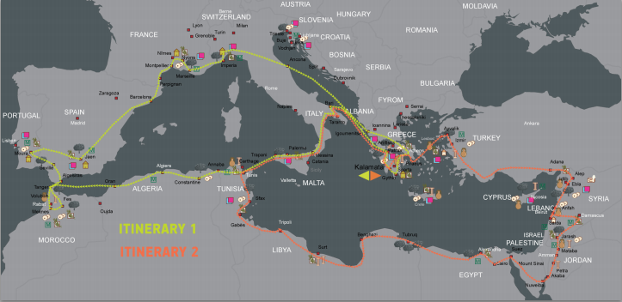
The Olive Tree Routes

Slide 5
Participating Countries
Greece Cyprus Algeria
Spain Portugal Moroco
France Syria Turkey
Italy Lebanon Tunisia
Croatia Jordan Libya
Slovenia Egypt Albania

Slide 6
Principal Impacts
As a foundation;
Olive Tree shop
International Network
Intercultural dialogue
Training

Slide 7



THE OLIVE TREE, SYMBOL OF MEDITERRANEAN COUNTRIES
For the Egyptians, Greeks and Romans as well as for Christians and Muslims, the olive tree and oil belong to everyday life. They take part, as well, in myths and History.
Symbol of the alliance between gods and men, or simple token of welcome, olive oil is a fundamental element of Mediterranean civilization.

Slide 8
History of the Route and nature of the organisation
In history, olive tree is grown up basically in Mediterranean Region
The products of that tree (fruit, oil, soap and candles) led people to live in this abundant soil.
Philosophically; the olive tree was mentioned in ancient and modern scription. And furthermore, it’s sometimes considered sacred in there texts, even in Bible and Koran.

Slide 9
Culturally; In same cultures, the olive tree and it’s variations were so important.
To support that;
Olive tree was the symbol of peace, wisdom, glory, abundance, power and pureness.
Branches of olive were a prize given to winners in Olympic Games.
Olive oil and candles are the source of light for churches and chapels.
The roots of olive trees were the basic of a bride’s dowry.

Slide 10
Environmentally;
Olive and it’s variations are being used as renewable energy sources.
It’s energy level is approximately as benefical as other kinds of sources.
It’s smoke has no impact on the environment
What’s more, it’s ash and remnant is a good fertiliser for gardens and plants.

Slide 11
Economically;
The olive tree has a big importance in Mediterrenean region.
Top 10 largest producing olive variations countries are in this region as well.

Slide 12
Management Structure of the Routes of the Olive Tree
Organised by : Homonymous Cultural Foundation
The success of the activities organised by the Cultural Foundation « The Routes of the Olive Tree » is mostly due to their implementation and cordination by a large partnership network in Greece and the Mediterranean countries. The members of the Network are Chambers of Commerce, institutions, unversities, research centers and cultural and financial authorities in more than 25 countries.

Slide 13
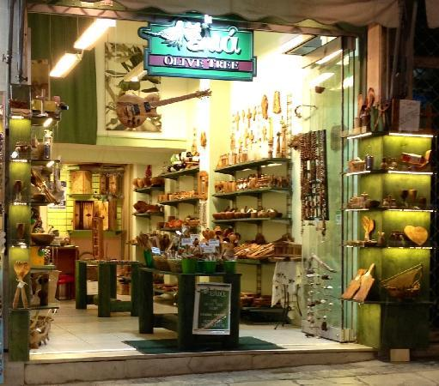
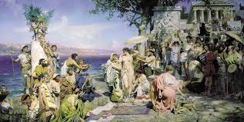
Activities
The Olive Tree Shop
Creates small wonders for you with zest, colours and ...imagination
Celebrations
Exhibitions of artistic photography and painting around the theme of olive tree.
Tasting of olive oil products, demonstrations with olive oil,
Thematic days like tourism and gastronomy

Slide 14
Co-Operations
Chambers of Industry or Commerce
University
Museums
Research Centre
Promotion of Sustainable Development

Slide 15
SUMMARY OBJECTIVES
TO CREATE «INTERACTIVE SYNERGIES» between
CONSERVATION, TOURISM AND DEVELOPMENT BY:
Favouring dialogue between the regions concerned, between developed areas and those in difficulty, between urban and rural spaces;
Encouraging thematic tourism and sustainable development ;
Carrying out an inventory of the material and immaterial heritage of the olive tree;
Contributing to public awareness and educating young people;
Multidisciplinary research on the widened theme of the olive tree.

Slide 16
SUMMARY ACTIONS
EVENTS
Seminars
Meetings
Workshops
Study visit
Training sessions
2009
More than 30 events
And… Network members of the foundation
organised their own local events

Slide 17
Budget of the foundation
The overall budget of the foundation:
30% Network members and friend of the routes of the olive tree;
20% Income from publications and the routes of the olive tree shop;
50% External grants including grants from Chamber of Commerce and Industry of Messenia

Slide 18
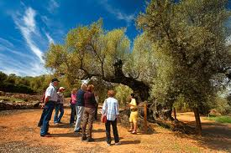
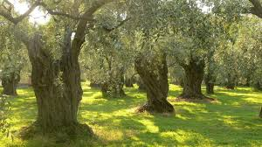
Future Activities
Want to develop tourism products in collaboration with other itineraries → would be offered by travel agencies
- 3 pilot ''itineraries'' in Peloponnese
- Greek partners → promote the local heritage of the olive tree & integrate it into a local itinerary

Slide 19
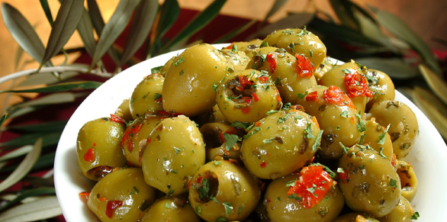
Conclusions
Strong dimension related to sustainable development
Foundation annual budget is under €200 000
  ~value for money~
Lack of finance and dependent on regional agencies that is interested in local products
Domination of Greece
Many EU programmes under
The Routes of the Olive tree

Slide 20
Recommendations
Developing of central planning (on the part of the Route) for all regions involved everywhere along the Route
National or regional planning for public infrastructure, private investment, clustering, marketing, etc.
More training programs and SME involvement
Open shops in other countries
Developing cross – marketing initiatives
Social network marketing
On the website better information about the actual Routes and contact points

Slide 21
Sources
http://www.olivetreeroute.gr/gr/index.php
http://www.coe.int/t/dg4/cultureheritage/culture/routes/olive_en.asp
http://www.euromedalex.org/fr/node/3000
http://www.culture routes.lu/php/fo_index.php?lng=en&dest=bd_pa_det&rub=77

Slide 22
"Care for me and
I will nourish you.
Water me and I will make you rich"
(Proverb from the Mediterranean) Thanks for your attention
For any further information please contact the representative
Giulia Vallorani
giulia.vallorani@gmail.com

