Slide 1
Look at the following signs in each question.
Someone asks you what it means.
Decide which letter A, B or C is the correct explanation.

Slide 2
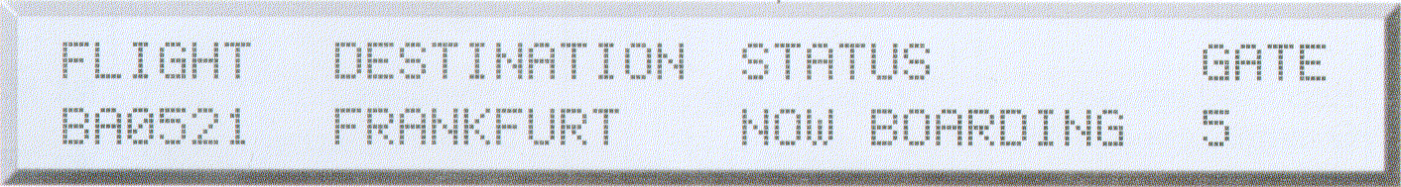
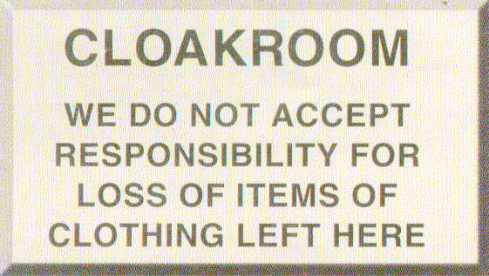
The plane will arrive soon.
This plane has left.
Passengers should go to Gate 5 immediately.
If your coat is stolen, it’s your problem.
If your coat is stolen, they will buy you a new one.
Do not leave your coat here.

Slide 3
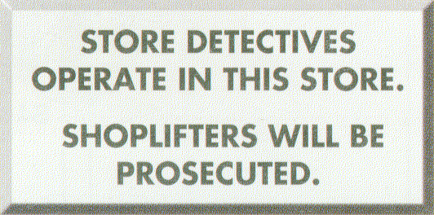
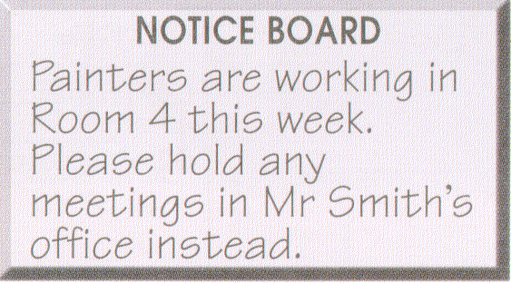
The police are watching the store.
If you steal something you may be caught.
The shop is closed at the moment.
Mr Smith is holding a meeting in his office.
All meetings this week are cancelled.
You should not hold a meeting in Room 4.

Slide 4
Look at the four signs again. Two of them talk about things happening for a limited period of time and two talk about things happening for an unlimited period. Two of them use the present simple and two use the present continuous. Which?

Slide 5
PRESENT SIMPLE or PRESENT CONTINUOUS?
So, we can say that we use the present simple for events which are unlimited in time:
Store detectives operate in this store.
We do not accept responsibility…
We use the present continuous for events which are limited in time, either around now…
BA0521 FRANKFURT NOW BOARDING
or over a longer period of time…
Painters are working in Room 4 this week.
The painting might take a few days – but it is still limited in time.

Slide 6
Look at the sentences below. In each pair one or both might be right.
1a. I watch football at the moment.
1b. I’m watching football at the moment.
2a. My brother lives in Paris.
2b. My brother is living in Paris.
3a. She’s the boss of the whole company.
3b. She’s being the boss of the whole company.
4a. John is really silly.
4b. John is being really silly.
5a. The earth goes round the sun once a year.
5b. The earth is going round the sun once a year.
6a. This week I study for my exams.
6b. This week I’m studying for my exams.

Slide 7
State verbs
There are some verbs that we do not usually use in the present continuous. These verbs are usually connected to the idea of:
emotion: like want wish
mind: agree believe mean know
appearance: look like resemble seem
possession: belong consist contain have need own
perception: see hear smell

Slide 8
Look at the following sentences. For each one choose between the present simple or present continuous.
Be careful some verbs can change their meaning depending on the situation.

Slide 9
I’m not believing a word you say.
I don’t believe a word you say.
‘What are you thinking about?’ ‘My family.’
‘What do you think about?’ ‘My family.’
What do you think of Wayne’s mother?
What are you thinking of Wayne’s mother?
I’m seeing him. He’s coming through the gate.
I see him. He’s coming through the gate.

Slide 10
The doctor’s seeing Mr Jones at the moment.
The doctor sees Mr Jones at the moment.
I hate smoked fish. It tastes horrible.
I hate smoked fish. It’s tasting horrible.
Wait a minute. I’m tasting the soup.
Wait a minute. I taste the soup.
I’m sorry, I’m not knowing where he is.
I’m sorry, I don’t know where he is.

Slide 11
He’s earning a lot of money at the moment.
He earns a lot of money at the moment.
Warning: these cakes are containing nuts.
Warning: these cakes contain nuts.
I’m not understanding my girlfriend sometimes.
I don’t understand my girlfriend sometimes.
The money’s belonging to me, I earned it.
The money belongs to me, I earned it.

Slide 12
Choose the correct answer.
What do you do?
I’m an architect.
I’m designing a new factory.
What are you doing?
I’m a teacher.
I’m trying to fix this toaster.
What’s Jimmy doing?
He watches the football on TV.
He’s watching the football on TV.

Slide 13
Where do you come from?
I’m Spanish.
I’m coming from Kansas.
What’s the weather like today?
It gets warmer.
It’s getting warmer.
You’ve got paint in your hair.
Yes, we paint the kitchen this week.
Yes, we’re painting the kitchen this week.
What about your grandmother?
Oh, she was born in Belfast. She still lives there.
Oh, she was born in Belfast. She’s still living there.

Slide 14
Where’s Bill?
He comes from York. Maybe the train’s late.
He’s coming from York. Maybe the train’s late.
Why are you here?
I take the bus because my wife has the car.
I’m taking the bus because my wife has the car.
What’s the problem?
You’re stupid. Slow down.
You’re being stupid. Slow down.

Slide 15
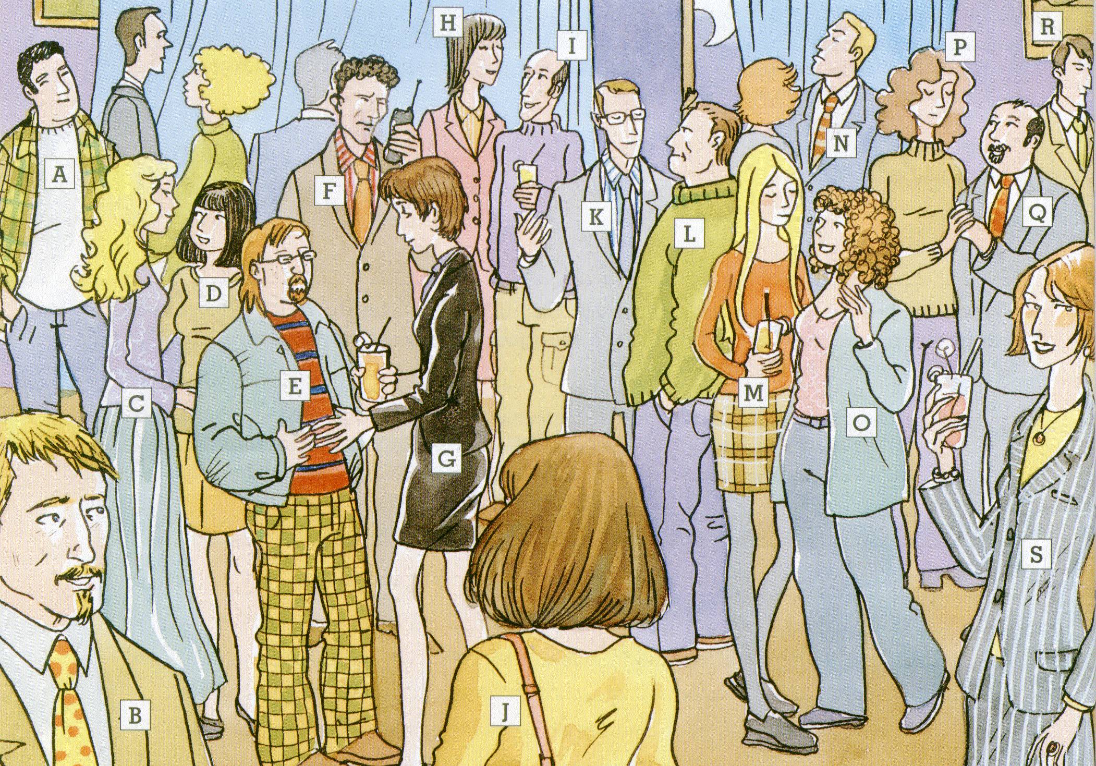
1. Vanessa is _ 6. Her husband is_
2. Her boyfriend is _ 7. The man she is looking at is _
3. Mary is _ and Charlie is _
4. Her husband is _
5. Julia is _

Slide 16

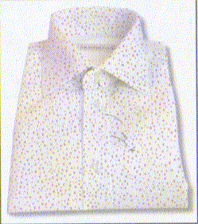
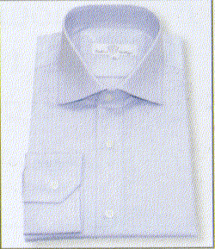


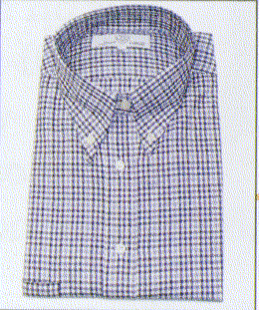

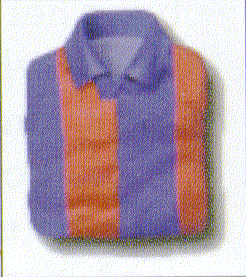
Find one word to describe each shirt: check plain spotted striped

Slide 17
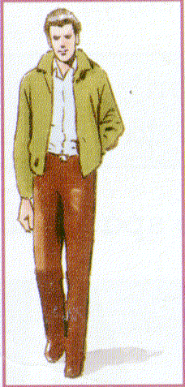
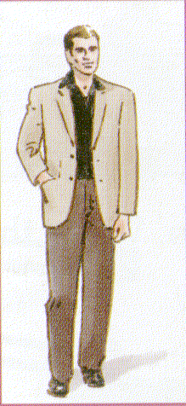
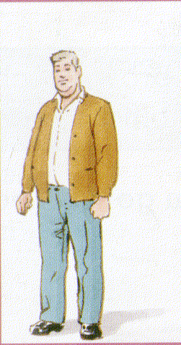



Find two words to describe each person: medium-height overweight short slim tall well-built

Slide 18
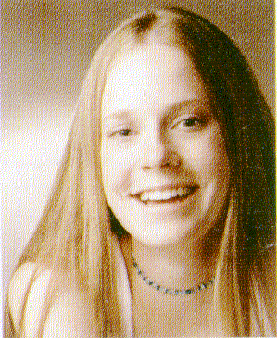
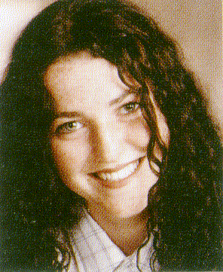

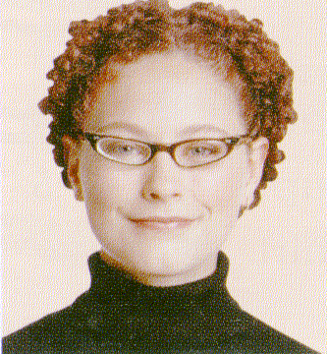


Find two words to describe each person’s hair: blonde brown curly ginger straight wavy

Slide 19
Complete the following questions. Using either the present simple or continuous.
___you work here?
___she working this week?
___Gillian live near you?
___it really important?
___we winning the game?
___Liz practising the trumpet?
___they want more money?
___you having fun?
___I eat too much?
___he doing his homework?
___your friends help you?
___we know him?
___they talking about me?
___Charlie want to see me?
___the kids making too much noise?
___your sister like basketball?
___I annoying you?
___Ron making much money?

Slide 20
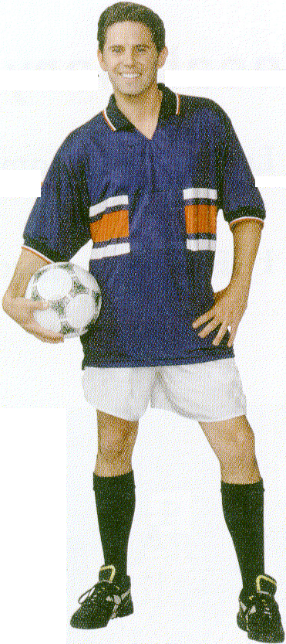
Adjective order
Look at Wayne. We can say he has short brown hair and he’s wearing a new, striped, football shirt. We don’t say he has brown short hair and he’s wearing a football, striped, new shirt.
Why?

Slide 21
brown, short, new, football, and striped are adjectives here.
They tell us something about his hair and his shirt. But when we have more than one adjective before a noun, they usually come in a fixed order. If we take one adjective of each type, they would normally follow the following order.

Slide 22
size (short)
age (new)
colour (blue)
pattern (striped)
purpose (football)
Wayne is wearing a short, new, blue, striped, football shirt.

Slide 23
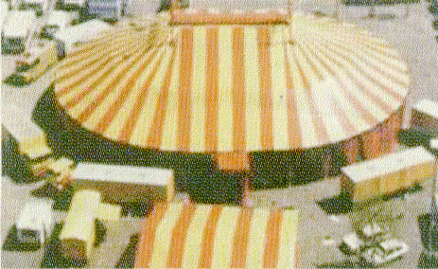
size age colour pattern purpose
A large, new, red-and-yellow, striped, circus tent

Slide 24
Now look at the adjectives below.
Three of them go with each picture on the following slide.
blue brown check coffee green kitchen modern new office red small sports striped tall work

Slide 25
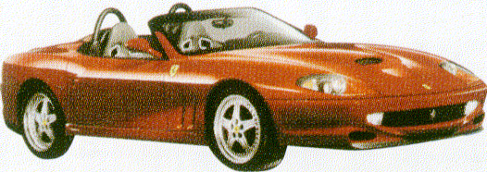
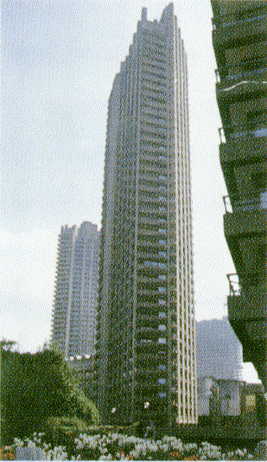
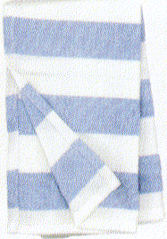
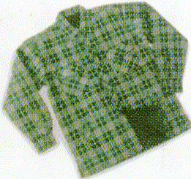

1. A _ _ _ car. 4. A _ _ _ building.
2. A _ _ _ cup. 5. A _ _ _ cloth.
3. A _ _ _ shirt.

Slide 26
Look at these three words:
CALM FARM WARM
Two of them are underlined because they rhyme – they end in the same sound. Look at the others below. In each group of three there are two words that rhyme.
cork park talk
mould would good
bomb home comb
missed worst wrist
know now toe
hour pour four
sheet accept receipt

Slide 27
Now look at these consonant letters from the previous words:
b c d f g h k l m n p r s t w
Some of them are silent. Look at the list again and decide which are silent.
cork park talk
mould would good
bomb home comb
missed worst wrist
know now toe
hour pour four
sheet accept receipt

Slide 28
Order of adjectives.
The words in each phrase below have been mixed up. Rewrite them in the correct order.
small pot a flower brown
and towel white a bath check red
book blue grammar a thin
white bag large a carrier
big engine a fire red
table old dining long a/an
tie a and school blue striped white
train a passenger grey modern
motorcycle helmet and striped black a red
enormous stadium football white a/an

