Slide 1
Consolidation
one

Slide 2
Put each word in brackets into a suitable verb form
Moving house
I come from a very large family, and recently my parents (1) (decide)__ that they (2) (spend)__ long enough living in an overcrowded house in Birmingham. 'We (3) (move)__ to the country', my father (4) (announce)__ one evening. 'I (5) (sell)__ this house, and we (6) (live)__ on a farm.' So last week we (7) (load)__ all our possessions into two hired vans, and for the last few days we (8) (try)__ to organize ourselves in our new home.

Slide 3
Yesterday, for example, my three brothers and I (9) (start)__ painting the downstairs rooms. Unfortunately while I (10) (mix)__ the paint, one of my sisters (11) (open)__ the door. Nobody (12) (tell) __her that we (13) (be)__ in the room, you see. So instead of painting the walls, we (14) (spend) __all morning cleaning the paint off the floor. But worse things (15) (happen)__ since then. This morning when I (16) (wake up)__, water (17) (drip) __through the ceiling next to my bed. We (18) (spend)__ today so far repairing the roof. It's not all bad news, though. The school in the village nearby (19) (close down)__ two years ago, and my parents (20) (not find) __another school for us yet.

Slide 4
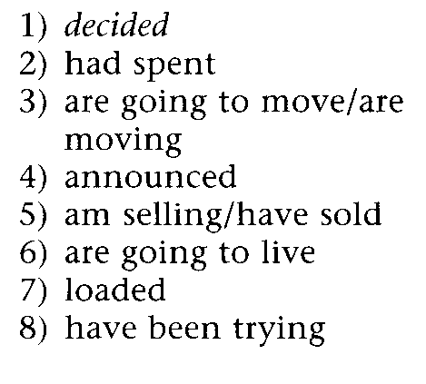
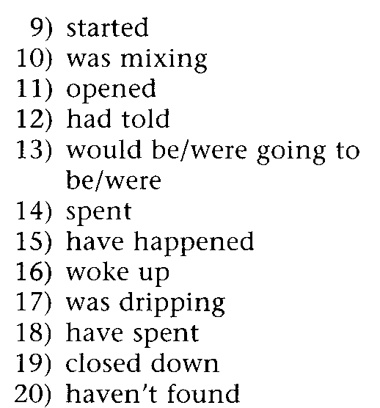
answers

Slide 5
Complete the second sentence so that it has a similar meaning to the first sentence, using the word given.
Do not change the word given.
You must use between two and five words, including the word given.

Slide 6
Jack left the office before I arrived there.
already
When I arrived at the office __.
b. Do you know how to drive this kind of car?
ever
Have__ this kind of car before?
c. This is my first visit to Scotland.
I
This is the first time__ Scotland.
d. During dinner, the phone rang.
I
While__ phone rang.

Slide 7
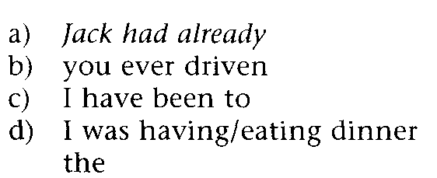
answers

Slide 8
Put each verb in brackets into a suitable verb form.
At the dentist's
I was on time for my dentist's appointment, but the dentist was still busy with another patient, so I (1) (sit)__ in the waiting room and (2) (read)__ some of the old magazines lying there. While I (3) (wonder)__ whether to leave and come back another day, I (4) (notice)__ a magazine article about teeth. It (5) (begin)__: 'How long is it since you last (6) (go)__ to the dentist? (7) (you go)__ regularly every six months?

Slide 9
Or (8) (you put off)__ your visit for the last six years?' Next to the article was a cartoon of a man in a dentist's chair. The dentist (9) (say)__: 'I'm afraid this (10)(hurt)__.' I (11) (suddenly realise) __that my tooth (12) (stop) aching__. But just as I (13) (open)__the door to leave, the dentist's door (14) (open)__. 'Next please,' he (15) (call)__, as the previous patient (16) (push)__ past me. 'Actually I'm not here to see you, I (17) (wait)__for my friend,' I (18)(shout)__, leaving as rapidly as I could. (19) (you ever do)__ this kind of thing? Surely I can't be the only person who (20) (hate)__ the dentist!

Slide 10
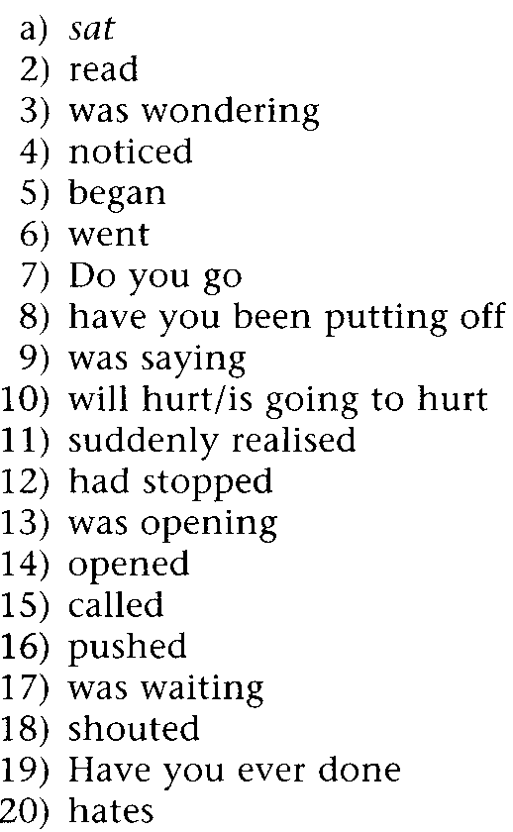
Answers

