Slide 1
Past Times
Describing events in the
past

Slide 2
Main events
The past simple is used to describe finished actions and events in the past.
Susan went into the station and bought a ticket.

Slide 3
Background description
The past continuous is used to describe actions in progress in the past. It gives information about the background situation.
There were a lot of people waiting in the station. Some were sleeping on the benches, and others were walking up and down. Susan was looking for Graham, so she didn't sit down.

Slide 4
Past before past
The past perfect is used to make it clear that one past event happens before another past event. We use the past perfect for the earlier event.
By the time the train arrived, Susan had managed to push her way to the front of the crowd.

Slide 5
However…
It is not always necessary to use the past perfect if a time expression makes the order of events clear.
Before the train arrived, Susan managed to push her way to the front of the crowd.

Slide 6
Past continuous used with past simple
We often use the past continuous first to set the scene, and then the past simple for the separate, completed actions that happen.
Susan was looking for Graham, so she didn't sit down. Instead, she tried calling him on her mobile phone.

Slide 7
and…
We often contrast an action in progress with a sudden event which interrupts it.
While Susan was trying to get onto the platform, a man grabbed her handbag.

Slide 8
Participle clauses
Participle clauses are introduced by the time expressions before, after and while. They have the same subject as the following clause.
After struggling with him, Susan pulled the bag from his hands.

Slide 9
Past Times
Habits in the
past

Slide 10
Past simple
The past simple is used to describe past habits or states. A time expression is usually necessary.
  I always got up at six in those days, (habit)
  I lived in Austria for several years. (state)

Slide 11
Used to
Used to is used to describe past habits or states. A time expression is not necessary.
I used to get up at six, but now I get up at eight.
I used to own a horse. (I owned a horse once.)

Slide 12
With negatives and questions used to becomes use to.
I didn't use to like beer.
Did you use to swim every day?
When we use used to we suggest that the action is no longer true and so make a strong contrast with the present.

Slide 13
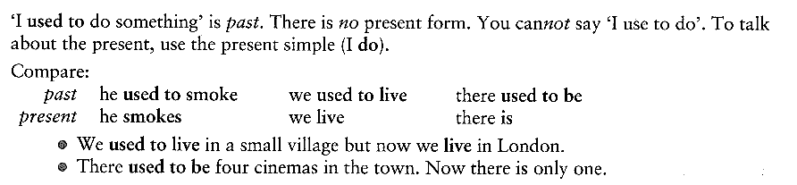
and…

Slide 14
However…
Do NOT confuse I used to do and I am used to doing.
The structures and meanings are different:
I used to live alone. (=I lived alone in the past but I no longer live alone.)
I am used to living alone.(=I live alone and I don’t find it strange or new because I’ve been living alone for some time.)

Slide 15
Would
Would is used to describe a person's typical activities in the past.
It can only be used to describe repeated actions, not states. It is mainly used in writing, and in personal reminiscences.
Every evening was the same. Jack would turn on the radio, light his pipe and fall asleep

Slide 16
Past continuous
The past continuous can be used to describe a repeated action in the past, often an annoying habit. A frequency adverb is necessary.
When Peter was younger, he was always getting into trouble.

Slide 17
Past Times
Politeness and uncertainty

Slide 18
Past continuous
We can use the past continuous with think, hope and wonder to give a polite or uncertain meaning.
I was thinking of having a party next week.
I was hoping you would join us at the cafe tonight.
I was wondering if you could help me.

Slide 19
Choose the correct answer
a) I suddenly remembered that I forgot/had forgotten my keys.
b) While Diana watched/was watching her favourite television programme, there was a power-cut.
c) Tom used to live/would live in the house at the end of the street.
d) Who was driving/drove the car at the time of the accident?
e) By the time Sheila got back, Chris went/had gone.
f) David ate/had eaten Japanese food before, so he knew what to order.

Slide 20
g) I did/was doing some shopping yesterday, when I saw that Dutch friend of yours.
h) I used to like/was liking sweets much more than I do now.
i) What exactly were you doing/did you do when I came into your office yesterday?
j) Laura missed the party because no-one was telling/had told her about it.
k) Tanya would/used to be a doctor.

Slide 21
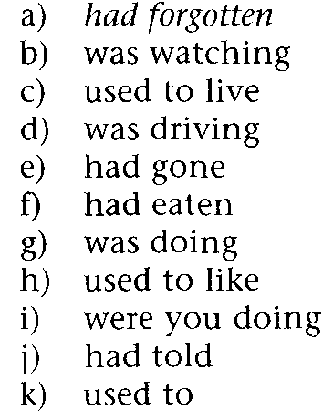
Answers

Slide 22
Put each verb in brackets into a suitable past verb form. Only use the past perfect where this is absolutely necessary.
a) While I (try)__ to get my car started, a passing car (stop) __and the driver (offer) __to help me.
b) The police (pay)__ no attention to Clare's complaint because she (phone) __them so many times before.
c) Mary (not wear)__ her glasses at the time, so she (not notice)___what kind of car the man (drive) __.
d) Nick (lie)__ down on the grass for a while, next to some tourists who (feed)__ the ducks.

Slide 23
e) Tony (admit)__ that he (hit)__ the other car, but said that he (not damage)__ it.
f) Sorry, I (not listen)__ to you. I (think)__about something else.
g) Helen (feel)__ very tired, and when she (finish)__her work, she (fall)__ asleep.
h) The police (get)__ to Clare's house as fast as they could, but the burglars (disappear)__.
i) I (phone)__ you last night but you (not answer)__.What (you do) ? __.
j) We (not go)__ out yesterday because it (rain)___.

Slide 24
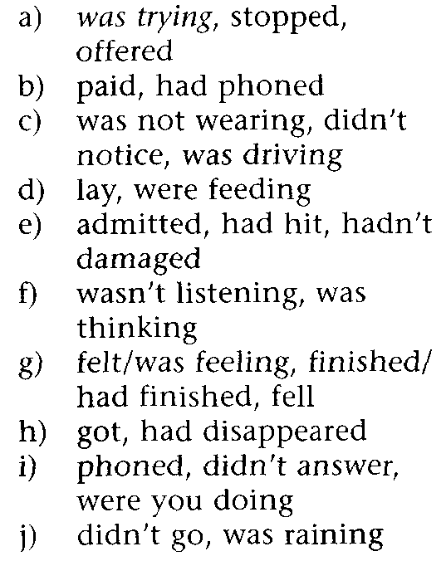
Answers

Slide 25
Put each verb in brackets into a suitable past verb form.
When Professor Mallory, the famous archaeologist, (1) (invite)__ me to take part in his expedition to find the Lost City of the Himalayas, I (2) (not hesitate)__ to accept his invitation. Mallory (3) (discover)__ an ancient map showing the position of the city, although no European (4) (ever go)__ to the area before.
In fact, most of Mallory's colleagues either (5) (believe)__
that the city (6) (never exist)__ or (7) (feel)__that it (8) (vanish)__ long ago and (9)(become)__ simply a legend.

Slide 26
According to the Professor, the builders of the city (10) (hide)__ it among the mountains in order to protect its immense riches. He (11) (believe)__ that the descendants of these ancient people (12) (still keep)__ themselves apart from the rest of mankind for the very same reasons. So when we (13) (set off)__ on a cool May morning towards the distant mountains, each of us (14) (look forward)__ to exciting discoveries. For a week or more we (15) (climb)__ higher and higher, following the map, which Mallory (16) (study)__ from time to time. Then one afternoon, while we (17) (rest)__ at the top of a valley, we (18) (notice)__ that a rider on a horse (19) (wave) __at us from the other side of the valley. A rider whose clothes (20) (shine)__ like gold!

Slide 27
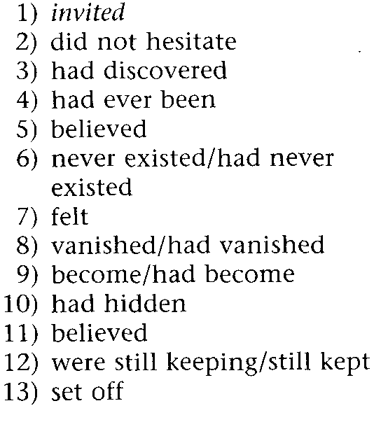
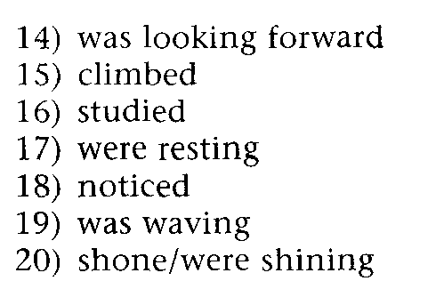
Answers

Slide 28
Key points
1 The past simple describes completed events in the past, such as the main events in a narrative. It can also describe habits and routines in the past.
2 The past continuous is used for:
a) background description.
b) actions in progress, often contrasted with a sudden event.
The past continuous cannot be used to describe past routines and habits.
3 Participle clauses can introduce a clause giving the main event. The subjects of both clauses must be the same.

Slide 29
4 The past perfect describes a past event which took place before another past event. If before or after is used, the past perfect is optional.
The past perfect is not used for an event that happened a long time ago in the past.
5 Used to only refers to past time, and has no present form.

Slide 30
6 Would can be used to describe habitual actions in the past, usually in writing. It does not make such a strong contrast with the present as used to. Compare:
Jim would always make his mother a cup of tea after lunch.
Jim used to drink tea, but now he prefers coffee.
Would cannot be used to describe states.
Sally used to be a dancer.

Slide 31
Writing task
Write between 50/100 words about a famous historical figure.
Include:
Why they are famous
A narration of something they did
Why you have chosen this person

