Slide 1
Present perfect
Recent events

Slide 2
Present perfect simple
The present perfect simple is used to describe recent events.
I've left my shopping bag behind.
The event happened in the past, but there is a result in the present.
I've broken my arm, as you can see.

Slide 3
No definite time is given for the event, but to emphasise the idea of recentness we can use just.
I've just broken my watch.
We can also describe events that have not happened.
I haven't found her phone number yet.

Slide 4
Present perfect
Indefinite events

Slide 5
Present perfect simple
No definite time is given for the events. They are a series of actions in our life up to now.
I've been to France three times.
After It's/This is the first/second time we use the present perfect.
It also refers to our life up to now.
This is the first time I have eaten Japanese food.

Slide 6
Compared with past simple
Events described using the past simple have definite times.
I went to France last year.
I ate at a Japanese restaurant on Saturday.
If we think of a definite place for an event, this may suggest a definite time.
I left my shopping bag on the train.

Slide 7
Present perfect
Present perfect continuous
Extended or repeated events

Slide 8
Present perfect simple
The present perfect simple describes a state which lasts up to the present.
I've lived in this house for five years.
The present perfect simple can describe a habitual action in a period of time up to the present.
I've never worn a tie to work, and I refuse to start now!

Slide 9
Present perfect continuous
The present perfect continuous can also describe a state which lasts up to the present moment.
I've been living in this house for five years.
There is little difference in meaning between simple and continuous in this case, or with How long questions.
How long have you lived/been living in this house?
The verbs wait, sit, lie, stay prefer the present perfect continuous.
I've been waiting for ages.

Slide 10
Present perfect or
Present perfect continuous?
for, since, ago

Slide 11
Completed actions
The present perfect simple can show that an action is complete.
I've finished my homework!
If we say how many or how much we use the simple form. A certain amount has been completed.
I've written ten pages of my homework!

Slide 12
Not completed
The present perfect continuous can show that an action is not completed, or that it has finished recently.
We've been walking for hours! Let's have a rest.
I've been digging the garden. That's why I'm so dirty!

Slide 13
Present result or action in progress
We use the present perfect simple if our attention is on the present result.
I've written my homework. Now I can watch the television.
We use the present perfect continuous if our attention is on the action in progress.
I've been writing my homework all evening! I didn't know it would take so long.

Slide 14
Choose the correct answer
a) Did you see/Have you seen my bag anywhere? I can't find it.
b) Larry is writing/has been writing/has written his novel for the last two years.
c) From the minute he got up this morning Gary asked/has asked/has been asking silly questions!
d) Have you given/Did you give Helen my message when you have seen/saw her?

Slide 15
e) Sorry, could you say that again? I didn't listen/haven't listened/haven't been listening to you.
f) The police think that they found/have found your wallet, so call this number.
g) Did you two meet/Have you two met before? Eric, this is Amanda.
h) Did you meet/Have you met anyone interesting at the reception?

Slide 16
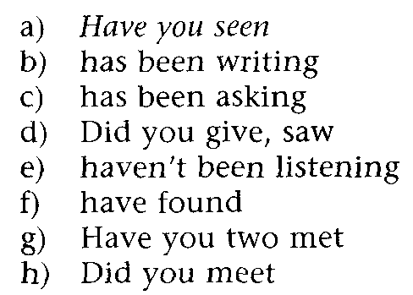
Answers

Slide 17
Put each verb in brackets into a suitable verb form.
a) I'm sorry about not coming last week. I (have)__ a cold and so I (stay) at home.
b) Wait a minute! I (have) __an idea. Let's go and see Roger. We last (see) him a long time ago.
c) It's nice to be back here in London. This is the second time I (come)__ here.
d) I'm phoning about your bicycle for sale, which I (see)__in the local paper. (you sell)__ it? Or is it still available?

Slide 18
e) This place is in a terrible mess! What on earth (you do)__ ?
f) And now for an item of local news. Hampshire police (find)__the dangerous snake which (go)__missing earlier in the week.
g) This tooth (kill)__ me lately! So I (make)__an appointment with the dentist for next Tuesday.
h) I can't give you the report I (promise)__ for today because I (not finish)__ it.

Slide 19
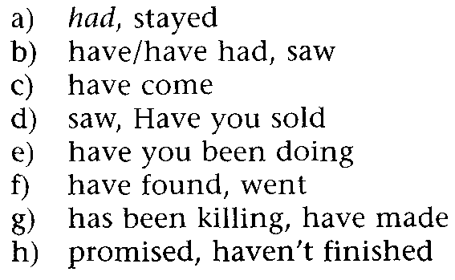
Answers

Slide 20
Choose the correct answer
a) I haven't seen Gerry for/since a long time. How is he?
b) It's ages ago/since I last went to a football match.
c) I've written to Deborah last week/recently.
d) What have you been doing today/yesterday?
e) Have you eaten Italian food before/already?

Slide 21
f) I've been living here in/since the end of last year.
g) Actually I had dinner with Sue last night/lately.
h) I've been trying to get in touch with David for ages/for the last time.
i) Terry hasn't been to Edinburgh since/when we went there together.
j) I can't remember how long/when I've had this watch.

Slide 22
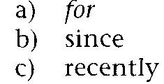
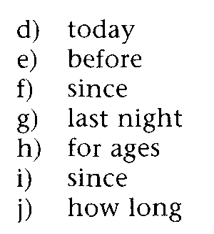
Answers

Slide 23
Key points
1 The present perfect simple describes events without a definite time.
Either these events take place in a period of time leading up to the present moment, or the result of the event is still evident.
The choice between the present perfect simple and the past simple can depend on how the speaker thinks. Compare:
A: What's the matter? A: What's the matter?
B: I've had an accident. B: I had an accident.
In the second example, the speaker thinks of the event as finished rather than still connected with the present.

Slide 24
2 Events described with the present perfect simple may be recent, or not.
3 The present perfect continuous is used for an action in progress. It suggests that the action is unfinished, or recently finished. Compare:
I've read this book. (completion of the action is emphasised)
I've been reading this book. (the action itself is emphasised - it may not be complete)
The present perfect continuous can also emphasise the length of time of the action.

Slide 25
For refers to a finished or unfinished period of time.
I waited for three hours.
He's been sitting there for ages.
Since refers to the point at which an unfinished period of time began.
He's been sitting there since two o'clock.
Ago refers to the time of a finished event.
Jill arrived a week ago.

