Slide 1
What do we mean by the term civilization?

Slide 2
Two possible definitions:
Process of economic, social, cultural, with particular reference to the action carried out by the nations of the Western world in regard to developing nations.
or
A human society that has highly developed material and spiritual resources and a complex cultural, political, and legal organization.

Slide 3
Great Britain
What we shortly and generally call “Britain” or “England” is an island in the Atlantic Ocean.
The Kingdom is the result of the union of the kingdoms of England (including modern-day England and Wales) and Scotland in 1707. In 1921 the Irish Free State (now the Republic of Ireland) separated from the United Kingdom, leading to the British state being renamed the United Kingdom of Great Britain and Northern Ireland.

Slide 4
England
England is often sub-divided into three parts:
The South: a line drawn from the river Severn in the West, to the Wash, a bay on the East coast. The landscape is most varied. There are hundreds of miles of sea coast which vary from flat, sandy or stony beaches to high rocky cliffs. Inland, the landscape is gentle and green. The farmland is like a vast park with trees.
The Midlands: England northwards from the Severn-Wash line to another line drawn from the estuary of the river Mersey in the West to the Humber estuary in the east.

Slide 5
England
The Midlands have large industrial areas which are very distinct from the rural areas. The Black Country of the West Midlands is one. It is the area where the Industrial Revolution began in Britain.
The North: England northwards from the Mersey- Humber line as far as the Scottish border. The landscape is different from other regions; there is more high ground which looks bare from a distance. It is in fact covered by short grass or low-growing heather.

Slide 6
Scotland
Scotland was once an independent kingdom. In 1603 the king of Scotland inherited the English throne. He ruled as James I of England and James VI of Scotland. In 1707 the Scottish was merged with the English parliament, and Scotland lost its politcal independence.
A referendum was held in 1979 to find how much the Scots wanted to rule their country. That gave the people the chance to vote against some particular action the Government was planning.

Slide 7
The geography of Scotland
There are three large geographical areas in Scotland:
The Highlands
The Lowlands
The Islands.
Five millions people live in Scotland, three quarters of them live in the central lowlands. Edinburgh is the capital. The regions of Scotlands are administrated from Edimburgh. Glasgow is the chief industrial and commercial city.

Slide 8
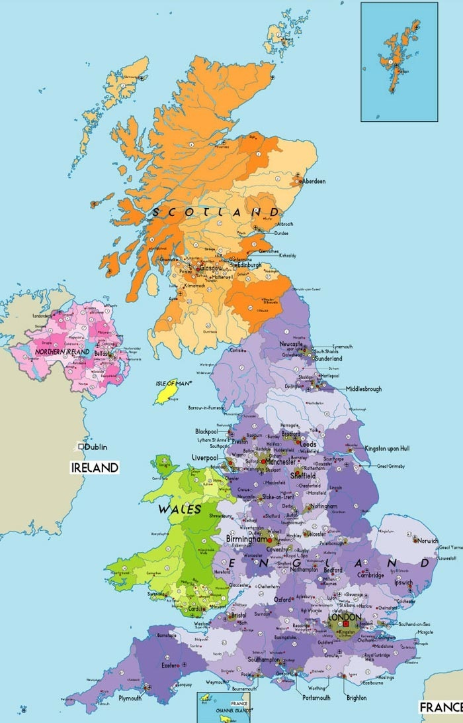
Britain in detail

Slide 9
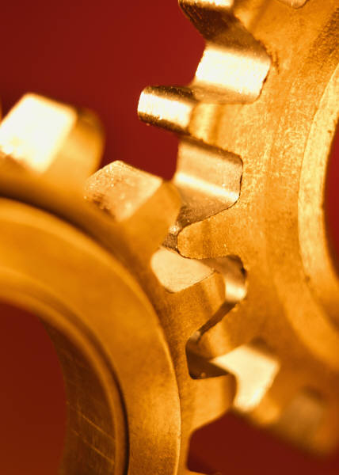
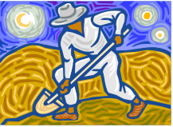
Physical Features
Rural areas vs crowded cities
Agriculture vs Industry

Slide 10
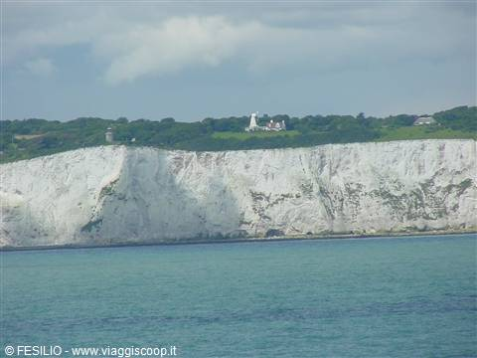
Famous beauty spots in Great Britain

Slide 11
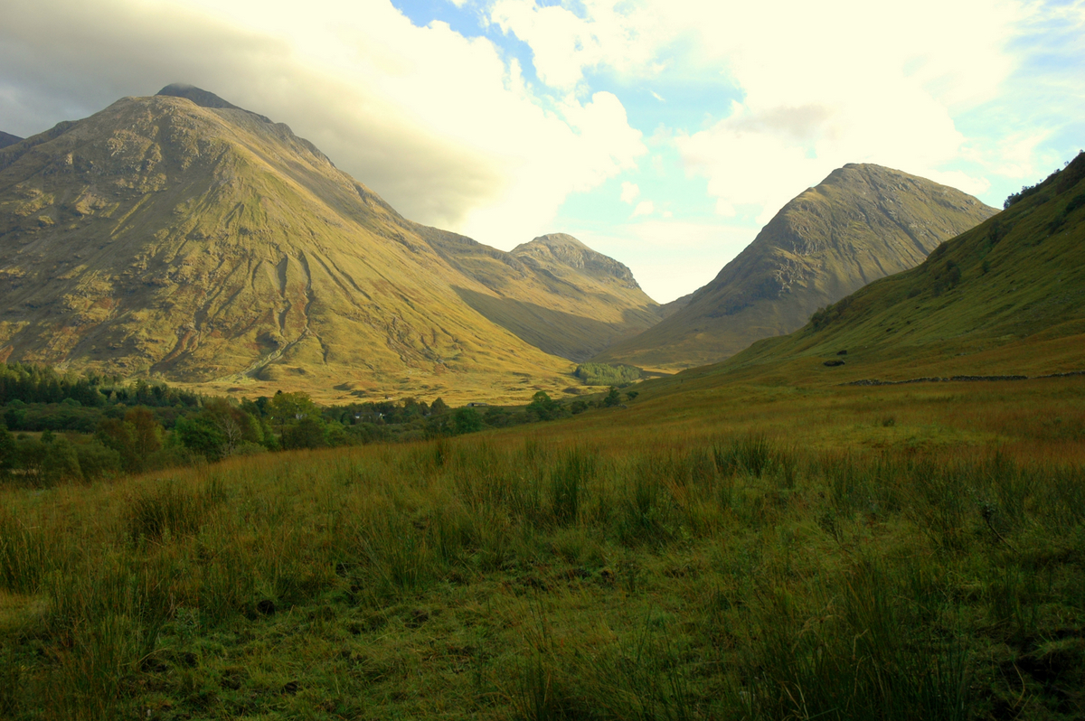

Slide 12
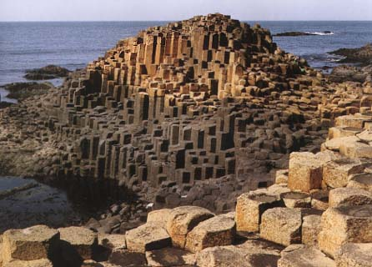

Slide 13
Have you recognized those places?
The White Cliffs of Dover
Scottish Highlands
The Giant’s Causeway

Slide 14
After watching the video answer the following questions
1) How tall is Finn Mc Cool?
2) How does Finn Mc Cool define the Scottish giant?
3) How does Benandonner define the Irish giant?
4) Why do the two giants start to quarrel?
5) What does Benandonner want to do against Finn Mc Cool?
6) How is the causeway built?

Slide 15

The Giant’s Causeway Legend

Slide 16
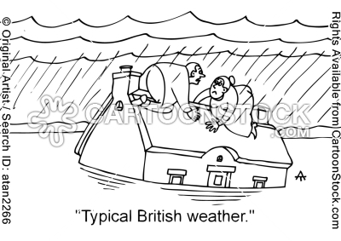
Climate

Slide 17
The climate
In the South it is warmer than in the other areas. The driest areas are in the east and south-east.
In the Midlands, it is cooler and wetter than in the south.
In the north, it gets colder the further north-east you go, and wetter in the west. There is almost always snow in winter.

Slide 18
Food Products
There are about 300,000 active farms mostly specialized in dairy products and cattle (beef and sheep).
Intense farming especially concerns poultry and eggs.
Main agricultural products are: apples, berries and flowers.
Organic Farming
Fishing is also widespread, the fundamental catches are haddock, cod, whiting, mackerel, plaice and sole.
There is also fish-farming industry especially about salmon and trout.

Slide 19
Transport
Over 300 ports
About 142 airports
The Channel Tunnel, Eurotunnel, ushered in 1994
The Tube

