Slide 1
Time off
theatres

Slide 2
Historical background
During the Middle Ages the only theatre performances allowed were the religious ones called Mystery, Miracle and Morality plays.
The situation drastically changed during the Renaissance, especially under the reign of Queen Elizabeth I, in which the theatre reached its peak of popularity. The audience was heterogeneous and included all social classes.
Theatres were built outside the City Corporations to avoid censorship.
However, during the Republican period, under Oliver Cromwell, theatres were closed in 1642 because they were supposed to corrupt people.
When they were opened again in 1660 nothing was as it used to be anymore. Theatres became an elitist entertainment reserved to the upper classes.
Women were finally allowed to act on the stage.

Slide 3
London theatres
A great deal of the Englishman’s leisure time is spent in going to theatres, concerts and cinemas. Although there are very good professional companies in most provincial towns, London is the leading centre of dramatic activity.
There are about fifty theatres in London the most important of which are: the National Theatre on the south ban of the river Thames. Drury Lane and the Aldwich Theatre.

Slide 4
Concerts are mainly given at the Albert Hall and at the Royal Festival Hall.
In 1963 the National Theatre Company was formed and started putting on plays at the Old Vic. In the past, under the leadership of its director, Laurence Olivier, the National Theatre Company reached world-wide renown.
Another very important company is the Royal Shakespeare at Stratford –on-Avon, every year from April to November.

Slide 5
St. Martin’s Theatre
It is a legendary place in the heart of London considered as Agatha Christie’s home. Indeed it is the set where her masterpiece has been represented for 60 years.
The Mousetrap has celebrated over 25,000 performances. It is quite simply a great piece of theatrical history because of what it is, “a whodunit” written by the greatest crime writer of all time.

Slide 6
The Covent Garden Opera House
Opera and ballet have their home at the Covent Garden Opera House.
Originally built in 1858, the current Royal Opera House is the embodiment of the highbrow culture hub, and legends including Maria Callas, Margot Fonteyn, Luciano Pavarotti and Rudolf Nureyev have graced its stage.

Slide 7
The Globe
It is the London theatre associated to William Shakespeare.
It was built in 1599 outside the city corporation to avoid censorship. Its architectural structure is very unusual, it is circular without a roof and the stage in the middle.

Slide 8
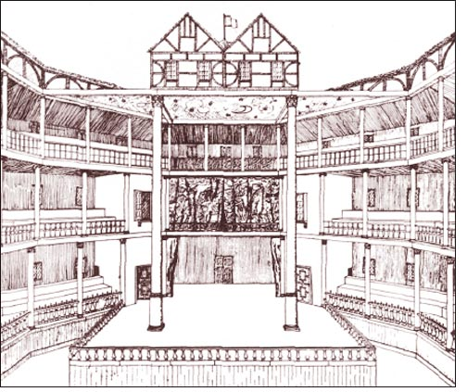
The Globe

Slide 9
Musicals
After Broadway, London is the European hub of musical performances.
Beside the classical Andrew Lloyd Webber’s musical like Cats, Jesus Christ Superstar, London hosts more classical musicals like Top Hat and Singin’n the Rain and new productions entirely British.
The best examples are: We will rock you based on Queen’s music., or Billy Eliot which was also a successful film in 2000.

Slide 10
Cinema
The cinema too enjoys great popularity in Britain in competition with television.
However most of the films the British see have been made in U.S.A.
The British cinema has reached a very high artistic level and many British films have gained international success, but the amount of film production is not very high.
Pinewood Studios are the legendary television and cinema stages.
Foreign films are not dubbed, but they have subtitles.

