Slide 1
Time off
Museums

Slide 2
London museums
Most museums in London are free of charge.
Free museums are, for instance, the British Museum, the National Gallery and the Tate Gallery. (Britain and Modern).
One has to buy a ticket for other museums, for example: Madame Tussauds, Victoria and Albert Museum, The Tower of London – The National Treasure.

Slide 3
The British museum
One of the world's oldest museums, the British Museum is vast and its collections, only a fraction of which can be on public display at any time, comprise millions of objects.
It is mainly an archeological museum.
The Great Court is a large and beautiful covered piazza, designed by Foster and Partners, surrounding the free reference library in former Round Reading Room.

Slide 4
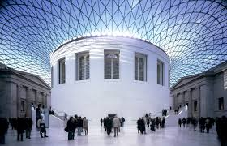
Interior details

Slide 5
Main attractions
The British Museum contains, among many other things, two must-see masterpieces:
The Rosetta Stone and Lord Elgin’s Marbles
The former is a stele which allowed the decoding of Egyptian hieroglyphics.

Slide 6
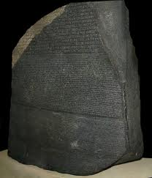
The Rosetta Stone

Slide 7
The ELGIN MARBLES
These marbles are the Parthenon Marbles, mainly sculptures, which Thomas Bruce, Seventh Lord Elgin, gathered during his service as ambassador to the court of the Ottoman Sultan in Istanbul.
In practice, the term is commonly used to refer to the stone objects he gathered or - according to critics- looted - from Athens between 1801-05.

Slide 8
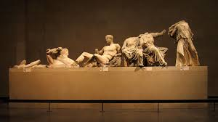
Elgin marbles

Slide 9
The national Gallery
Situated in the heart of London, precisely in Trafalgar Square.
It’s a neo-classical building was founded in 1824 to display a collection of just 36 paintings, today.
The National Gallery is home to more than 2,000 works. There are masterpieces from virtually every European school of art.

Slide 10
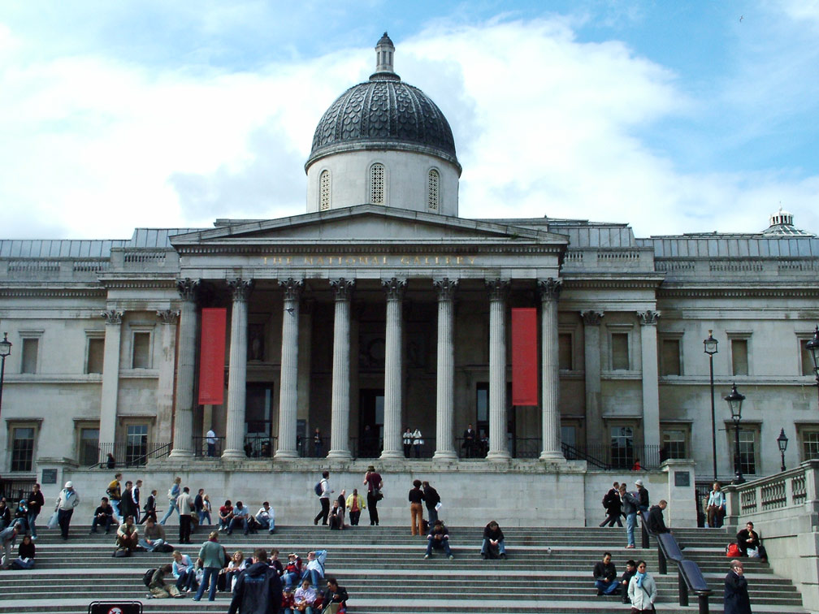
The national Gallery façade

Slide 11
The ambassadors
Among the extraordinay pieces of art, the National Gallery boasts the presence of a very famous painting of the Renaissance:
“The Ambassadors” by Hans Holbein The Younger(1533).
The painting is characterized by a visual device called anamorphosis.

Slide 12
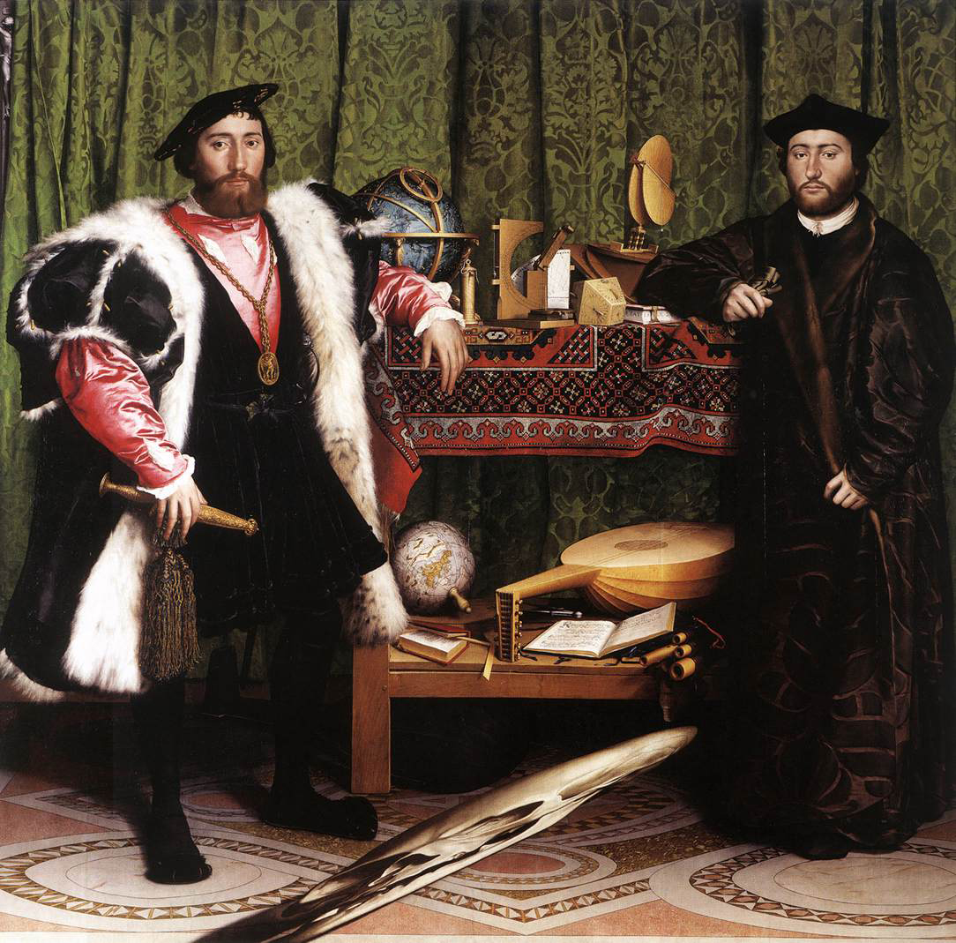
The ambassadors

Slide 13
Tate Britain Gallery
Probably the most British museum in London.
It is situated in the south of London in an area called Pimlico.
Its name comes from the name of the collector of works of art who founded the gallery, Mr Tate, the rich owner of a sugar plantation.

Slide 14
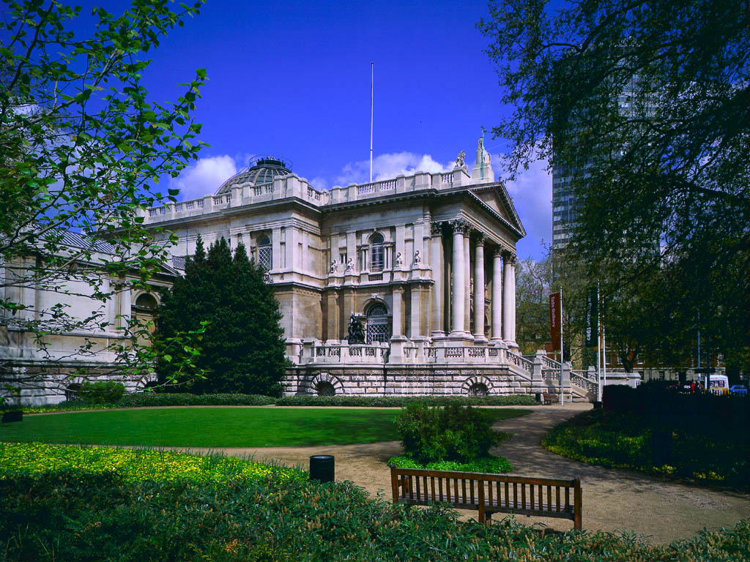
Tate Gallery

Slide 15
Dante gabriel rossetti
The Tate Gallery is the home the most important British painters: Turner, Constable and, above all, the Pre-Raphaelites.
The latter consists of a brotherhood of artists (painters, poets, designers) founded in 1848 who considered the art before Raphael as the ideal one and tried to reproduce it.

Slide 16
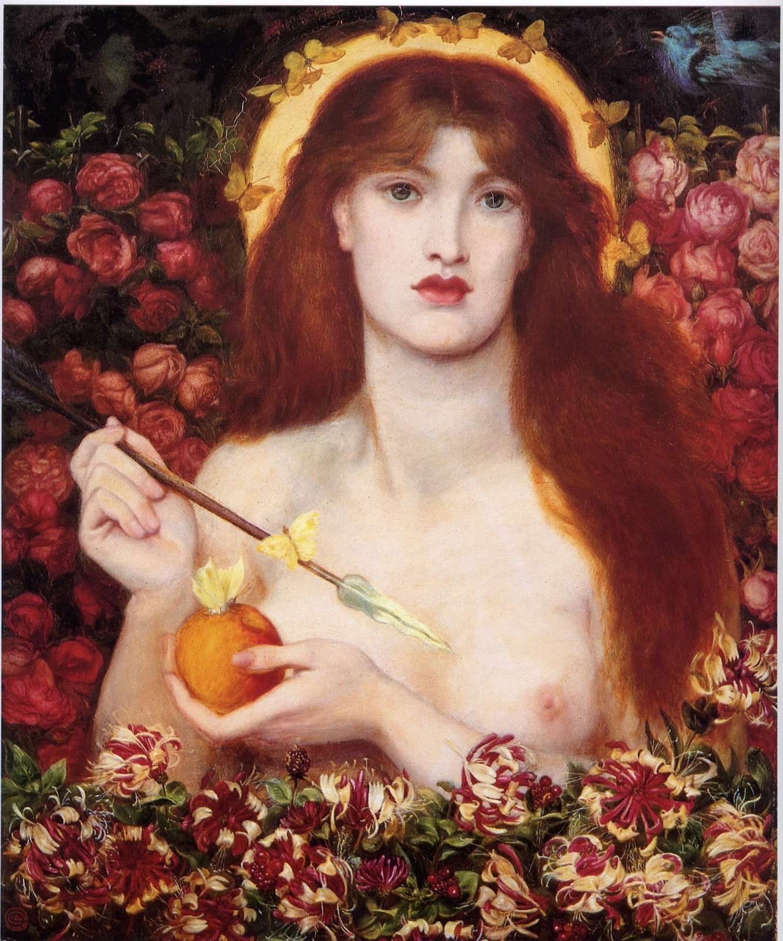
Venus verticordia

