Slide 1
Time off
Top Architectural Attractions

Slide 2
The London Eye
The London Eye was opened on New Year’s Eve 1999 to celebrate the Millennium.
It is 135 metres high and from the top you can see all London. On a clear day you can even see Windsor Castle which is 40 km away.
The London Eye has 32 capsules, each with room for 25 people. Each ‘trip’ lasts 30 minutes. It moves slowly, at a speed of about 15 metres a minute, but it never stops. Passengers have to get on when it is moving

Slide 3
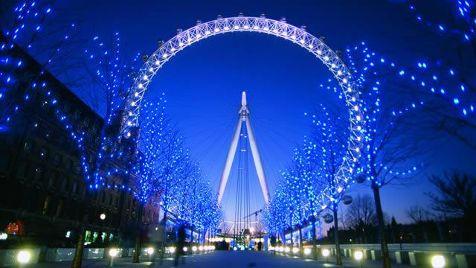
The London Eye
Night view

Slide 4
The Millennium Bridge
London's Southwark Council sponsored a competition in 1996 to choose the designer of a new Millennium Footbridge that would span the Thames River between the Southwark Bridge and the Blackfriars Bridge. This would be the first bridge built across the Thames River since the building of the magnificent Tower Bridge of 1894.

Slide 5
The winning entry, a suspension bridge, was tagged ‘the blade of light’ and was designed by Arup, Foster and Partners and Sir Anthony Caro.This footbridge would stretch a total of 325 meters and would include supporting cables below the deck level in order to preserve the view of several landmarks on either side. The design allowed for a 4-meter-wide deck for walkers and the structure was designed to hold 5,000 pedestrians at any given time.

Slide 6
Construction of the bridge began in late 1998 and was completed in June 2000.
The southern end of this suspension bridge is located near the Globe Theatre and the Modern Tate Museum.
The northern end sits near St. Paul’s Cathedral Pedestrians can gain a wonderful view of the cathedral's dome from the bridge and the sight is especially marvelous at night.

Slide 7
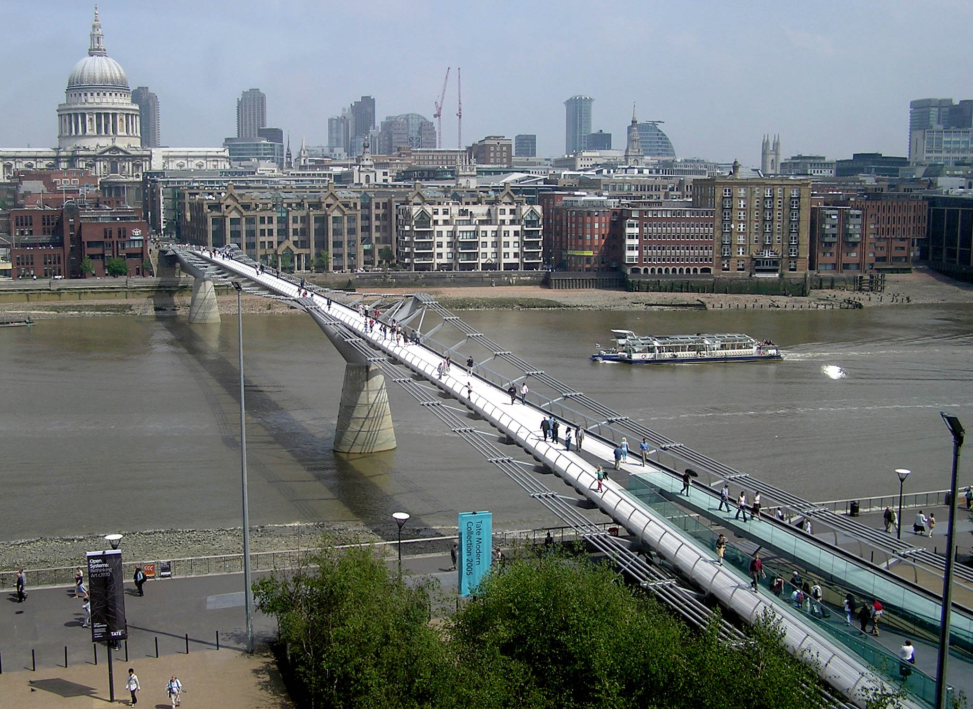
The Millennium Bridge

Slide 8
The Gherkin
The cigar-shaped structure has a steel frame with circular floor plans and a glass façade with diamond-shaped panels. The swirling striped pattern visible on the exterior is the result of the building's energy-saving system which allows the air to flow up through spiraling wells. On the street level, the Gherkin's base is well integrated with an open public plaza. Huge white X braces create a dramatic entrance.
The top of the tower, where visitors find an open hall covered by a glass conical dome is even more spectacular. From here you have great views over the city. Unfortunately the building is not open to the public. Its unique, bold and energy efficient design has won the Gherkin many awards including the Stirling Prize, the London Region Award.

Slide 9
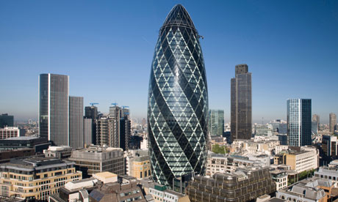
The Gherkin

Slide 10
The Shard
Designed by the Italian architect Renzo Piano, the Shard is the tallest skyscraper in Europe: 310 metres with 72 floors.
It was built using the 95% of re-cycled materials and the position of the mirrors is designed to make the most of the light and the wind.
As a whole, The Shard is a kind of vertical city with open spaces. There are restaurants and convivial lounge bar between floors 31 and 33 and some decidedly private such as luxury apartments between floors 53 and 65, wide, with an enviable view and, for this reason, quite expensive (between 30 and 50 million pounds, about 6,000 per square meter)
It is situated in the trendy area of Southwark close to the river Thames.

Slide 11
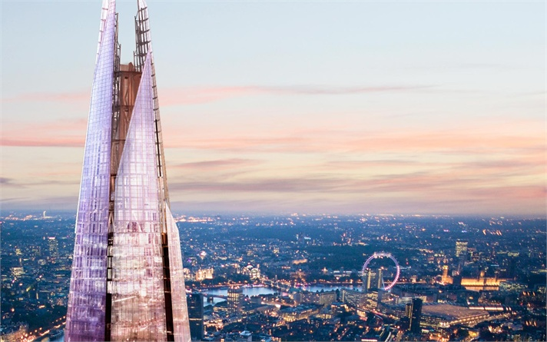
The Shard

Slide 12
The Crescent
The Royal Crescent in Bath was designed by John Wood the Elder and built by his son John Wood the Younger in the 18th century (between 1767 and 1774).
Although some changes have been made to the various interiors over the years, the Georgian stone (the Bath stone) façade remains much as it was when it was first built.Many notable people have either lived or stayed in the Royal Crescent since it was first built over 230 years ago, and some are commemorated on special plaques attached to the relevant buildings.
The Royal Crescent now includes a hotel and a Georgian house museum, while some of the houses have been converted into flats and offices. It is a popular location for the makers of films and television programmes, and a major tourist attraction in its own right

Slide 13
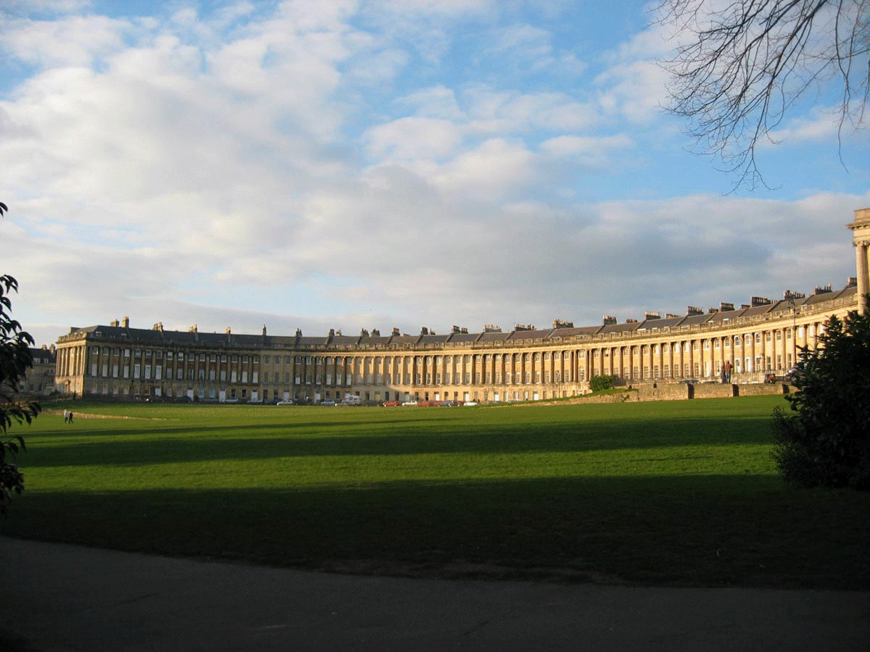
The Royal Crescent

Slide 14
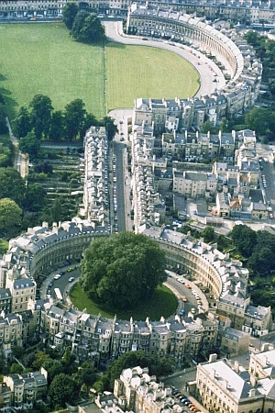
The Circle and the Crescent

