Slide 1
Time off
Holidays

Slide 2
The past
Before the 18th century people move from one place to another in search of better living conditions, for military reasons or for commercial exchanges.
Tourism is therefore a relatively recent phenomenon, a symbol of the modern age and one of the consequences of the Industrial Revolution (XVIII-XIX century). It combined several factors for its success: the development of transport and communications, the increased leisure time available, thanks to the grant of leave, and, of course, the improvement of families’ living conditions.

Slide 3
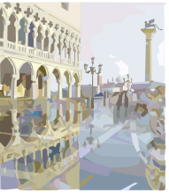
The Grand Tour
Nevertheless, tourism was an elitist activity reserved to the privileged.
Only the 0,3% of the British population could travel for pleasure, mostly the aristocracy or rich merchants and landowners.
The new trend was to travel to improve one’s personal artistic and intellectual education.
This experience took the name of The Grand Tour.

Slide 4
From north to south
Young English intellectuals, but also German and French, made this trip, which usually lasted a long time, to know the Mediterranean culture and the historical and artistic heritage of the classics, especially of Ancient Rome and Greece.

Slide 5

Tourism as a mass phenomenon kicks off in the fifties, namely in a phase of economic recovery after the devastation of the Second World War.
Guided tours became very popular.

Slide 6

Today’s holiday
Two-thirds of all British people have their holidays in July and August, which are the most popular months for holidays. English school children are on holiday from the end of July to the beginning of September.
The traditional British holiday is a seaside holiday: Brighton, Torquay, Plymouth are some of the most favourite destinations.

Slide 7
Britons abroad
Europe is the most popular destination for UK residents, accounting for 80 per cent of visits abroad.
Spain has been the most popular country to visit since 1994, with 13.8 million visits in 2005.
France was second in popularity, with 11.1 million visits.
The number of visits by UK residents to the USA increased by 2 per cent in 2005 to 4.2 million, 6 per cent higher than the number in 2001.The number of visits abroad made by UK residents has more than tripled since 1985, to a record 66.4 million visits in 2005.

Slide 8
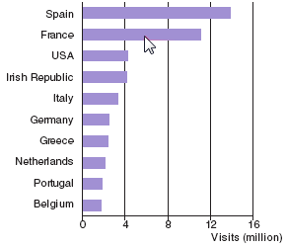
Holiday trend

Slide 9
Italy and the Britons
Beside the famous artistic Italian cities and archaeological sites, the Chianti region in Tuscany, is an area very dear to the British (hence the term Chiantishire) and is a symbol of the good life.
Yet, the tourists who frequent it are relatively few compared to those who flock to the beaches of the Mediterranean.

