Slide 1
Politics
The first limitations on monarchs started long time ago, at the time of the feudal system.
King John and Magna Charta 1215

Slide 2
In 1275 under king Edward I there was a first example of English Parliament divided in the Lords/Bishops and the Commons.
During the Tudor dynasty (1485-1603) there was a return to pre-eminence caused by many conflicts.
The Stuarts and king Charles I.
The Petition of Rights in 1628.
The Civil war.
The Protestant Parliament 1642.
King Charles was beheaded 1649.

Slide 3
After Cromwell the monarchy was restored with king Charles II.
During the seventeenth century there was the rise of political parties.
Whigs and Tories.
King James II.
William of Orange and the Glorious Revolution 1688.
Declaration of rights 1689.

Slide 4
Hannoverian Dynasty saw the election of Britain’s first Prime Minister Robert Walpole.
First Reform Act 1832.
The expansion of voting rights to all man 1918.
In 1928 women also obtained the right to vote.

Slide 5
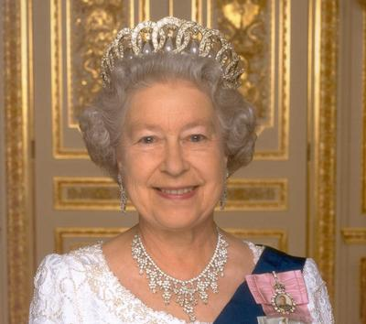
How Britain is Run Nowadays
The Uk is a constitutional monarchy. Its monarch - either king or a queen - is the head of the state, he/she has very little power. Queen Elizabeth II reigns but she does not rule. Parliament and the existing government have the power.

Slide 6
The UK does not have a written constitution or printed set of rules for governing the country.
The Constitution has been formed in three ways:
by all the laws and decrees that they have been made for centuries;
by the way these laws have been interpreted in the Law Courts in the past and now re-interpreted from time to time;
by the way things have been done for centuries although some of these practices have never been formally written down.

Slide 7
Britain is a democracy: men and women over 18 have a vote. Voting is not compulsory. They have the right to elect a representative to Parliament. The representative is the M.P. the Prime Minister.
At the opening of parliament the Queen reads a speech written by the prime minister from the throne in the House of Lords. Parliamentary elections must be held if the government loses its majority support in the house of commons if the Prime Minister decides to hold an election or if the Parliament is coming to the end of a five year period.

Slide 8
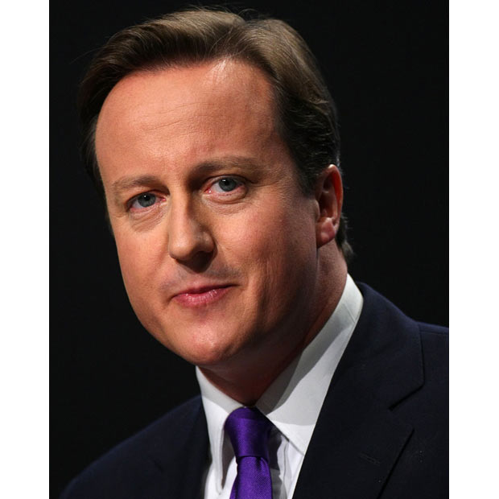
The House of Commons
The are 650 MP to the House of Commons but holy tree hundred and 70 seats in the debating Chamber for them to sit on.

Slide 9
The House of Lords
All peers (Lords) peereses who have inherited their titles have the right to take their seat in the House of Lords. But not everyone does so.
Distinguished men and women who have been made peers for their life-time. Their titles cannot be inherited.
Certain clergy of the Church of England.
Some judges called the Law Lords.

