Slide 1

BALKAN BABEL:
TRANSLATION ZONES,
MILITARY ZONES
by Emily Apter
(Professor of French and Comparative Literature at
New York University)
Translation/Transnation
Claudio Calossi
Alessandra Meschini
TPCI I inglese

Slide 2
The definition of TRANSLATIONAL TRANSNATIONALISM,
among minority languages
English language SUPREMACY through economic globalization
DEPENDENCY of minority languages on dominant language
MAIN THEMES
Relationship between linguistic standardization, formation of national identity and diffusion of European languages in colonized territories

Slide 3
What is a minor literature?
Regarding Gilles Deleuze and Félix Guattari’s Kafka: toward a minor literature, Kafka’s language as a pastiche of vehicular language
Pasley & Harman
Important for the definition of trans- in literary TRANSnationalism
People do NOT use anymore an OFFICIAL LANGUAGE as a LINGUA FRANCA when there are two minority languages. Everything takes place in the SPHERE OF MINORITY.
Ex. Trainspotting

Slide 4
TENSIONS BETWEEN OFFICIAL, LITERARY, AND COLLOQUIAL LANGUAGES ARE THE BOUNDARIES OF TRANSLATION STUDIES
In a metaphorical way, the area in which two kinds of languages meet each other is the seismic zone of translation and linguistic conflicts, what the author defined as the BALKAN BABEL.

Slide 5
BALKANISM is term coined by Todorova, in her work “Imagining the Balkans”. It describes the unstable situation in the Balkans provoked by the border wars and the unruly coexistence of several linguistic identities.
TRANSLATION ZONES are areas where every minority language is at war with the others in order to achieve linguistic supremacy. No major language takes part in the “fight”. This conflict is particularly bitter on the borders.

Slide 6
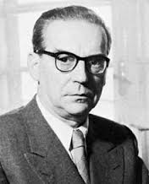
BALKANISM
The common adoption of terms from another language is dictated by linguistic migration (or transnationalism).
In his novel, this is seen as a theft from the cultural patrimony of that country and so it can lead to a violent conflict.
IVO ANDRIĆ (1872-1975) was a Yugoslav novelist, short story writer and the 1961 winner of the Nobel Prize in Literature. Author of “The Bridge on the Drina” (1945).

Slide 7
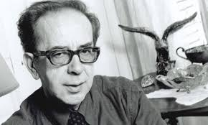
Albania's best-known poet and novelist
Representation of classical myths in modern contexts
Born in 1936 in Girokaster, Albania
Irony
Albanian political situation
ISMAIL KADARÉ
Broken April (1978)
Three-Arched Bridge (1978)
Nobility of the Albanian language

Slide 8
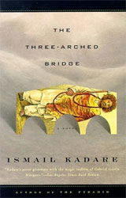
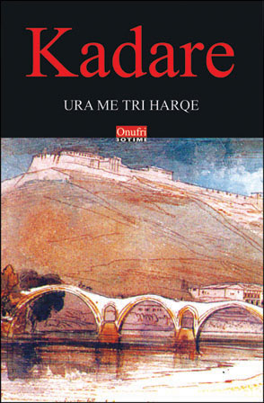
BRIDGE
Seen as a way to put in RELATION two different populations (Albanian and Turks).
The construction of the bridge is as difficult as the attempt to communicate between different cultural and linguistic identities within the Balkans.
Turk’s influence on the Albanian language is described by the narrator as a BIOLOGICAL WEAPON, impossible to control.

Slide 9
Why are Balkans a problematic linguistic area?
Barriers of untranslatability
Sameness between languages (such as Serbian and Croatian) declared separate by official decree.
Physical proximity of different language groups.
Historical failure of nationalist linguistic policies aiming to eliminate differences.
Proliferation of hybrid dialects that cannot be considered as standard languages.

Slide 10


LANGUAGE
is compared to
WAR
Weapons such as “intelligent machines” are replaced by linguistic techniques which are regulated by strict rules date back to ancient manuals.
Language is very simple and used only for war purposes. Minorities and dialects are flatted out by the language of “intelligent machines”.
.

Slide 11
Two ways of considering LINGUISTIC WARS in Kadaré’s works:
Mafia war → Mafia is seen as a group of people striving to reaffirm the purity of their language and preserve it from contamination of dialects and hybrid languages.
Total war → NUCLEAR ENGLISH (Virilio and Lotringer) it is a total war declaration to linguistic diversity. It is similar to the notion of Basic English (Quirk), an unemotional and colloquial language. It is the revival of the myth of the creation of an universal language in the era of “intelligent machines”.
.

Slide 12
Two main thesis about the possible origin of BASIC ENGLISH:
Linguistic standardization because of the rise of totalitarian regimes (ex. France and Russia) in order to have a better control over the nation.
Attempt to create a universal practical language influenced by Pragmatism, Positivism and Utilitarism.
.

Slide 13
CONCLUSION
Nowadays, technology could make this universal language a reality. But in other countries like Japan, an opposite phenomenon is beginning to develop. The wider the use of English as a common language spreads, the more forms of altered English come to life as a response to the need of having a personal language understandable only by a small group of people.

Slide 14
To preserve his supremacy, English will have to carry out a policy against balkanization.
WILL INTERNET OR HACKERS
PERMIT THIS TO HAPPEN?
.

Slide 15
DO YOU KNOW ANY OTHER EXAMPLES OF ALTERED FORM OF ENGLISH
AROUND THE WORLD?
.

Slide 16
DO YOU KNOW ABOUT ANY OTHER PROBLEMATIC LINGUISTIC ZONES?
.

Slide 17
In Albany, Kadaré has played a significant role in defending the purity of his mother tongue. In Italy, HAVE SOMEONE EVER PLAYED A SIMILAR ROLE?
.

Slide 18
THANK YOU FOR YOUR ATTENTION!

