Slide 1
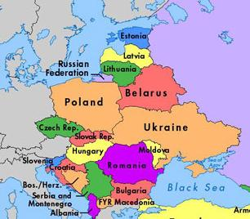
Economic Factors
Global Competitiveness Index (GCI), 2012-13
Source: adopted from http://www3.weforum.org/docs/WEF_GlobalCompetitivenessReport_2012-13.pdf

Slide 2
Economic Factors
The most problematic factors for doing business
Source: adopted from http://www3.weforum.org/docs/WEF_GlobalCompetitivenessReport_2012-13.pdf

Slide 3
Economic Factors
Basic requirements of global competitiveness (20% GCI)
Source: adopted from http://www3.weforum.org/docs/WEF_GlobalCompetitivenessReport_2012-13.pdf

Slide 4
Economic Factors
Efficiency enhances of global competitiveness (50% GCI)
Source: adopted from http://www3.weforum.org/docs/WEF_GlobalCompetitivenessReport_2012-13.pdf

Slide 5
Economic Factors
Innovation and sophistication factors of global competitiveness (30% GCI)
Source: adopted from http://www3.weforum.org/docs/WEF_GlobalCompetitivenessReport_2012-13.pdf

Slide 6
Demographic Factors
Source:

Slide 7
Cultural Factors
Source: adopted from http://institute.gorshenin.ua/researches/122_sovremennaya_molodezh_ukraini.html

Slide 8
Cultural Factors
Young people in Ukraine: family VS carrier
Source: adopted from http://institute.gorshenin.ua/researches/120_sovremennaya_molodezh_ukraini.html

Slide 9
Cultural Factors
Source: adopted from http://institute.gorshenin.ua/researches/119_dlya_chego_ukrainskoy_molodezhi_nuzhen.html

Slide 10
Environmental Factors
Environmental Performance Index (EPI), 2012
Source: adopted from http://epi.yale.edu/epi2012/countryprofiles

Slide 11
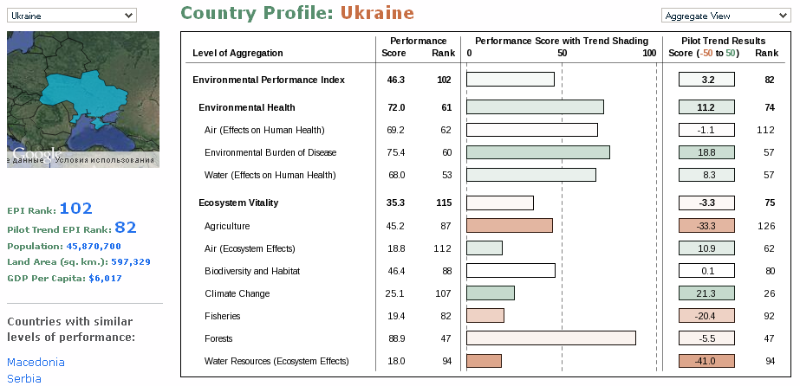
Environmental Factors
Source: adopted from http://epi.yale.edu/epi2012/countryprofiles

Slide 12
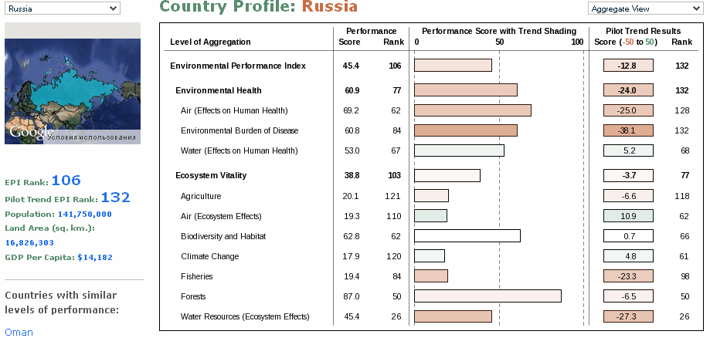
Environmental Factors
Source: adopted from http://epi.yale.edu/epi2012/countryprofiles

Slide 13
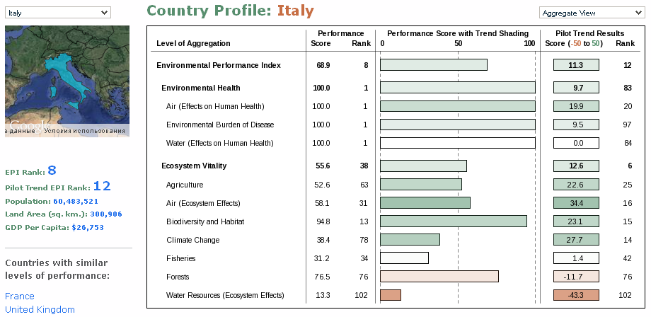
Environmental Factors
Source: adopted from http://epi.yale.edu/epi2012/countryprofiles

Slide 14
Technological Factors
Internet connectivity
Source: adopted from http://www.akamai.com/stateoftheinternet/soti-visualizations.html#stoi-map

Slide 15
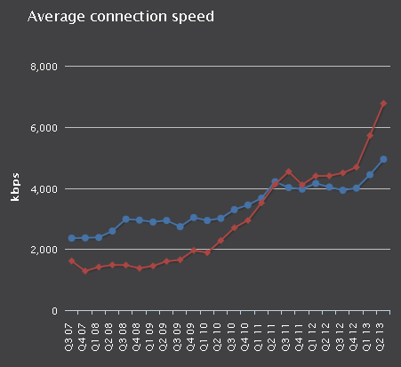
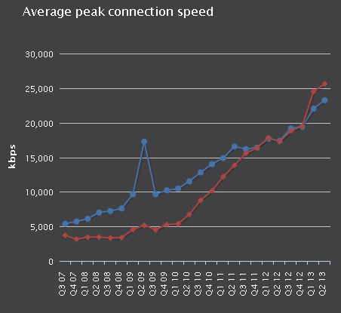

Technological Factors
Average connection / peak connection speed
Source: http://www.akamai.com/stateoftheinternet/soti-visualizations.html#stoi-map

Slide 16
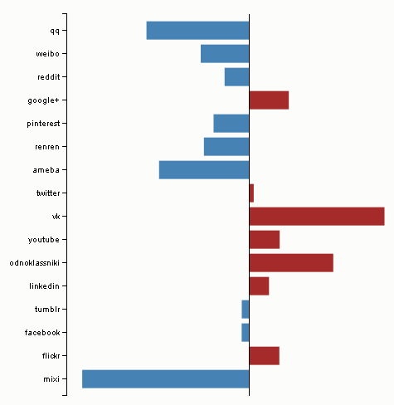
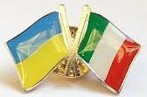
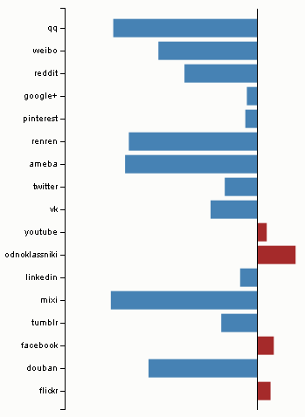
Technological Factors
Ukraine
Italy
Popularity of social networks
Source: http://bitlyscience.github.io/geo_social/

