Slide 1
National accounts or national account systems (NAS) are the implementation of complete and consistent accounting techniques for measuring the economic activity of a nation.
Nation Account System - What
National accounts broadly present output, expenditure, and income activities of the economic actors (corporations, government, households) in an economy, including their relations with other countries' economies, and their wealth (net worth).
They present both flows (measured over a period) and stocks (measured at the end of a period).

Slide 2
What and Why
There are a number of aggregate measures in the national accounts, notably including gross domestic product or GDP, perhaps the most widely cited measure of aggregate economic activity.
Ways of breaking down GDP include as types of income (wages, profits, etc.) or expenditure (consumption, investment/saving, etc.).
Measures of these are examples of macro-economic data. Such aggregate measures and their change over time are generally of strongest interest to economic policymakers, although the detailed national accounts contain a rich source of information for economic analysis.

Slide 3
Who
The accounts are derived from a wide variety of statistical source data including surveys, administrative and census data, and regulatory data, which are integrated and harmonized in the conceptual framework.
They are usually compiled by national statistical offices and/or central banks in each country, though this is not always the case, and may be released on both an annual and (less detailed) quarterly frequency.

Slide 4
What, in depth: GDP
Gross domestic product (GDP) refers to the market value of all final goods and services produced within a country in a given period. GDP per capita is often considered an indicator of a country's standard of living.
GDP can be determined in three ways, all of which should, in principle, give the same result. They are the product (or output) approach, the income approach, and the expenditure approach

Slide 5
GDP by expediture
The expenditure approach works on the principle that all of the product must be bought by somebody, therefore the value of the total product must be equal to people's total expenditures in buying things.
GDP = private consumption + gross investment + government spending + (exports − imports), or
GDP = C + I + G + (X-M)

Slide 6
GDP by income
The income approach works on the principle that the incomes of the productive factors ("producers," colloquially) must be equal to the value of their product, and determines GDP by finding the sum of all producers' incomes.
This method measures GDP by adding incomes that firms pay households for the factors of production they hire- wages for labour, interest for capital, rent for land and profits for entrepreneurship.
The US divide incomes into: Wages, salaries, and supplementary labour income; Corporate profits; Interest and miscellaneous investment income; Farmers’ income; Income from non-farm unincorporated businesses.

Slide 7
GDP by production
The production approach sums the outputs of every class of enterprise to arrive at the total. It is also called as Net Product or Value added method. This method consists of three stages:
Estimating the Gross Value of domestic Output in various economic activities;
Determining the intermediate consumption, i.e., the cost of material, supplies and services used to produce final goods or services; and finally
Deducting intermediate consumption from Gross Value to obtain the Net Value of Domestic Output.
Gross Value Added = Value of output – Value of Intermediate Consumption
Value of Output = Value of the total sales of goods and services + Value of changes in the inventories.

Slide 8
Gross? Domestic?
Gross means that GDP measures production regardless of the various uses to which that production can be put. Production can be used for immediate consumption, for investment in new fixed assets or inventories, or for replacing depreciated fixed assets.
Domestic means that GDP measures production that takes place within the country's borders

Slide 9
Domestic & National
GDP can be contrasted with gross national product (GNP) or gross national income (GNI).
The difference is that GDP defines its scope according to location, while GNP defines its scope according to ownership.
In a global context, world GDP and world GNP are therefore equivalent terms.
GDP is product produced within a country's borders; GNP is product produced by enterprises owned by a country's citizens.

Slide 10
Questions?
What are the main limitations of GDP?
See:
http://ingrimayne.com/econ/Measuring/GNP2.html

Slide 11
Unemployment
Unemployment (or joblessness), as defined by the International Labour Organization, occurs when people are without jobs and they have actively sought work within the past four weeks.
The unemployment rate is a measure of the prevalence of unemployment and it is calculated as a percentage by dividing the number of unemployed individuals by all individuals currently in the labour force.
Unemplyment rate = unemployed workers/total labor force

Slide 12
Unemployment rate
As defined by the International Labour Organization, "unemployed workers" are those who are currently not working but are willing and able to work for pay, currently available to work, and have actively searched for work.
Individuals who are actively seeking job placement must make the effort to: be in contact with an employer, have job interviews, contact job placement agencies, send out resumes, submit applications, respond to advertisements, or some other means of active job searching within the prior four weeks.
Simply looking at advertisements and not responding will not count as actively seeking job placement.

Slide 13
Inflation
Inflation is a rise in the general level of prices of goods and services in an economy over a period of time.
Inflation is usually estimated by calculating the inflation rate of a price index, usually the Consumer Price Index.
The Consumer Price Index measures prices of a selection of goods and services purchased by a "typical consumer”. The inflation rate is the percentage rate of change of a price index over time.
CPI t = (Pt-P0)/P0 * 100

Slide 14
Inflation
Other widely used price indices for calculating price inflation include the following:
Producer price indices (PPIs) which measures average changes in prices received by domestic producers for their output.
Commodity price indices, which measure the price of a selection of commodities. In the present commodity price indices are weighted by the relative importance of the components to the "all in" cost of an employee.
Core price indices: because food and oil prices can change quickly due to changes in supply and demand conditions in the food and oil markets, it can be difficult to detect the long run trend in price levels when those prices are included. Therefore most statistical agencies also report a measure of 'core inflation', which removes the most volatile components (such as food and oil) from a broad price index like the CPI.
GDP deflator is a measure of the price of all the goods and services included in gross domestic product (GDP). It is: nominal GDP measure divided by its real GDP measure.

Slide 15
Balance of Trade
The balance of trade (or net exports) is the difference between the monetary value of exports and imports of output in an economy over a certain period. It is the relationship between a nation's imports and exports.
A positive balance is known as a trade surplus if it consists of exporting more than is imported; a negative balance is referred to as a trade deficit or, informally, a trade gap.
The balance of trade is sometimes divided into a goods and a services balance.

Slide 16
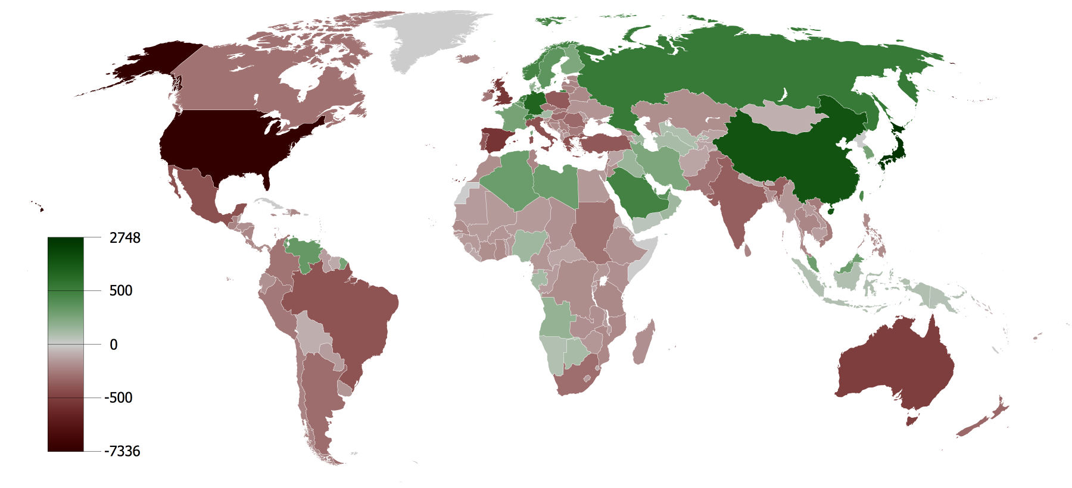
World Balance of Trade

Slide 17
Questions?
Is the Italian balane of trade in surplus or deficit?
What are the main reasons of that surplus/deficit (geographical and sector analysis)?

Slide 18
FDI
Foreign direct investment (FDI) refers to the net inflows of investment to acquire a lasting management interest (10 percent or more of voting stock) in an enterprise operating in an economy other than that of the investor.
It usually involves participation in management, joint-venture, transfer of technology and expertise.
There are two types of FDI:
inward foreign direct investment
outward foreign direct investment
.. resulting in a net FDI inflow (positive or negative) and "stock of foreign direct investment", which is the cumulative number for a given period.

