Slide 1
Lez. 30
presentazione di di Stella alzano sul cap. "Parents and chiledren" di Nozick

Slide 2
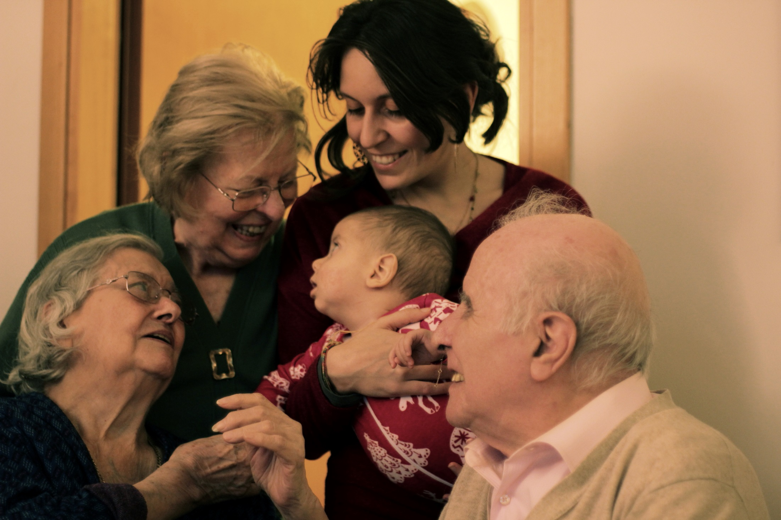
Parents & Children
From Examined Life – Philosophical Meditations by Robert Nozick

Slide 3
“Having children and raising them gives one’s life substance”
There is not a stronger bond than being a parent;
The relationship of love between a child and a parent is not only based on emotions: children, in fact, are just like a body part for their parents;
As stated by Nozick, “Parents reside within their children’s unconscious, children in their parents’ bodies”

Slide 4
“Children form part of a wider identity you have”
It is wrong to burden our children with our expectations and ambitions;
Still, parents perceive the qualities and achievements of their children as a sort of extension of their own identity;
As parents, you get the feeling that “in your wider identity’s division of labor they (the children) are taking care of some tasks”

Slide 5
“Being a parent helps one become a better child”
As we enter adulthood, it becomes the grown-up child’s task to take care of his parents.
This is a two-step process:
    “Taking responsibility for the state of the relationship ”;
    “ Taking care of them when they are no longer able to cope fully for themselves”.
    “If adolescence is sometimes marked by rebelling against one’s parents and adulthood by becoming independent of them, what marks maturity is becoming a parent to them”.

Slide 6
“Being grown-up is a way of no longer being a child, (…) not just by acting as their parent but by stopping needing or expecting them to act as yours”;
Nothing in the world can represent symbolically the love of our parents;
We can only find a substitute able to perform similar functions to that love, or some of them;
“The difference between a substitute for something, and that which must be it symbolically, is intricate and complex. Yet growing up and reaching maturity depends upon mastering that difference and turning, however wistfully, toward a substitute fit for an adult.”

Slide 7
“Bequeathing something to others is an expression of caring about them”
Even if we can say that the recipient of an inheritance earned the perpetual love of the original creator of wealth, it is the former who earned the right of manifesting or strenghtening the bond with a bequest;
It happens frequently that an inheritance is passed on for generations, losing any emotional value and generating profound social and economical inequalities;

Slide 8
Several philosophers have affirmed that who creates or earns the wealth places part of his essence in it;
“If property is a bundle of rights to something (to consume, alter, transfer, spend, and bequeath it) then in bequest not all of these rights get transferred, and in particular the right to bequeath that item does not - this adheres to the original earner or creator”.

Slide 9
A possible solution to the problem of inequalities
To restructure an institution of inheritance, introducing two specifications:
  the amount that a person has inherited himself will be subtracted from the estate he is able to bequeath;
  “A person may not bequeath to two unborn persons who are in different generations of descent from some last already existing node of a family tree”.

Slide 10
The other inheritance
“Wealthy people devote their time to amassing money and spending it; they are able to pass this money on to their children. How may the rest of us leave what we have been concerned with? ”;
We spend our life researching and learning with passion, how can we pass at least some of this knowledge and some of this “other” wealth on to our children?

Slide 11
The pill
Nozick imagines a pill able to incorporate the acquired knowledge and wisdom for our children to ingest;
To avoid wealthy people from buying this other wealth with money, Nozick suggests asking science experts to develop a transmission system of this knowledge based on the partial genetic match between the recipient’s neurons and the donor’s.

Slide 12
Of course, children would not become clones of their parents, they would absorb this knowledge and critically build their own starting from this inherited base;
All of this is not desirable: “It would be oppressive if inequalities of understanding and knowledge were to pile up over generations. And given the ways in which some knowledge builds and depends upon other, it does not make any sense to contemplate a system analogous to the one we suggested for material wealth.”;

Slide 13
Conclusions
As Nozick points out, important values such as knowledge, curiosity and passion are worth passing on not only to our children. As parents, what we can transfer directly to our children is instead a model and the ability to choose.

