Slide 1

Economics
Università degli Studi di Macerata Facoltà di Giurisprudenza
Andrea Ghetti

Slide 2
Topics for short report
Critics in Monopolistic Competition
Sticky prices in Oligopoly
Externality

Slide 3
Monopolistic Competition
It’s an imperfect market situation where many competitive producers sell products that are similiar but not identical. In monopolistic competition a firm takes the prices charged by its rivals as given and ignores the impact of its own prices on the prices of other firms.

Slide 4
Monopolistic Competition : The features
There are many firms that offer products as close substitutes for each other (that is, the products are substitutes but not exactly alike)
Each firm has a degree of control over price
The competition takes place also on the level of quality and differentiation, so quality becomes one of the most important issue on the concorrence between firms
Firms can freely enter or exit in/from the market in function of total profit
Prices are higher (because imperfect competition among firm presses the price to the minimal several cost)
The number of firms may not be the “ideal one”
Role of advertising (let people know about the products and more advertising means more power for firms)

Slide 5
Critics
When firms sell several products and charge prices above the marginal cost, each of them has an incentive to advertise in order to attract more buyers to its particular products
Firms spends between the 10-20% of revenue on advertising
Firms use advertising in order to manipulate people’s tastes
Advertising impedes competition by implying that products are more different thant they truly are

Slide 6
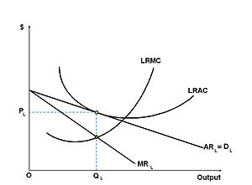
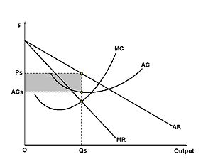
Equilibrium
The long-run
The short-run
The firm still produces where marginal cost and marginal revenue are equal; however, the demand curve (and AR) has shifted as other firms entered the market and increased competition. The firm no longer sells its goods above average cost and can no longer claim an economic profit.
The firm maximizes its profits and produces a quantity where the firm's marginal revenue (MR) is equal to its marginal cost (MC). The firm is able to collect a price based on the average revenue (AR) curve. The difference between the firms average revenue and average cost, multiplied by the quantity sold (Qs), gives the total profit.

Slide 7
Example
In many U.S. markets, producers practice production differentiation by altering the physical composition of products, using special packaging or simply claiming to have superior products based on brand images or advertising.Toothpastes, toilet papers, computer software and operating systems are examples of differentiated products.

Slide 8
Oligopoly
It’s an imperfect market situation in which there are few sellers, each offering a similiar or identical products to the others, so that to have a direct confrontation.

Slide 9
Oligopoly : The features
It’s a market with few producers (firms with the highest level of market power)
Awerness of the firms: each partecipant is aware of the fact that its own actions can influence other partecipants
Direct comparison and competition between companies
Collusion (when very competitive firms try to have an agreement about price)
For every action the single firm has to anticipate the reaction of competitors
Great caution in changes

Slide 10
Prices in Oligopoly
Prices in an oligopoly-system turn out to be more stable than in monopoly or in perfect competition; that is, they don’t change everytime costs change, and if they do, they change in a little different quantity
Prices are modified only in the face of major and permanent changes in costs
They tend to be sticky. The term sticky in economy describes a situation in which a variable is resistant to change
Prices can often be considered sticky-upward.

Slide 11
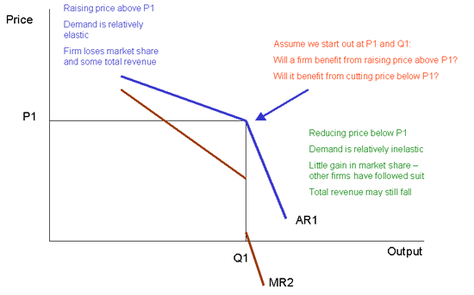
The Kinked Demand Curve
The kinked demand curve requires firms to match price reductions by their competitors to maintain market share

Slide 12
Four possible causes of price stickness :
Menu costs
Money illusion
Imperfect information
Fairness concerns

Slide 13
Example of stickiness
In the absence of competition, firms rarely lower prices, even when demand drops and production cost decreases. Instead, when production become cheaper, firms take the difference as profit, and when demand decreases they are more likely to hold prices constant
Many firms during recessions lay off workers. Wages, prices and employment levels can all be sticky

Slide 14
Externality
An externality (or transaction spillover) is a cost or a benefit, not trasmitted through prices, incurred by a party who didn’t agree to the action causing the cost or benefit.The benefit of externality is called external benefit (positive externality), while the cost is called external cost (negative externality). In both cases (negative and positive externality), in a competitive market, prices do not reflect the full costs or benefits of producing or consuming a product or a service. Cost and benefit are determinated by the sum of the economic benefits and costs for all parties involved

Slide 15
Negative Externality
Examples
Air pollution from burning fossil fuels causes damages to crops, historical buildings and public health
Water pollution caused by industries that add poisons to the water and compromise the health of people, animals and plants
When drivers use roads, they impose congestion costs and higher accidents risks on all other drivers
The consumption of alcohol when a person is driving because he may injure or even kill other people
Abuse of smoking and/or alcohol

Slide 16
Positive Externality
Examples
A public organization that coordinates the control of an infectious disease preventing others in society from getting sick
Knowledge spillover of inventions and information
Role of education
Taxation

Slide 17
Supply and demand diagram
The usual economic analysis of externalities can be illustrated using a standard supply and demand diagram if the externality is valued in term of money.
There might be other two curves for the demand or benefit of the good: the social demand curve and the normal demand curve.

Slide 18
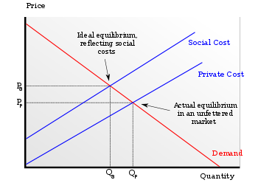
External costs
Demand curve with external costs; if social costs are not accounted for price is too low to cover all costs and hence quantity produced is unnecessarily high (because the producers of the good and their customers are essentially underpaying the total, real factors of production.)

Slide 19
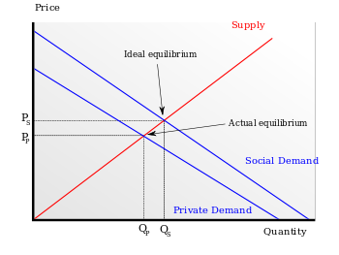
External benefits
Supply curve with external benefits; when the market does not account for additional social benefits of a good both the price for the good and the quantity produced are lower than the market could bear.

Slide 20
Possible solutions
Criminalization
Civil Tort law
Government provision
Pigovian taxes

Slide 21
Ronald Coase and the CoaseTheorem
Ronald Coase argues that if all parties involved can easily found a system of payments in order to pay each other for their actions, then an efficient outcome can be reached without government intervention. Government intervention may not always be needed because externalities can sometimes be solved by agreement between the parties involved.
The Coase theorem has some requires:
Property rights well defined
People act rationally
Transaction costs be minimal
If all of these conditions apply, the private parties can bargain to solve the problem of externalities.

