Slide 1
Facoltà di Giurisprudenza
-ECONOMICS-
Anno accademico 2011/2012
Nicola Bruni

Slide 2
My short report is about:
Market failure
Equilibrium price
Equilibrium quantity

Slide 3
MARKET FAILURE
Market failure occurs when freely-functioning markets, fail to deliver an efficient allocation of resources. The result is a loss of economic and social welfare. Market failure exists when the competitive outcome of markets is not efficient from the point of view of society as a whole. This is usually because the benefits that the free-market confers on individuals or businesses carrying out a particular activity diverge from the benefits to society as a whole.

Slide 4
Markets can fail because of:
- Negative externalities causing the social cost of production to exceed private cost.
-Positive (or beneficial) externalities causing the social benefit of consumption to exceed the private benefit.
-Imperfect information
-Market dominance by monopolies can lead to under-production.
-Equity (fairness) issues.

Slide 5
Market failure results in
- Productive inefficiency: Businesses are not maximising output from given factor inputs. This is a problem because the lost output from inefficient production could have been used to satisfy more wants and needs
- Allocative inefficiency: Resources are misallocated and producing goods and services not wanted by consumers. This is a problem because resources can be put to a better use making products that consumers value more highly

Slide 6
Let's consider an example of negative externalities
-is the case of emissions of pollutants
associated with certain products (ex. aluminum).
-The social cost of the product is higher than that supported by the producers.
-The social cost of aluminum production exceeds the private cost of manufacture. The optimal amount of aluminum, is therefore lower than that of balance.
-The solution is: Altering the system of incentives to induce economic agents to hold account the external effects their actions.

Slide 7
EQUILIBRIUM PRICE AND EQUILIBRIUM QUANTITY
EQUILIBRIUM PRICE: the price that balances supply and demand.
EQUILIBRIUM QUANTITY: the quantity supplied and the quantity demanded when the price has adjusted to balance supply and demand.
At the equilibrium price, the quantity of the good that buyers are willing and able to buy exactly balances the quantity that sellers are willing and able to sell. The equilibrium price is sometimes called the market-clearing price because, at this price, everyone in the market has been satisfied.

Slide 8
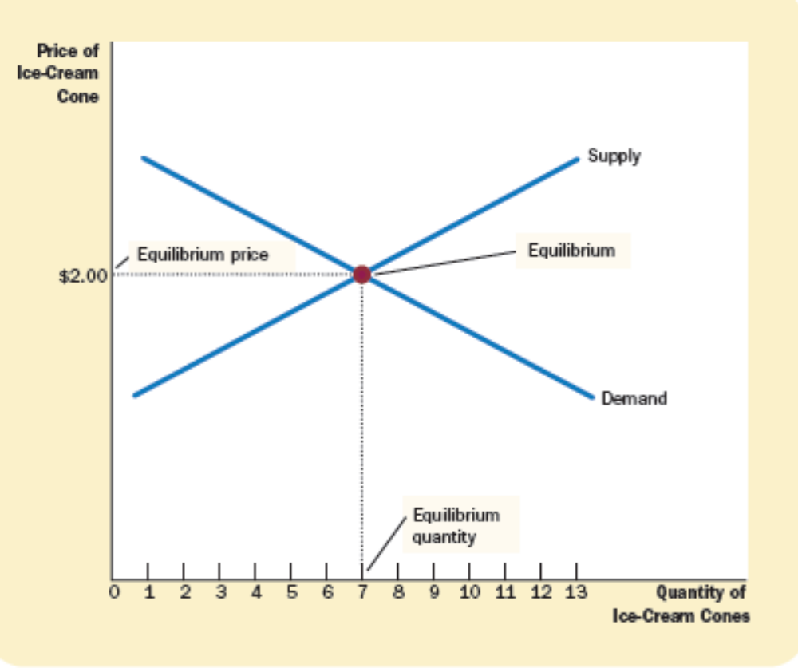
Let’s consider an example:
Here the equilibrium price is $2: At this price, 7 ice-cream cones are supplied, and 7 ice-cream cones are demanded.

Slide 9
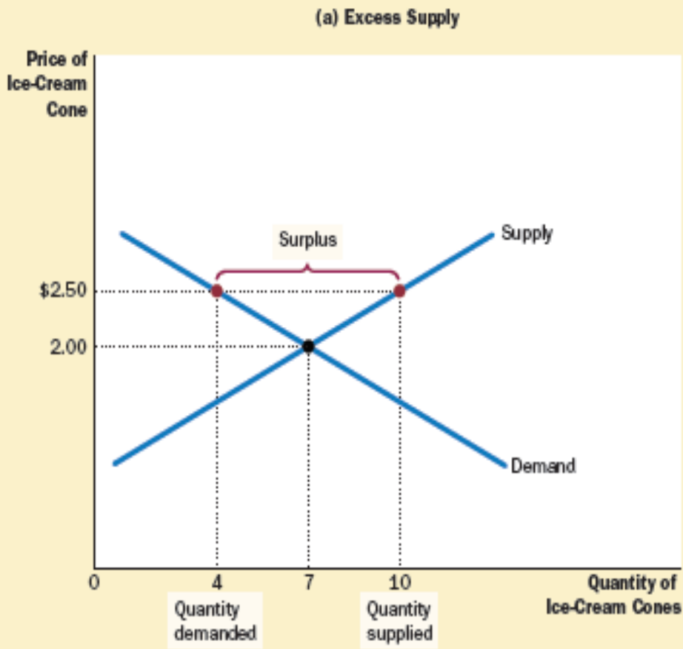
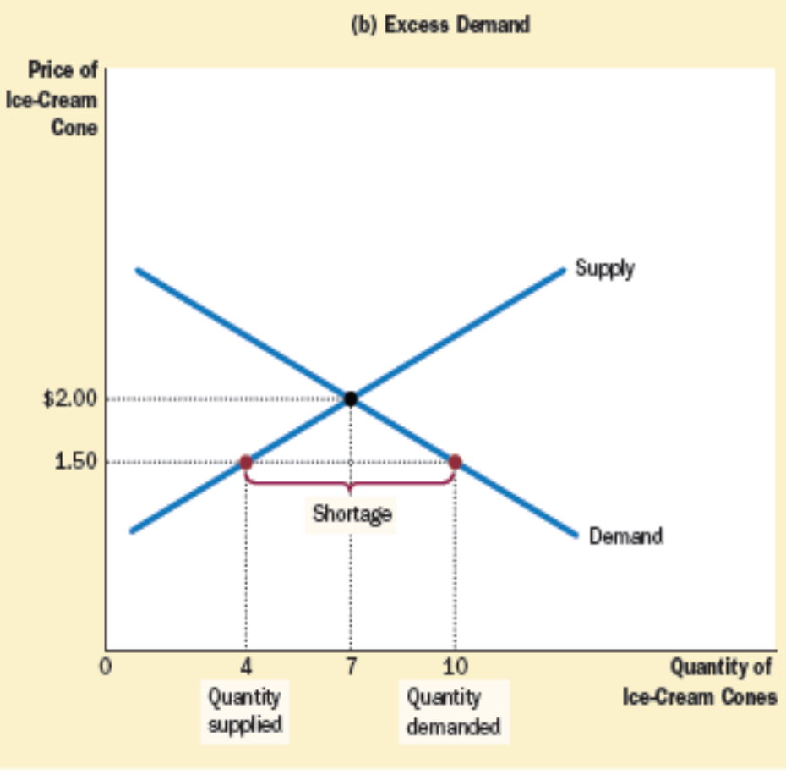

Slide 10
The End
thanks for your attention.

