Slide 1

ECONOMICS
Docente: Giorgio Galeazzi
Facoltà di Giurisprudenza
2011/2012
Lazea Claudia Maria
Classe MO1

Slide 2
Topics:
“ The Invisible Hand “ by Adam Smith
The gains from trade by David Ricardo
Equilibrium

Slide 3

“The Invisible Hand”

Slide 4
  This idea was introduced for the first time by the economist Adam Smith in his work called “ The Wealth of nations “.
  In economics, invisible hand or invisible hand of the market is the term economics use to describe the self-regulating nature of the marketplace. The concept is very simple because the main idea is that by trying to maximise sellers gains in a free market individual ambition benefits society, even if the ambitious have no benevolent intentions.
  The theory of the Invisible Hand states that if each consumer is allowed to choose freely what to buy and each producer is allowed to choose freely what to sell and how to produce it, the market will settle on a product distribution and prices will be beneficial to all the individual members of a community, and hence to the community as a whole.
  Actually the invisible hand transforms self-interest into the growth of the collective health.

Slide 5
Example:
“ It is not from the benevolence of the butcher , the brewer or the baker that we expect our dinner, but from their regard to their own interest. We adress ourselves, not to their humanity and never talk to them of our own necessities but of their advantages “
Smith uses the metaphor in the context of an argument against protectionism and goverment regulation of marketplace. In order to make things even more simple we can say that is the market, not the intervention of the public authorities to determine the best allocation of capital.

Slide 6
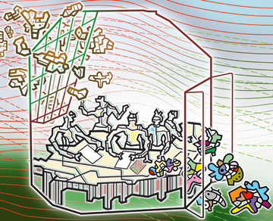
“ The gains from trade “ by David Ricardo

Slide 7
This theory was first introduced by David Ricardo in one of his most important work called “On the Principles of politic economy and taxation”.
Firstly in economics the law of comparative advantage says that two countries (as well as individuals or firm) will both gain from trade if, in the absence of trade they have relative costs for producing the same good.
Even if one country is more efficient in the production of all goods than the other, anyway both countries will still gain by trading each other , as long as they have different relative efficiencies.
The net benefits to each country are called the gains from trade

Slide 8
Example:
In Portugal is possible to produce both wine and cloth with less labour than it would take to produce the same quantities in England. However the relative costs of producing those two goods are different in the two countries.
In England it is very hard to produce wine, and only moderately difficult to produce cloth. In Portugal both are easy to produce. Therefore while it is cheaper to produce cloth in Portugal than Englend, it is cheaper still for Portugal to produce excess wine, and trade that for English cloth.
On the other hand England benefits from this trade because its cost for producing cloth has not changed but it can now get wine at a lower price, closer to the cost of cloth.
The consequence is that each country can gain by specializing itself in the good which has comparative advantage, and trading that good for another country.

Slide 9
EQUILIBRIUM
A condition or state in which economic forces are balanced, These economic variables will be unchanged from their equilibrium values in absence of external influences;
Economic equlibrium may be defined also as the point where supply equals demand for a product – the equilibrium price is for example the point where the hypotetical supply and demand curves intersect;
Economic equilibrium can be static or dinamic and may exist in a single market or multiple markets. It depens on different factors, such as consumer’s preferences;

