Slide 1
Danilo Monterotti
In collaboration with
Univeristy of Macerata
Presents:
Economics:
SUNK COSTS
&
THE EXTERNALITIES

Slide 2

Index
Sunk costs
Shubik’s Theory
Ernest Dupuis III
Sunk costs and the cost overrun
The externalities
Types of externalities
Private solution to externalities
Public intervention and the externalities

Slide 3
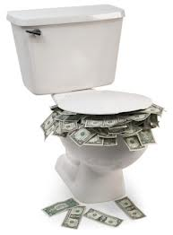
Sunk costs…
In economics and business decision-making, sunk costs are retrospective (past) costs that have already been incurred and cannot be recovered. Sunk costs are sometimes contrasted with prospective costs, which are future costs that may be incurred or changed if an action is taken. Both retrospective and prospective costs may be either fixed (continuous for as long as the business is in operation and unaffected by output volume) or variable (dependent on volume) costs. Note, however, that many economists consider it a mistake to classify sunk costs as "fixed" or "variable."

Slide 4
…And the economic loss
The sunk cost is distinct from economic loss. For example, when a car is purchased, it can subsequently be resold; however, it will probably not be resold for the original purchase price. The economic loss is the difference (including transaction costs). The sum originally paid should not affect any rational future decision-making about the car, regardless of the resale value: if the owner can derive more value from selling the car than not selling it, then it should be sold, regardless of the price paid. In this sense, the sunk cost is not a precise quantity, but an economic term for a sum paid, in the past, which is no longer relevant to decisions about the future; it may be used inconsistently in quantitative terms as the original cost or the expected economic loss.

Slide 5
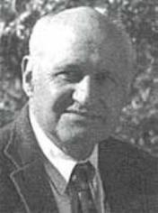
Shubik theory’s
In the microeconomics only the variable costs must be relevant for a decision. For this theory the sunk costs don't have to influence our decision, because in this way, you cannot take a decision that is really the best decision. The effect of the sunk costs is present in theory of dollar auction thinked by Shubik in 1971: the roles say that is sell at an auction one dollar, for example, and that it is won by the best offerer. But this auction it is not like a normal auction, infact also the second best offerer must pay without obtein anything. In this way the offert of the second best offerer rapresents a sunk cost! For this reason there is a irrational meccanism to increase the auction to recover this costs. The effect is that the dollar is won by the best offerer who usually makes an offert to some dollars.
Martin Shubik, 24 March 1926
American economist

Slide 6
…. Ernest Dupuis
Economists like Ernest Dupuis III argue that sunk costs are not taken into account when making rational decisions. For example if you buy a cinema's ticket about a movie that you hate, the ticket's cost became a sunk cost, because you cannot recover the ticket price. In the case of a movie ticket that has already been purchased, the ticket-buyer can choose between the following two end results if he realizes that he doesn't like the movie:

Slide 7
Having paid the price of the ticket and having suffered watching a movie that he does not want to see,
Having paid the price of the ticket and having used the time to do something more fun.
In either case, the ticket-buyer has paid the price of ticket so that part of the decision no longer affects the future. If the ticket-buyer regrets buying the ticket, the current decision should be based on whether he wants to see the movie at all, regardless of the price, just as if he were to go to a free movie. The economist will suggest that, since the second option involves suffering in only one way (spent money), while the first involves suffering in two (spent money plus wasted time), option two is obviously preferable.

Slide 8
Sunk cost and the cost overrun
Sunk costs may cause cost overrun. In business, an example of sunk costs may be investment into a factory. For example, $20 million has been spent on building a power plant; the value at present is zero because it is incomplete (and no sale or recovery is feasible). The plant can be completed for an additional $10 million, or abandoned and a different but equally valuable facility built for $5 million. It should be obvious that abandonment and construction of the alternative facility is the more rational decision, even though it represents a total loss of the original expenditure, the original sum invested is a sunk cost.

Slide 9
The Externalities
DEFINITION: The effect of the action of an economic welfare of other persons not directly involved.
EFFECTS: Because buyers and sellers tend not to consider the effects
outside of their actions in determining the quantity demanded
and supply, the market fails to allocate resources efficiently,
that is, the price and the amount of equilibrium are not efficient ones.

Slide 10
There are different types of externalities:
Externalities of consumption: Occurs when a consumer is interested
directly to the production or consumption of another individual.
Externalities of production: Occurs when the production possibilities
of a company are influenced by the choices of another entity
or a consumer.
Negative externalities: costs imposed on other individuals consumers or
producers - not directly involved in the exchange market (ex.
cigarette smoke, car exhaust).
Positive Externalities: Benefits received directly from consumers or
producers not involved in the exchange market (ex. vaccinations;
restoration of a historic building, investment in new technologies).

Slide 11
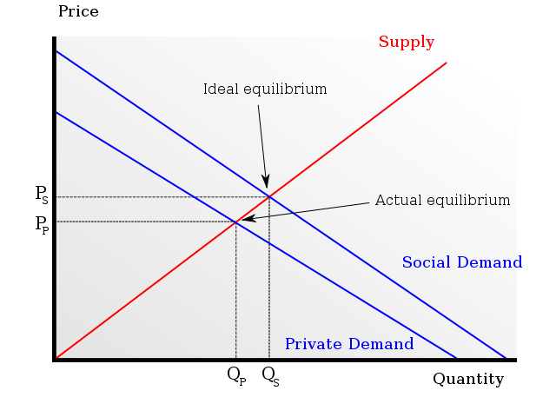
Consumption externalities affects the demand curve:
- IF POSITIVE: the activity of consumption generates a benefit for other; the demand curve / private value is lower than the curve of the
social value; the chosen quantity from the market is lower than that efficient
(ex. consumption of education).

Slide 12
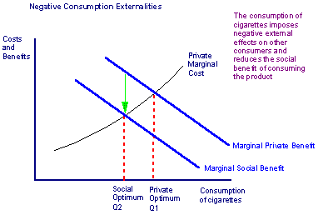
- IF NEGATIVE: the activity of consumption generates harm to others - the
demand curve / private value is higher than the curve of the
social value; the chosen quantity from the market is higher than that efficient
(ex. cigarettes consumption).

Slide 13
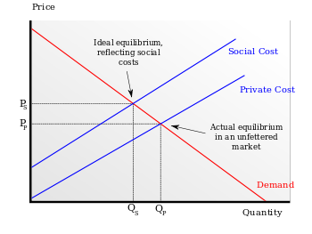
Externalities of production affects the supply curve:
- If negative: the productive activity generates a loss to other parties - the curve offer / private cost is lower than the cost curve
social; the chosen quantity from the market is higher than that efficiently (ex:
pollution);

Slide 14
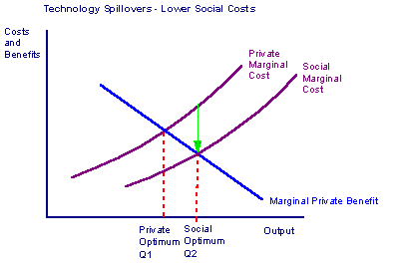
- if positive: productive activity generates a benefit for others - the
supply curve / private cost is higher than the cost curve
social; the chosen quantity from the market is lower than that efficiently (ex:
scientific research).

Slide 15
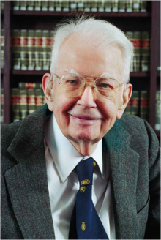
Private Solutions to Externalities
COASE TEOREM: If all the stakeholders can
negotiate without cost allocation of resources, can to solve themselves the problem of externalities.
Transaction costs: The costs in which the parties incurred to reach and implement an agreement.
Ronald Coase, 28 december 1910
American-based economist

Slide 16
Public Intervention and Externalities
REGULATION: The state can remedy the
externalities by prohibiting or making compulsory specific
behaviors.
Taxes and subsidies: The State may internalize
externality by imposing taxes on activities
that cause negative externalities and subsidizing
those that generate the positive.
Tradable emission permits: Allowing
voluntary transfer of rights to pollute
from one enterprise to another.

