Slide 1
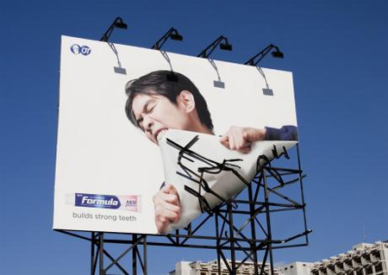
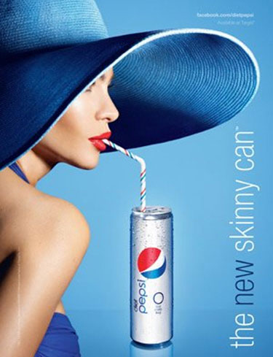
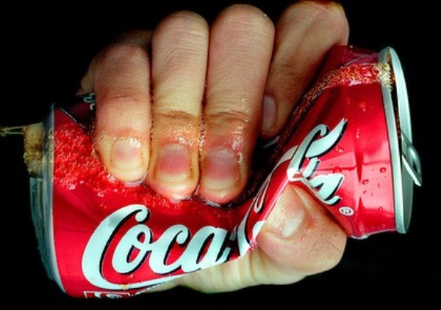
THE ROLE OF AVERTISING IN MONOPOLISTC COMPETITION

Slide 2
Advertising is very important in monopolistic competition.
When firms sell differentiated products and charge prices above marginal cost, each firm has an incentive to advertise in order to attract more buyers to its particular product.
The amount of advertising varies across products.
For economy as a whole, spending on advertising comprises about 2% of total firm revenue, or more than $100 billion.
Advertising takes many forms

Slide 3
The debate over advertising
THE CRITIQUE OF ADEVERTISING argue:
Firms advertise in order to manipulate people’s tastes. Much advertising is psychological rather than informational.
- For example: the typical television commercial for some brand of soft drink. The commercial most likely does not tell the viewer about the product’s price ore quality, instead, it might show a group of happy people at a party on a beach on a beautiful sunny day and in their hands are cans of the soft drink.
Advertising impedes competition, because tries to convince consumers that products are more different than the truly are, and makes buyer less concerned with price differences among similar goods

Slide 4
THE DEFENSE OF ADVERTISING argue:
Firms use advertising to provide information to customers, this information allows customers to make better choices about what do buy and enhances the ability of markets to allocate resources efficiently.
Advertising fosters competition, because allows customers to be more fully informed about all the firms in the market and can more easily take advantage of price differences
Advertising allows new firms to enter more easily, because gives entrants a means to attract customers from existing firms

Slide 5
What effect does advertising on the price of good?
In an article published in the Journal of Law and Economics in 1972, economist Lee Benham tested this effect. In the USA during 1960s, the various state governments had vastly different rules about advertising by optometrists. Some states allowed advertising for eyeglasses and eye examinations. Many states prohibited it, for example the Florida.
Benham used these differences in state law as a natural experiment and the results were striking: in those states that prohibited advertising, the average price paid for a pair of eyeglasses was $33.( this price is higher because to convert 1963 prices into today’s dollars, you can multiply them by 5). In those states that did not restrict advertising, the average price was $26. Thus, advertising reduced average prices by more than 20%. In the market of eyeglasses, and probably in many other markets as well, advertising fosters competition and leads to lower prices for consumers.

Slide 6
Advertising as a signal of quality
Defenders of advertising argue that even advertising that appears to contain little hard information may in fact tell consumers something about product quality. The willingness of the firm to spend a large amount of money on advertising can itself be a signal to consumer about the quality of the product being offered. Advertising is profitable in a firm of high quality, and not for a firm of lower quality, because consumers tend to buy the good of high quality, but not to those of low quality.
The content of the advertisement is irrelevant because a important firm signals the quality of its product by its willingness to spend money on advertising. In fact many firms pay famous actors large amount of money to make advertisements that appear to convey no information at all. The information is not in the advertisement’s content, but simply in its existence and expense.

Slide 7
Brand names
Advertising is related to the existence of brand names. In many markets there are two types of firms:
Firms sell products with recognized brand names
Firms sell generic substitutes
There is a disagreement about the economics of brand names:
Critics argue that brand names cause consumers to perceive differences that do not really exist. These critics assert that consumers’ willingness to pay more for the brand-name good is a form of irrationality fostered by advertising
More recently, economist have defended brand names as a useful way for consumers to ensure that the goods they buy are of high quality. There are two arguments :
Brand names provide consumer information about quality
Brand names give firms and incentive to maintain high quality
Defenders of brand names argue that consumer have good reason to pay more for brand-name products because they can be more confident in the quality of these products

Slide 8
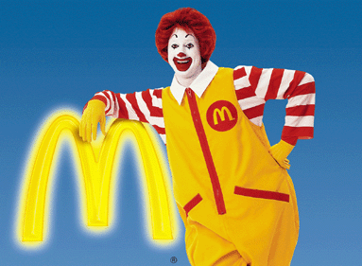
Example: McDonald’ Hamburgers
McDonald’s offers a consistent product across many cities. Its brand name is useful to you as a way of judging the quality of what you are about to buy. But if some customers were to become ill from bad food sols at a McDonald’s , the news would be disastrous for the company. By contrast, if some customers were to become ill from bad food at a local restaurant, might have to close down, but the lost profits would be much smaller. Hence, McDonald’s should have a incentive to ensure that its food is safe.

Slide 9
THANKS FOR YOUR ATTENTION
Ludovica Carcia

