Slide 1
Materiali di studio
Premessa/cornice: Fisica ingenua
- Bertamini, M. & Casati, R. (2009). False beliefs and naïve beliefs can be good for you., Commentary on McKay, R. and Dennett, D. (2009) The Evolution of Misbelief. Behavioral and Brain Sciences, 32, 512-513.
- Lawson, R. & Bertamini, M. (2006). Errors in judging information about reflections in mirrors. Perception, 35, 1265-1288.
- Savardi, U., Bianchi, I., Bertamini, M. (2010). Naive prediction of orientation and motion in mirrors. From what we see to what we expect reflections to do. Acta Psychologica, 134 (1), 1-15.
- Bertamini, M. & Wynne, L.A. (2009). The tendency to overestimate what is visible in a planar mirror amongst adults and children. The European Journal of Cognitive Psychology, 22, 516 - 528.
- Bianchi, I. (2009). Le forme dell’esperienza diretta. In: A: Zuczkowski & I. Bianchi, L’analisi qualitativa dell’esperienza diretta (pp. 151-162). Roma: Aracne.

Slide 2
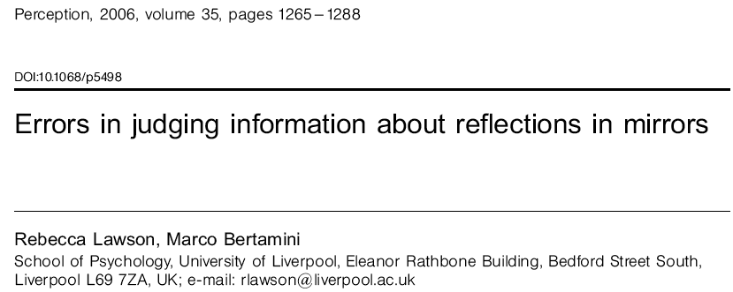

Slide 3
Introduction:
Dalla naive physics alla naive optics
Research in the area of naive physics deals with people's beliefs about the physical world with particular attention paid to systematic errors that people make. For example, many people make important errors in describing the behaviour of projectiles, falling objects, and the surface level of liquids (eg Hecht and Bertamini 2000; Kaiser et al 1992; McCloskey 1983; Robert and Harel 1996). In most studies mechanical systems have been investigated.
Recent research has turned to the area of naive optics (Cottrell and Winer 1994; Winer et al 1996). Of particular relevance to the present studies is work by Bertamini and colleagues on people's understanding of the reflective properties of planar mirrors (Bertamini et al 2003a, 2003b; Bertamini and Parks 2005; Croucher et al 2002; Hecht et al 2005; Jones and Bertamini 2006).

Slide 4
Introduction:
Gli errori emersi nella naive optics
Bertamini and colleagues have reported three common errors…
1

Slide 5
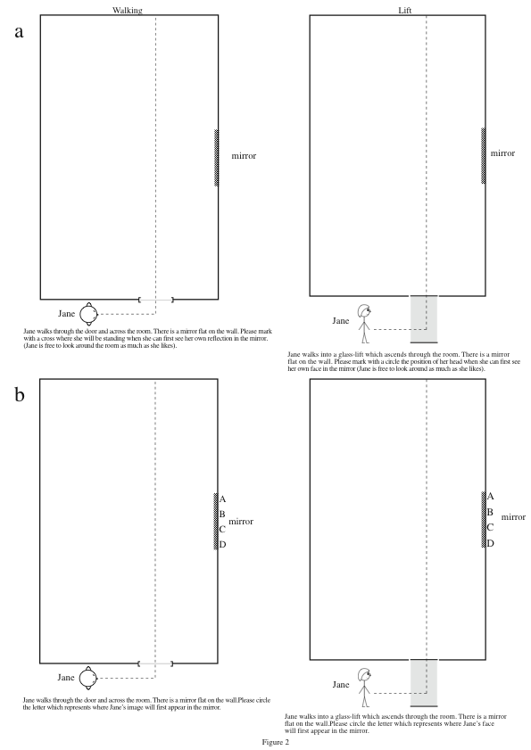

Slide 6
Introduction:
Gli errori emersi nella naive optics
1
The early error
if people are told to imagine that they are approaching a mirror from the side,
many people believe that they would see their reflection before they could actually do so
(Bertamini et al 2003b; Croucher et al 2002). The observer's line of sight must be
perpendicular to the surface of the mirror for the reflection to be visible, so the observer
must at least reach the near edge of the mirror to see his/her reflection.
The belief that you can see your reflection before this point is the early error.
This error is present for paper-and-pencil tasks,
for a positioning task in a real room with a pretend mirror,
and for animated computer graphic displays
(Bertamini et al 2003b; Croucher et al 2002; Hecht et al 2005).

Slide 7
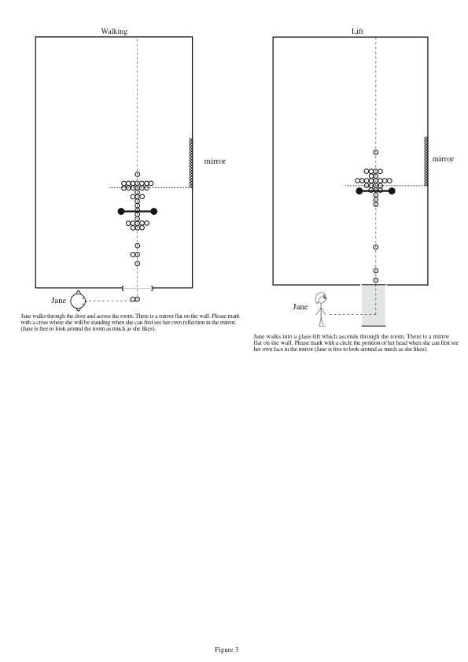

Slide 8
Introduction:
Gli errori emersi nella naive optics
Bertamini and colleagues have reported three common errors…
2

Slide 9
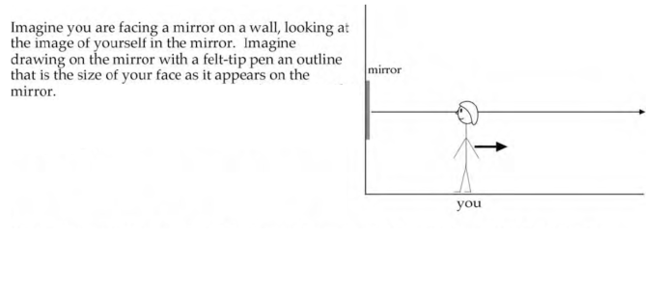

Slide 10
Introduction:
Gli errori emersi nella naive optics
2
The size overestimation error
Bertamini and Parks (2005) confirmed earlier informal reports (eg Gombrich
1960; Gregory 1997) that people markedly overestimated what size the reflection of their
face would be as they looked at it on the surface of a mirror. In fact, the reflection is
exactly half the width (and half the height, so quarter the area) of the observer's actual
Face - see figure 1. However, most people estimate the reflection to be around the same
size as their actual face. This is the size overestimation error.

Slide 11
Introduction:
Gli errori emersi nella naive optics
Bertamini and colleagues have reported three common errors…
3

Slide 12
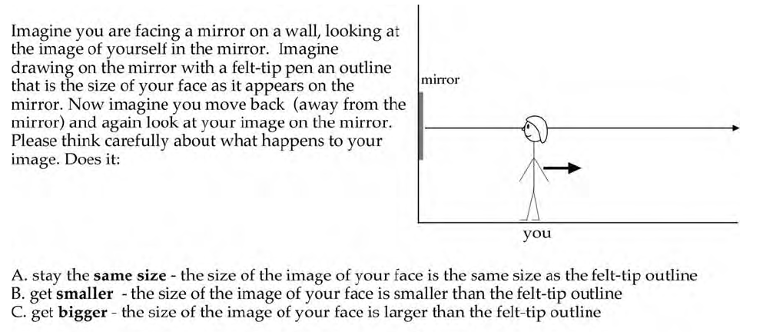

Slide 13
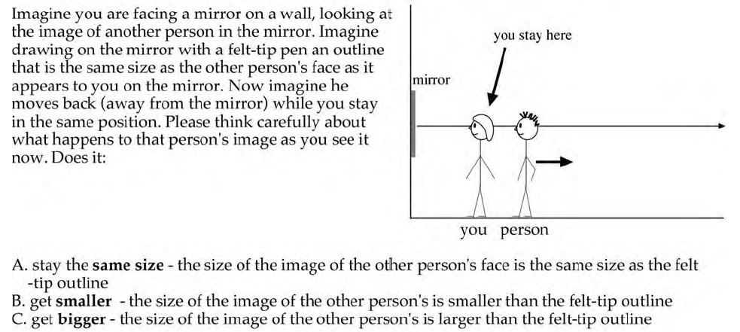

Slide 14
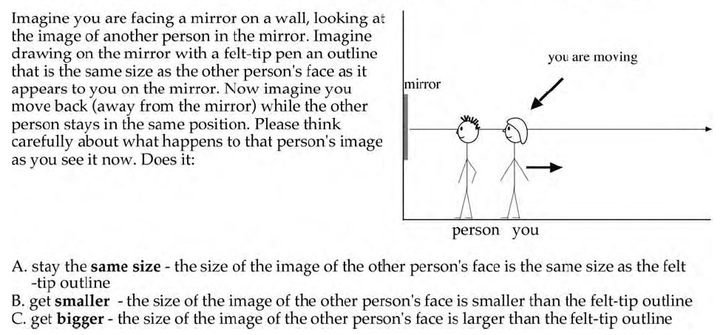

Slide 15
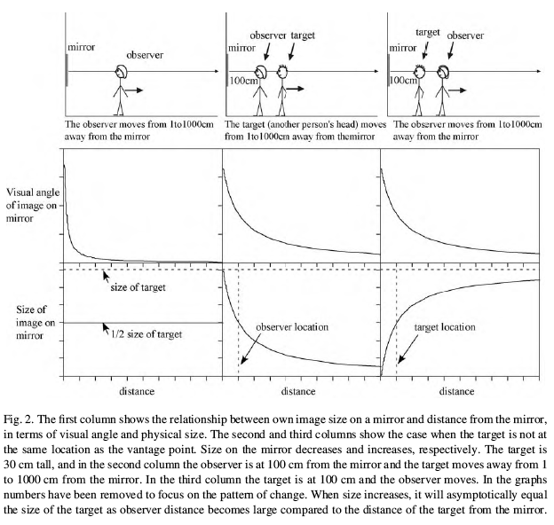

Slide 16
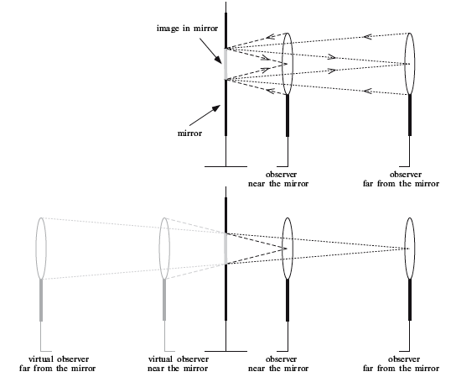
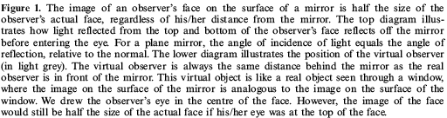

Slide 17
Introduction:
Gli errori emersi nella naive optics
3
The distance error
Bertamini and Parks (2005) found that most people believed that their
reflection in the mirror would appear smaller as they moved farther from the mirror.

Slide 18
Introduction:
Obiettivo del lavoro
These three errors are large and directional, so they are unlikely to be due merely to a difficulty in responding accurately.
However, Bertamini and colleagues did not test whether people would continue to produce these errors when they could see their reflection in a real mirror. It is important to establish this to understand the nature of these errors. This is the aim of the current studies.

Slide 19
Quali sono le fonti dell’errore?

Slide 20
HP 1) Ricordo errato di percezioni corrette
One reason for people's errors in understanding the properties of the physical world may be that people acquire and maintain incorrect beliefs despite having real-world opportunities to correct their misunderstanding. The information tested may be readily available in everyday life but the correct response is not remembered. If this is the case, then providing people with rich, perceptual information whilst they do a task should improve their ability to discriminate natural from incorrect, unnatural situations.

Slide 21
The pattern of some of the errors reported in the naive physics literature is consistent with this account.
For example, when people made judgments about the movement of pendulums or objects free-falling from aeroplanes (Kaiser et al 1992), or the trajectory of balls (Kaiser et al 1985), animation improved performance relative to static depictions of alternatives.
With mirrors, some people expect that an object on one side in the world is located on the opposite side in the virtual world (a left - right reversal heuristic; for example, people may believe that, as they approach a mirror from the right, they will first see their reflection appear from the left of the mirror). However, when shown a mirror in which left and right are reversed they do not find this natural (Bertamini et al 2003a).
In these studies, improvements occurred even if people were merely presented with a number of alternatives, only one of which corresponded to the real-world situation.

Slide 22
HP 2) Percezione errata.
HP 2) Percezione errata
An alternative source of erroneous beliefs about the physical world may be misperceptions in everyday life.
In this case, the persons' inaccurate belief would not be corrected by additional visual experience because the visual evidence supports the incorrect belief. On this account, errors are caused by perceptual phenomena.
Some of the systematic errors reported in naive physics research can, at least partly,
be explained by this latter, perceptual account. For example, McCloskey et al (1983)
found that many people indicated that objects appeared to fall straight down when
dropped from a moving carrier, even when they were shown animations of natural, para-
bolic trajectories. People made these errors even when the correct answer was shown to
them. In this case, capture of attention by a misleading frame of reference (the moving
carrier) appears to bias perception.

Slide 23
Similarly, Sholl and Liben (1995) reported a misperception that
the water surface is tilted when people were actually shown water in a tilted container. Again, this misperception persisted even for some people who knew that the water surface should be horizontal.
McCloskey et al (1980) also noted that objects set in motion in the real world eventually stop even when no external force appears to act on them,
so that it is not surprising that people often do not understand the principle of inertia.

Slide 24
Here, we report four studies in which we examined whether people's early errors, distance errors, and overestimation errors with planar mirrors were reduced or eliminated by allowing people to look at reflections in real mirrors.
Early errors in the walking task were eliminated by providing visual feedback. This suggests that many people have an inaccurate belief about when they can see their reflection. Surprisingly, this false belief is maintained in the face of contradictory feedback available when people look at planar mirrors under everyday conditions.
People strikingly overestimated the size of reflections on the surface of mirrors, even when they were given visual feedback. This suggests that people's inaccurate beliefs about the size of reflections in mirrors was caused by a powerful perceptual phenomenon.
In brief, it is extremely hard to judge the size of an image (even when it lies on a physical object like the glass surface of a mirror or a window) rather than judging the actual size of the object itself. This testifies to the remarkable power of size constancy (Ross and Plug 1998). People's size judgments reflected the actual, physical size image size (Baird and Wagner 1991) of objects, although they were instructed to estimate retinal size.

Slide 25
EXP 1 parte I
The first experiment comprised two parts.
WALKING TASK: In the first, people were asked to approach a mirror from the side and stop when they would first be able to see themselves in it.
The correct response is to stop at a point perpendicular to the near edge of the mirror.
Group A did the task while the mirror was covered with paper. Based on the results
of Bertamini et al (2003b), Croucher et al (2002), and Hecht et al (2005), we expected
many in group A to make early errors indicating that they believed that they would
see themselves in the mirror before they actually could.
Group B did the same task as group A, but the paper covering the mirror was
removed. If an early error was found for group B as well as for group A, this would
indicate that the information needed to respond accurately in this task is not available
or is not salient in the real-world, so the early error is due to a perceptual phenom-
enon. Conversely, if the early error was eliminated in group B, it would suggest that
the early error was due to a misunderstanding that could be corrected by perceptual
evidence.

Slide 26
EXP 1 parte I
Gruppo A
Gruppo B

Slide 27
EXP 1 parte II
ESTIMATION TASK: In the second part of experiment 1, people estimated the size of the reflection of their face in a mirror. They chose a paper ellipse that, if placed directly on the surface of the mirror, would just cover up their reflection so that they could no longer see their face. The correct ellipse is half the width, and half the height, of the observer's
face, irrespective of his/her distance from the mirror.
Group A did the first size-estimation trial standing near a covered mirror. They selected a matching ellipse by holding ellipses up one at a time next to the covered mirror.
People were expected to incorrectly select large (face-sized) ellipses, replicating the overestimation error. The paper covering the mirror was then removed and the test was repeated. If increased perceptual feedback improved performance then
people should select smaller ellipses on the second trial (with their reflection visible)
relative to the first trial (with the mirror covered). This would support the first account
that the overestimation was due to an incorrect belief that could be corrected by direct
experience. However, if people selected large, face-sized ellipses on both trials, this would
support the second, perceptual account. Finally, group A repeated the test a third time,
but they were now allowed to place the ellipses directly onto the surface of the mirror,
to further increase the perceptual information provided.

Slide 28
EXP 1 parte II
Gruppo A
50 cm
50 cm
50 cm

Slide 29
EXP 1 parte II
For group B, the first size-estimation trial was identical to that of group A, except
that their reflection was visible. This permitted a between-group comparison of the
effect of making people's reflection visible on people's initial estimations of reflection
size. The second trial for group B was identical to the first, except that the person
stood farther from the mirror. If people produced the distance error, they would
choose smaller ellipses in this second, far trial, relative to the first, near trial.
Bertamini and Parks (2005) investigated this issue by asking people to imagine what happened to their reflection as they moved farther from a pretend mirror.
In the present study people looked at their reflection as they stood near or far from the mirror. We therefore examined whether the distance error persisted in the face of perceptual feedback.

Slide 30
Gruppo B
50 cm
150 cm
50 cm

Slide 31
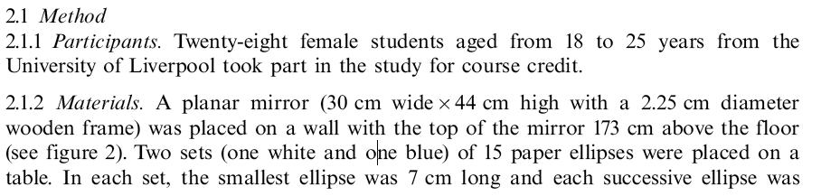
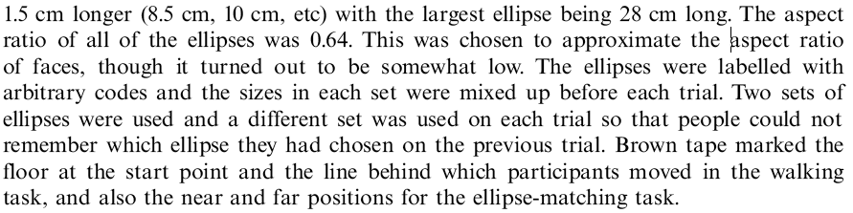

Slide 32
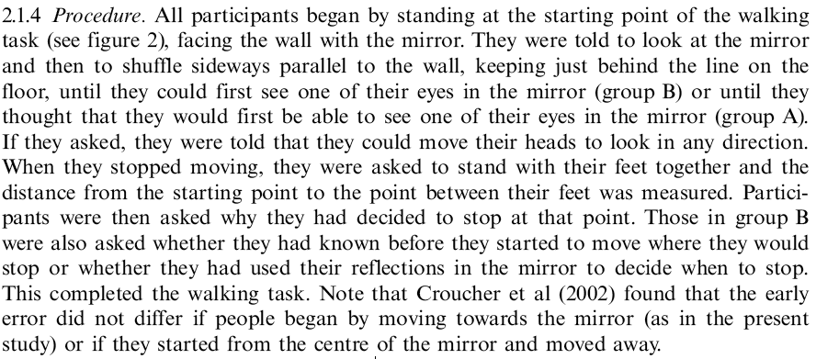

Slide 33
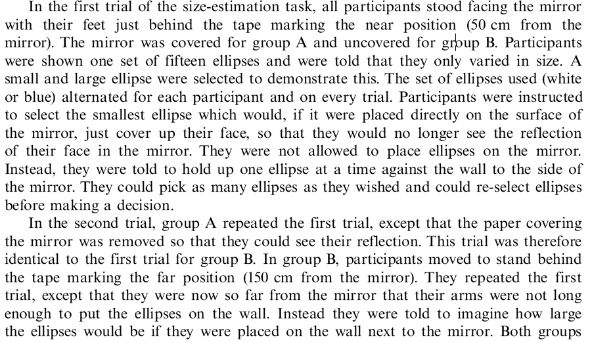
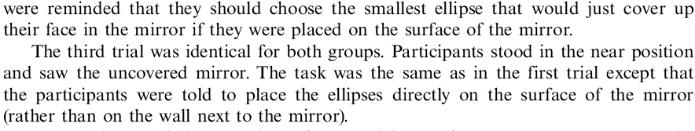

Slide 34
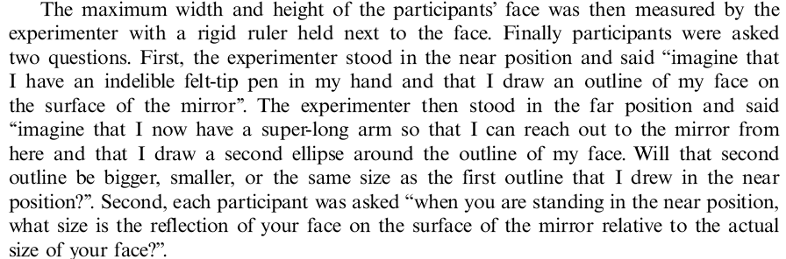

Slide 35
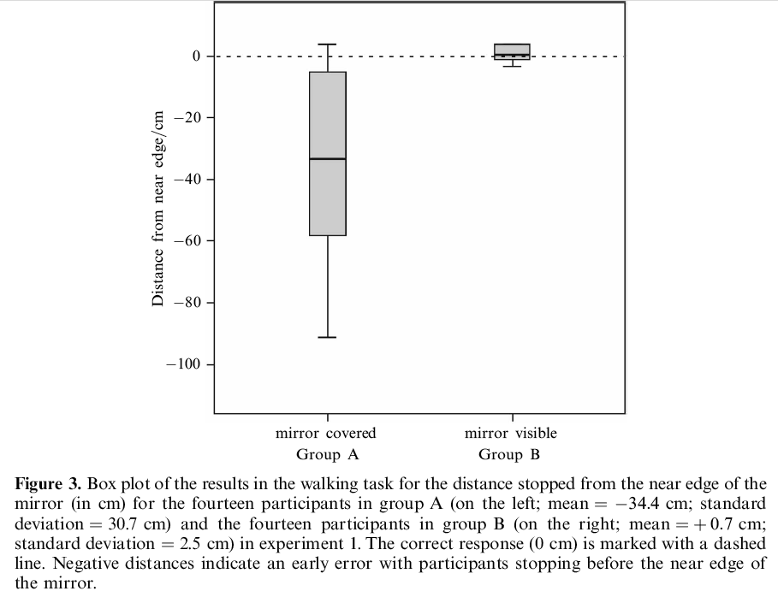
Risultati (walking task - early error)

Slide 36
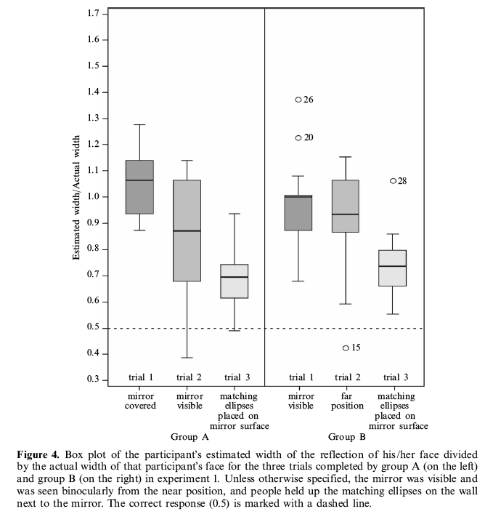
The results for group A confirmed those of Bertamini and Parks (2005): when people had to imagine
seeing their reflection in a mirror, they grossly overestimated their size. Surprisingly, this
overestimation was as severe for group B, though this group could see their reflection,
supporting the perceptual account of this error.

Slide 37
For group A,
uncovering the mirror modestly improved performance but a strong overestimation
persisted. This suggests that the overestimation is largely resistant to correction from
perceptual feedback, supporting the perceptual account. A modest improvement did occur
when people could see their reflection..

Slide 38
for group B only, the overestimation was signifi-
cantly larger when people stood in the near position (0.98) in the first trial than when
they stood in the far position (0.90) in the second trial.
When questioned at the end of the study, most people (79%) thought that the
reflection of their face on the surface of the mirror would be smaller when they looked
at it from the far position than from the near position.
Even in the far position, people selected ellipses that were much too large

Slide 39
The proportion when the ellipse was placed on the mirror (0.72) was significantly smaller than 1, but it was still significantly larger than the correct answer of 0.5.
Performance was thus more accurate when the
ellipse was placed directly on the surface of the mirror. Nevertheless, to our surprise, both groups continued to overestimate the size of their reflection by over 40%.

Slide 40
Discussion EXP 1
(…)

Slide 41
EXP 2 control
Experiment 2 was conducted to examine a number of reasons why, in experiment 1,
people overestimated the size of the reflection of their face even when they could see their reflection.
1 prova: E’ un problema di stima di forme ellittiche?
First, we checked that people did not always overestimate the size of elliptical shapes. We expected people to be accurate and not to systematically deviate from the correct answer. If so, this would suggest that the overestimation observed in experiment 1 was either due to errors in estimating the size of faces or to errors in estimating the size of reflections in mirrors.

Slide 42
EXP 2 control
2 prova: E’ un problema di stima dei riflessi della propria testa o dei riflessi in generale?
Second, we investigated whether overestimation was specific to estimating faces or
generalised to other, novel objects. A paper ellipse that was approximately the same size as a face was placed next to the observer's head. The observer saw the reflection of this ellipse in the mirror that he or she was facing. This reflection was about the same size as the reflection of the face.
If the observer could accurately estimate the size of the reflection of this novel ellipse it would suggest that size constancy for faces produced the overestimation in experiment 1. When people see the reflections of faces in mirrors, they may find it difficult to discount their knowledge of the actual size of faces. This
could explain why, in experiment 1, people usually selected ellipses that were about the size of their faces. In contrast, if people continued to overestimate when they tried to match the size of the reflection of a novel, test ellipse, it would indicate that they had a general difficulty in estimating the size of reflections on the surface of a mirror.

Slide 43
EXP 2 control
3 prova: Controllo stima del proprio volto riflesso
On the third trial in experiment 2, people estimated the sizes of the reflection of
their face. We predicted that a clear overestimation would be found here, as this
trial replicated the first trial in experiment 1 for group B. This trial provided a within-
participants control to test whether size estimation for reflections of novel ellipses (tested in the first two trials) was more accurate than that for reflections of faces.

Slide 44
EXP 2 control
4 prova: E’ un problema di binocularità (costanza di grandezza legata alla percezione in profondità?)
Finally, the fourth trial repeated the third except that people closed one eye as
they were matching the ellipses. This tested whether people's responses were more
accurate when faces were viewed monocularly rather than binocularly. If size over-
estimation is linked to size constancy, reducing depth information may reduce size
constancy and hence the overestimation error (Holway and Boring 1941; Kaneko and
Uchikawa 1997; Koh and Charman 1999). Monocular viewing moves one step towards reducing the reflection to a flat picture. Analogously, we naturally close one eye when trying to frame a photograph to flatten what we see, to get a better idea of how the photograph will look.

Slide 45
50 cm
50 cm
50 cm
50 cm

Slide 46

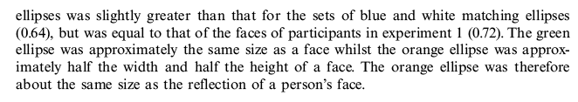

Slide 47
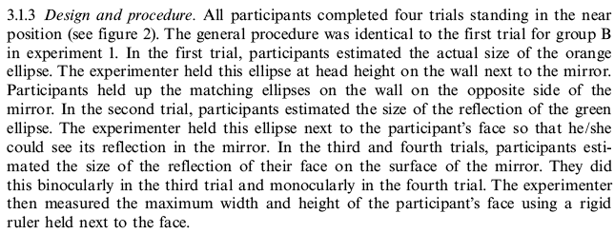

Slide 48
Risultati
The width of the ellipse selected by each participant was divided by the actual width
of the test ellipse (for the first two trials) or by the actual width of that participant's
face (for the last two trials) to calculate the proportion of the width of the ellipse or
his/her face that would be covered by the chosen ellipse (see figure 5). If participants
had responded accurately, then this proportion would be 1 on the first trial (when
they matched to the actual, physical ellipse) and 0.5 on the other three trials (when they matched to a reflection on the surface of the mirror).

Slide 49
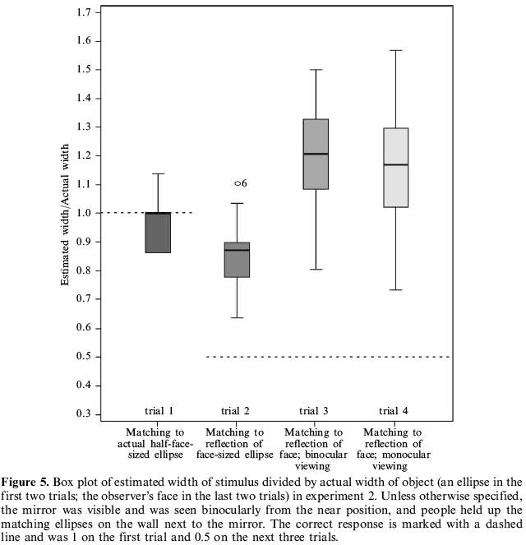
The proportion of the width of this test ellipse that would be covered by
the chosen ellipse (0.96) was not significantly different from the correct response of 1. Thus participants could accurately estimate the physical size of ellipses seen directly.

Slide 50
The proportion of the width of
this test ellipse that would be covered by the chosen ellipse (0.86) was significantly
larger than the correct response of 0.5. This ratio was, though, significantly less than 1, so estimates were smaller than the actual size of the ellipse. People grossly overestimated the size of the reflection of this
test ellipse, demonstrating that overestimation of reflections is not restricted to faces.

Slide 51
The proportion of the width of their face that would be
covered by the chosen ellipse (1.21) was significantly larger than the correct response
of 0.5. Indeed these estimates were significantly greater than 1. A repeated-measures ANOVA comparing estimates on the second and third trials revealed that people overestimated the size of the reflection of their face more than of the face-sized test ellipse. This suggests that there may be a face-specific overestimation over and above people's general overestimation
of the size of reflections.

Slide 52
The proportion of the width of
their face that would be covered by the chosen ellipse (1.16) was significantly larger than the correct response of 0.5. As on the third trial, this proportion was also significantly greater than 1. A repeated-measures ANOVA comparing estimates on the third and fourth trials found that overestimations did
not reduce significantly when people viewed their reflections monocularly rather than
Binocularly.

Slide 53
Discussion EXP 2
(…)

Slide 54
EXP 3
Experiments 1 and 2 used an indirect means of estimating size. People were told to select
the ellipse that would just cover up the stimulus. This response measure may have biased
people.
E’ un dato dipendente dal tipo di stima di misura usata?
Experiment 3 was conducted to try to replicate the overestimation error with a different response measure. People were asked to directly estimate the width and height of stimuli
in centimeters. This verbal estimation task was easier to explain and was more familiar
than that of matching ellipses. Nevertheless we predicted that people would continue
to overestimate the size of reflections on the surface of mirrors, for both reflections
of a test ellipse and reflections of their face.

Slide 55
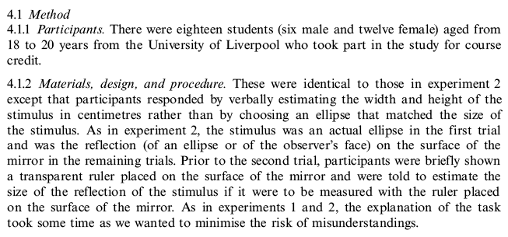

Slide 56
50 cm
50 cm
50 cm
50 cm

Slide 57
Risultati
The participant's width estimation was divided by the actual width of the test ellipse
(for the first two trials) or by the actual width of that participant's face (for the last
two trials) (see figure 6). If participants had responded accurately, this proportion
would be 1 on the first trial (when they estimated the actual, physical size of a test
ellipse) and 0.5 on the other three trials (when they estimated the size of a reflection
on the surface of a mirror).

Slide 58
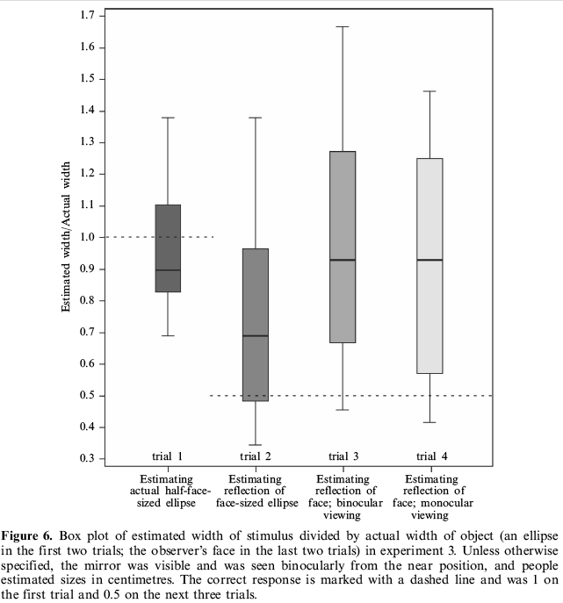
Their estimated width divided by the width of this test ellipse (0.95) was
not significantly different from the correct response of 1. Replicating experiment 2, people could accurately estimate the size of real objects. Furthermore,
as in experiment 2, people tended to slightly underestimate the width of the ellipse, so any error was in the opposite direction to the overestimation of mirror reflection size observed in experiments 1 and 2.

Slide 59
Their estimated width
(0.74) was significantly larger than the correct response of 0.5.
This proportion was, though, significantly less than 1, so
people's estimates were smaller than the actual size of the ellipse. As in experiment 2,
people grossly overestimated the size of the reflection of a test ellipse, confirming that the
overestimation of reflections is not restricted to faces.

Slide 60
Their estimated (1.02) was significantly larger than the correct response of 0.5, and was not significantly different from 1.
A repeated-measures ANOVA comparing estimates on the second and third trials revealed that people overestimated the size of the
reflection of their face more than of the face-sized test ellipse.
Replicating experiment 2, this suggests that there is a face-specific overestimation of
reflection size in addition to people's general overestimation of the size of reflections.

Slide 61
Their estimated width div-
ided by the width of their face (0.91) was significantly larger than the correct response
of 0.5. As on the third trial, this proportion was not signif-
icantly different from 1. A repeated-measures ANOVA comparing
estimates on the third and fourth trials found that overestimations reduced when
people viewed their reflections monocularly. This final result
contrasts with that found in experiment 2, where monocular viewing did not improve performance, although there was a trend in the same direction.

Slide 62
Discussion EXP 3
(…)

Slide 63
EXP 4
In experiment 4 we tested whether people could be explicitly taught a strategy that would
eliminate their overestimation. We first attempted to replicate the main findings of experi-
ment 2 by repeating the first three trials.
On the critical fourth trial, people were told to use a monocular, lining-up strategy when choosing an ellipse which would just cover up their reflection in the mirror.
People were instructed to place their chosen ellipse at the same height on the wall as the top of the reflection of their face and then decide whether the bottom of the ellipse lined up with the bottom of the reflection of their chin.
We also tested whether people could accurately measure the size of their reflection using a transparent ruler placed on the surface of the mirror.
The subjects in experiments 1, 2, and 3 were only young psychology students.
To ensure generality, one group in experiment 4 was recruited from a more diverse
population of volunteers. The second group were young psychology students but their
instructions were altered. We were concerned that the instructions in experiments 1
and 2 to pick the ellipse that would ``just cover'' a stimulus may have led people to
overestimate. This could be, first, due to an anchoring effect, if people started by
choosing an ellipse that was definitely large enough to cover the stimulus. To examine this
issue, in experiment 4 the second group was told to pick the ellipse that would ``almost
completely cover'' the stimulus.

Slide 64



Slide 65
Almost completely cover
50 cm
50 cm
50 cm
rifare con strategia e monoc.
+ misura su specchio
+ stima distanza dello sp
+ stima rapp riflesso/reale
50 cm

Slide 66
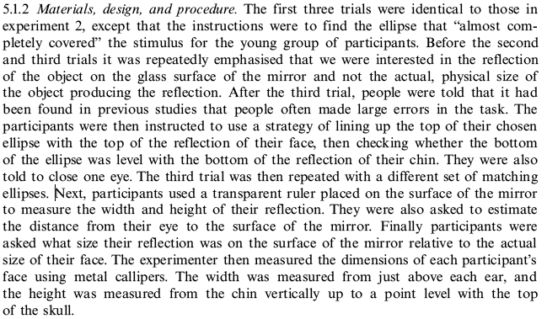

Slide 67
Results
The width of the ellipse selected by each participant was divided by the actual width
of the test ellipse (for the first two trials) or by the actual width of that participant's
face (for the last two trials) to calculate the proportion of the width of the ellipse or
his/her face that would be covered by the chosen ellipse (see figure 7). If participants
had responded accurately then this proportion would be 1 on the first trial (when they
matched to actual, physical ellipses) and 0.5 on the other three trials (when they matched to reflections on the surface of the mirror).

Slide 68
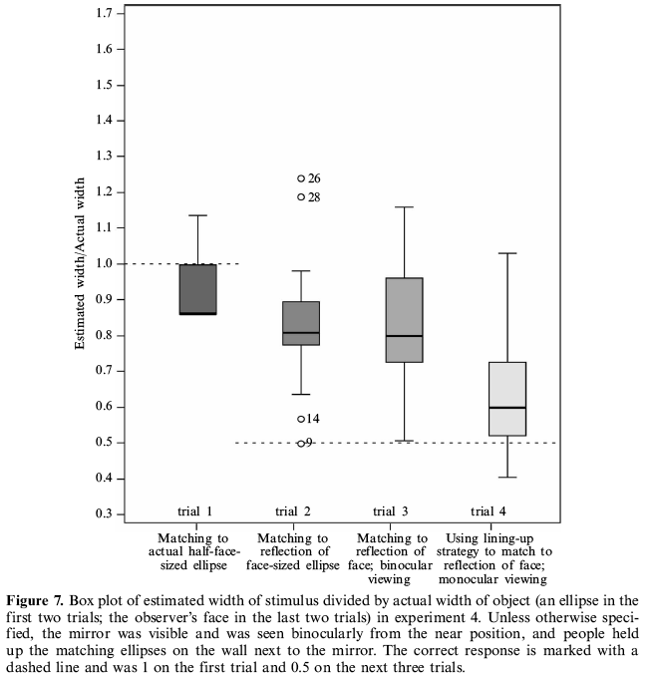
As predicted, there was a main effect of trial.
There was no effect of instructions. There was thus no evidence that the ’’almost cover'' instructions (0.81) led people to choose smaller ellipses than the ``just cover’’ instructions (0.79) that were used in experiments 1 and 2.
Given that there was
no difference between the two groups, their results were pooled for the following analyses.

Slide 69
The proportion of the width of this test ellipse that would be covered by the
chosen ellipse (0.91) was significantly less than the correct response of 1. Thus, as in experiments 2 and 3, participants slightly underestimated the
width of the ellipse.
Any error in estimating the size of real objects was therefore in
the opposite direction to the overestimation observed with mirror reflections.

Slide 70
The proportion of the width of
this test ellipse that would be covered by the chosen ellipse (0.82) was significantly
larger than the correct response of 0.5. This proportion was,
though, significantly less than 1, so estimates were smaller
than the actual size of the ellipse. Replicating the results of experiments 2 and 3, people grossly overestimated the size of the reflection of a test ellipse, confirming that the
overestimation of reflections is not restricted to faces.

Slide 71
The proportion of the width of their face that would be covered by
their chosen ellipse (0.84) was significantly larger than the correct response of 0.5, but was significantly less than 1.
In contrast to the results of experiments 2 and 3, a repeated-measures ANOVA found
that people did not overestimate the size of the reflection of their face more than that
of the face-sized test ellipse.

Slide 72
A repeated-measures ANOVA
comparing estimates on the third and fourth trials found that the new strategy significantly reduced overestimations.
On the fourth trial, the
proportion of the width of their face that would be covered by their chosen ellipse
(0.63) was significantly larger than the correct response of 0.5,
but it was significantly less than 1. Explicitly instructing people to use a monocular, lining-up strategy did greatly reduce the magnitude of errors, though
most people continued to overestimate size.

Slide 73
People were accurate at using a transparent ruler to measure the width and height of
the reflection of their faces. The ratio of the persons' measurement of the width of their
reflection to the physical width of their face as measured by the experimenter (0.46) was
slightly (but significantly) less than the correct response of 0.5. The ratio of the persons' measurement of the height of their reflection to the physical height of their face as measured by the experimenter (0.50) was not significantly different from the correct response of 0.5.
People were also quite accurate at estimating the distance from their eyes to the surface of the mirror (mean = 52 cm; st. dev. = 11 cm; the correct response was approximately 55 cm).
Despite judging reflection size quite accurately in the fourth trial, and in spite of
accurately measuring their reflection size with a ruler, people were still not confident
or accurate at deciding what size the reflection of their faces was relative to the size
of their actual faces. Most (29/36) thought that their reflection was smaller than their
actual face but six thought that their reflection was the same size, and one thought
it was larger. Most people had some insight into the size of their reflection after
completing the study, but they did not explicitly know that their reflection was half the
width of their actual face.
Overall, males estimated image size (but not actual size) more accurately than females, but males still did overestimate image size.

Slide 74
Discussion EXP 4
(…)

