Slide 1
IRELAND(S)

Slide 2
In ancient times, Ireland was divided into provinces, each ruled by a King. These provinces were dynamic and their borders changed all the time. Today, when Irish talk about the provinces of Ireland, they mean Leinster, Ulster, Munster and Connaught.

Slide 3
There are 32 counties in Ireland with 6 of them in Northern Ireland.

Slide 4
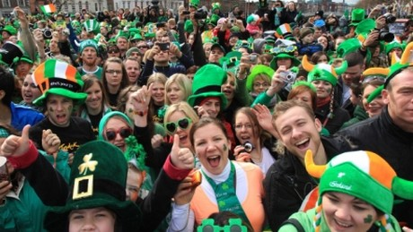
THE PEOPLE
IN
IRELAND

Slide 5
Inhabitated areas
Compared to other parts of Europe, Ireland is very sparsely populated. Settlement is concerned around the east and south coasts. The major metropolitan areas include Belfast, Cork and Dublin.

Slide 6
Changes in the number of inhabitants
The population today is significantly lower than it was about 170 years ago. The current population of the island is approximately 5.7 million people (4 million in the Republic and 1.7 million in Northern Ireland); in 1840 the whole population of the island was 8,175,124.

Slide 7
Religious identity
Most Irish people still define themselves on religious grounds. Though churchgoing has dimished dramatically in the Republic, the Roman Catholic Church still has a strong influence on political decision-making. The North remains rigidly divided between catholics and Protestants.

Slide 8
A challenge to Irish homogeneity
The 1990s’ economic boom was accompanied by the arrival of refugees and asylum seekers that has challenged Ireland’s homogeneity. While many Irish people have embraced the concept of multiculturalism, others have seen the newcomers as a threat, and this has resulted in a spate of racist attacks over the last few years.

Slide 9
The Irish character
Nonetheless, the Irish are well known for their joviality. They love to talk and tell stories, and their sense of houmor is unique. The best place to meet a typical Irish character is in one of the many pubs the island is full of.

Slide 10
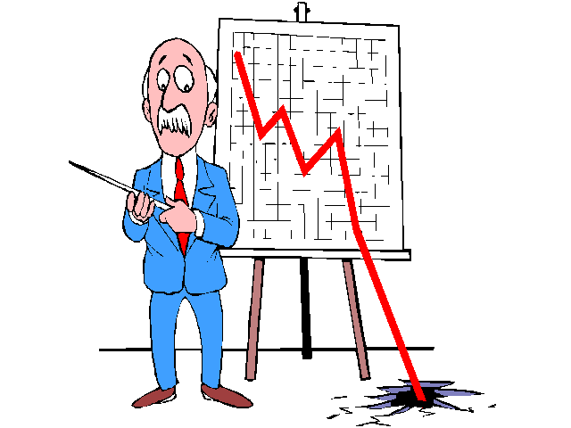
THE IRISH
ECONOMY

Slide 11
IRELAND
a small, modern, trade-dependent economy that experienced a growth of about 7% in 1995-2005
large computer and telecommunications firms moved in, bringing jobs and investment
skipped straight from
an agricultural economy
to a post-industrial one

Slide 12
Exports
The primary engine for Ireland’s growth
Rise in
Consumer spending
Construction
Business investment

Slide 13
The Irish Famine – 1840s
The Great Famine
The Great Potato Famine
«The Irish catastrophe»
Jim Donnelly

Slide 14
«The Great Famine in Ireland began as a natural catastrophe of extraordinary magnitude, but its effects were severely worsened by the actions and inactions of the Whig government, headed by Lord John Russell in the crucial year from 1846 to 1852».

Slide 15
«Altogether about a million of people in Ireland are reliably estimated to have died of starvation and epidemic disease between 1846 and 1851, and some two million emigrated in a period of a little more than a decade (1845-1855)».

Slide 16
«The Irish famine of the late 1840s killed nearly one-height of the entire population».
Successive blasts of potato blight – proper name fungus Phytophthora infestans – robbed more than one-third of the population of their usual means of subsistence for four or five years.

Slide 17
«This was not an artificial famine as the trsditional Irish nationalist interpretation has long maintained.
The original gross deficiency of food was real».

Slide 18
In 1846-47
blight destroyed the crop that had previously provided approximately 60% of the nation’s food needs.
The food gap created by the loss of the potato in the late 1840s was so enormous that it could not have been filled.

Slide 19
After 1847
There was an artifical famine in Ireland.
There existed an absolute sufficiency of food that could have prevented mass starvation, if it had been properly distributed so as to reach the smallholders and labourers of the west and the south of Ireland.

Slide 20
Why didn’t the British government do much more to mitigate the effects of the enormous initial food gap of 1846-47?

Slide 21
1. The government might have prohibited the export of grain from Ireland during the winter 1846-47 and early in the following spring, when there was little food in the country and before large supplies of foreign grain began to arrive.

Slide 22
2. The government could have continued its so-called soup-kitchen scheme for a much longer time. The scheme was remarkably inexpensive and effective. It should not have been dismantled after only six months and in spite of the enormous harvest deficiency of 1847.

Slide 23
3. The British government should have been willing to treat the famine crisis in Ireland as an imperial responsability and to bear the costs of relief after the summer of 1847. In stead, in an armosphere of rising «famine fatigue» in Britain, Ireland at that point and for the remainder of the famine was thrown back essentially on its own inadequate resourses.

Slide 24
The Celtic Tiger

Slide 25
What is the celtic tiger?
Period of rapid economic growth in Ireland
1995 – 2008
2008 > recession
Economic boom

Slide 26
What is the celtic tiger?
Metaphor coined by Kevin Gardiner – UK economist in 1994
Gardiner compared Ireland’s unexpected economic take-off to the Asian tiger economies

Slide 27
What is the celtic tiger?
The Celtic Tiger represented a model for economic development

Slide 28
GDP
Gross Domestic Product
at the turn of the millennium
10%
above that the four big European economies
the second highest in the EU behind Luxemburg

Slide 29
What did the Irish government do
in order to improve economy in the country?

Slide 30
The Irish government
has implemented a series of national economic programmes
designed to
- reduce government spending
- curb prices and wages
- increase labour force skills

Slide 31
EU contribution
Investment funds from the EU helped renovate the country’s infrastructure

Slide 32
The situation today
Boom has slowed
Unemployment is rising again
The cost of living is getting higher and higher

Slide 33
The Troubles
From 1921 to 1972 Northern Ireland had its own parliament in Belfast, the capital.
Politically, and economically, the province was controlled by Protestants, who were the majority of the population.
In the late 1960s, there were large, peaceful demonstrations by Catholics who wanted better political representation, jobs and housing.

Slide 34
The Troubles
Protestant reaction to the demonstrations by Catholics was strong and often violent.
In 1969, British soldiers were sent to Northern Ireland to help keep the peace.
In 1972, 13 Catholics were killed by British soldiers during a civil rights march.

Slide 35
The Troubles
This incidents, known as Bloody Sunday, led to even greater problems between Catholics and Protestants.
This long period of violence since the 1960s was called the Troubles.

Slide 36
The Troubles
period of civil unrest
discrimination against the minority Catholic community by Protestant majority led to a civil rights campaign in 1968-69.
More than 3,000 people died and 30,000 injured.

Slide 37
The Troubles
Terrorist violence has been caused by the Irish Republican Army (IRA) on the Catholic side, and groups including Ulster Volunteer Force (UVF) on Protestant side.
Talks between all political groups and including the British and the Irish governments resulted in the Good Friday Agreement of April, 1998, and the possibility of a Northern Ireland Parliament again.

