Slide 1
Università degli Studi di Macerata
21 October 2011
Project Cycle Management for
International Development
Cooperation
Project Cycle Management presentation
Teacher
Pietro Celotti

Slide 2
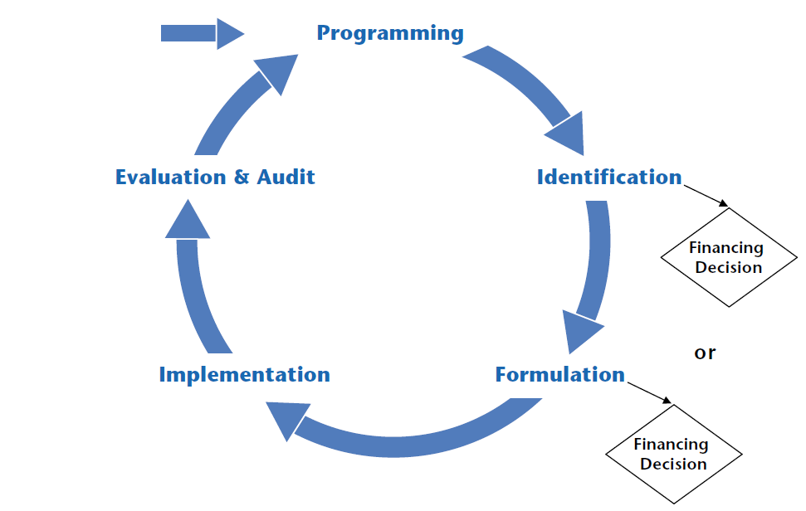
PCM diagram

Slide 3
PCM features
The phases in the cycle are progressive – each phase should be completed for the next to be tackled with success
New programming and project identification draws on the results of monitoring and evaluation as part of a structured process of monitoring and evaluation

Slide 4
Programming and Call for proposals
Programming phase depends on the donor
In case of development projects, programming is normally based on Call for proposals approach
The use of Call for proposals approach is the general rule when dealing with non-state actors

Slide 5
Call for proposals: EC role
Donor establishes:
    the broad objectives it wishes to achieve
    the scope of projects it is willing to fund
    the application and assessment procedures
    a set of eligibility criteria for applicants
    co-funding rate and ceiling

Slide 6
Call for proposals: Applicant role
The applicant:
    is free to identify the project idea in the scope of the Call for proposals
    has to formulate the proposal according to the Call for proposals requirements
    has to guarantee the necessary co-funding
    in case of approval, will implement the project

Slide 7
PCM value
PCM helps to ensure that:
    projects are supportive of overarching policy objectives of donor and partners
    projects are relevant to an agreed strategy and to the real problems of target groups / beneficiaries

Slide 8
PCM requirements
PCM requires the use of advanced tools and especially of the Logical Framework
PCM is not a merely technical procedure but a process starting with the active participation of stakeholders
Local ownership is considered as a key value to be promoted in each phase

Slide 9
Stakeholders analysis
The following information must be collected:
    Basic characteristics
    Interest and how affected by the problems
    Capacity and motivation to bring about change
    Possible actions to address stakeholders interests

Slide 10
Cooperation projects are based on stakeholders’ involvement
p.celotti@t33.it

