Slide 1
Università degli Studi di Macerata
7 November 2011
Project Cycle Management for
International Development
Cooperation
Logical Framework approach
Teacher
Pietro Celotti

Slide 2
Intervention logic
General Objective Level
Infant and maternal mortality rates reduced
IN
OUT
Project purpose level
Rates of infection among babies and infants reduced
Reduced incidence of acute birth complications
Rates of post-partum and neo-natal infection reduced
Results level
Increased N. of babies and infants vaccinated
Increased/earlier diagnosis of birth complications
Standards of hygiene and patient care improved
Attendance at rural clinics by mothers increased
Attendance at rural clinics by mothers increased
Sufficient drugs available
Mothers willing to attend clinics
Mothers willing to attend clinics
Improved staff skills
Increased and regular coverage by clinics
Increased and regular coverage by clinics
Sufficient drugs available
Activity level
1…..
2…..
3…..

Slide 3
Identifying the objective
Once the Problem and Objective Trees are designed and the possible strategies are identified, the project’s purpose (or specific objective) has to be chosen.
If only one specific objective or purpose is chosen, the project is clearer.
Once the specific objective and the relevant strategy are chosen, the means-ends relations must be analised again. Furthermore, “Results” and “Activities” have to be inserted in the Logical Framework.
The elements that we have not inserted are out of the project. They become assumptions.

Slide 4
Indicators
The objectively verifiable indicators allow to measure the achievement of the project’s objectives and results.
They allow to verify if the objectives are realistic (feasible).
They are the basis of the monitoring and evaluation project’s system.

Slide 5
Quality of the indicators
Indicators must be specific and must be relevant to the situation to be changed by the project’s activities.
Indicators must be as much quantitative as possible. It should be possible to aggregate them and to elaborate further statistics.
Indicators must be obtainable. This means that the costs necessary to collect the information sources of the indicators must be reasonable.
Indicators must be relevant to the information and management needs of the project’s.f
Information concerning the indicators must be collected and reported in time to influence the managerial decisions.

Slide 6
Sources of verification
Sources of verification describe how to find the information necessary to check the level of achievement of the objectives.
Sources of verification can be:
    Internal (es. report, project’s data) ‏
    External
External sources should be assessed in terms of accessibility, reliability, relevance.
External sources should not be too expensive.

Slide 7
Assumptions
Assumptions are external factors, which will affect the project’s implementation and long-term sustainability but lie outside its control.
The probability and significance of these assumptions being met should be estimated as part of assessing the riskiness of the project‏.

Slide 8
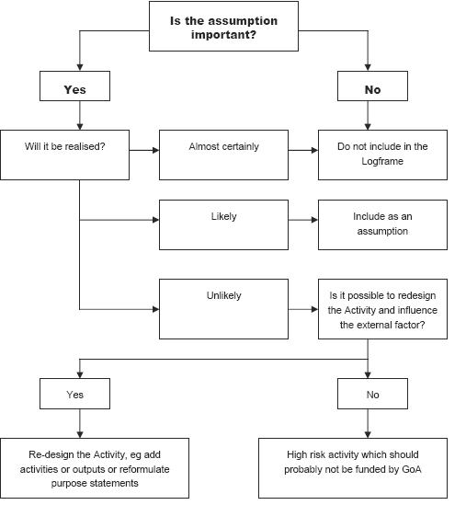
Assumptions

Slide 9
Indicators and assumptions demonstrate the feasibility of your project
p.celotti@t33.it

