Slide 1
Università degli Studi di Macerata
6 November 2012
Project Cycle Management for
International Development
Cooperation - Applied
Project Cycle Management presentation
Teacher
Pietro Celotti

Slide 2
What is a project
A project is a series of activities aimed at bringing about clearly specified objectives within a defined time-period and with a defined budget

Slide 3
Project’s features
Clearly identified beneficiaries
Specific aim
Limited and explicitly given ressources (time, funds)
Precisely defined coordination, management and financing arrangements
Monitoring and evaluation system

Slide 4
Glossary
Stakeholders
Beneficiaries
Target groups
Project partners

Slide 5
Back to the programme..
Normally projects depend on a programme and contribute to the achievement of its objectives
All together, they are a “package” with a common focus/theme
In order to evaluate the programme, the individual projects must be evaluated

Slide 6
Case history
If we go back to the identification of the RIVER project, the Call for proposal of the Culture 2007-2013 programme can be considered
Exercise (in groups): identify the main information to be given to your boss in order to take a decision concerning submission (or not) of a proposal under this programme – prepare a sheet and be ready to present it!

Slide 7
Weaknesses of the project approach
Inadequate local ownership of the projects
Huge number of different projects, funded by different donors (high transaction costs)
Establishment of separate management, financing and monitoring/reporting arrangements for the project partners

Slide 8
When is a project appropriate?
Pilot projects to build capacity
Regional environmental projects or international public goods
Emergency and post-crisis interventions
When conditions within a country or sector do not allow yet other approaches to be used

Slide 9
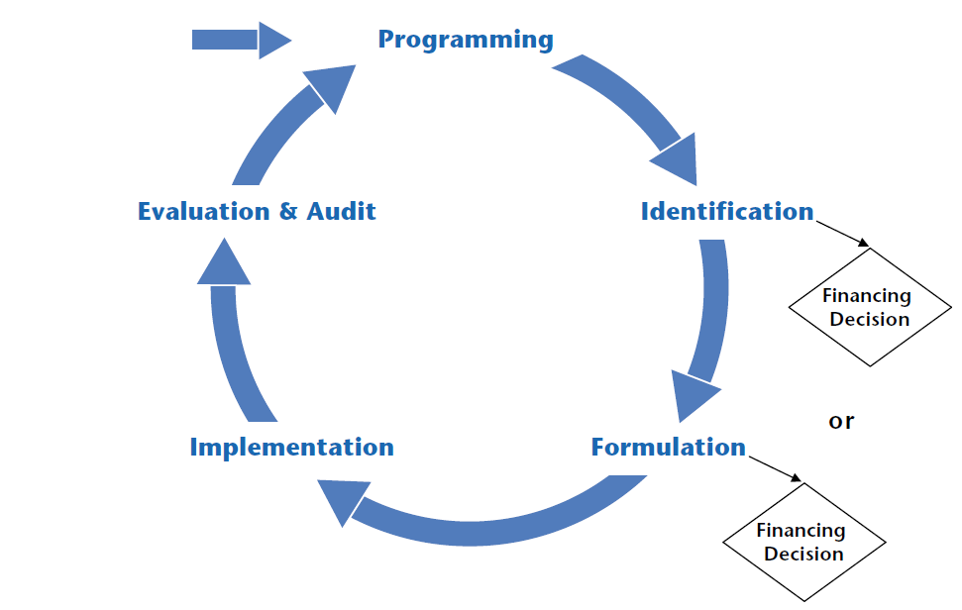
PCM diagram

Slide 10
PCM features
The phases in the cycle are progressive – each phase should be completed for the next to be tackled with success
New programming and project identification draws on the results of monitoring and evaluation as part of a structured process of monitoring and evaluation

Slide 11
Programming and Call for proposals
Programming phase depends on the donor
In case of development projects, programming is normally based on Call for proposals approach
The use of Call for proposals approach is the general rule when dealing with non-state actors

Slide 12
Call for proposals: EC role
Donor establishes:
    the broad objectives it wishes to achieve
    the scope of projects it is willing to fund
    the application and assessment procedures
    a set of eligibility criteria for applicants
    co-funding rate and ceiling

Slide 13
Call for proposals: Applicant role
The applicant:
    is free to identify the project idea in the scope of the Call for proposals
    has to formulate the proposal according to the Call for proposals requirements
    has to guarantee the necessary co-funding
    in case of approval, will implement the project

Slide 14
PCM value
PCM helps to ensure that:
    projects are supportive of overarching policy objectives of donor and partners
    projects are relevant to an agreed strategy and to the real problems of target groups / beneficiaries

Slide 15
PCM requirements
PCM requires the use of advanced tools and especially of the Logical Framework
PCM is not a merely technical procedure but a process starting with the active participation of stakeholders
Local ownership is considered as a key value to be promoted in each phase

Slide 16
Case history, again
When the RIVER project was presented, some strong and weak points were mentioned
Exercise (in groups): analyse the award criteria presented in the Culture Programme Specifications and associate (1) one criterion with a RIVER’s strong poing (2) one criterion with a RIVER’s weak point – each group should justify the selection

Slide 17
Cooperation projects are based on stakeholders’ involvement
p.celotti@t33.it

