Slide 1
Università degli Studi di Macerata
10/12/2012
Project Cycle Management for
International Development
Cooperation
Horizontal competencies
Teacher
Pietro Celotti (courtesy of Sviluppo Marche SpA)

Slide 2
“VISIBLE” Definition of the PM’s role
The VISIBLE Project Manager is the owner of the project and therefore responsible for its correct implementation in terms of overall resource management: people; time and finance. The PM has the authority to run the project on a day-to-day basis (on behalf of the employer, client, project board, funding organisation or other designated body) and should have sufficient latitude to exercise a wide degree of creativity in performing this role and ensuring results are achieved.

Slide 3
“VISIBLE” PM’s responsibilities
        The Project Manager oversees all aspects of the project using planning, monitoring and controlling processes. The PM is responsible for co-ordination and completion of the project and to this end will perform a variety of tasks including setting deadlines, assigning responsibilities, monitoring and reporting progress of the project. The PM may be responsible for more than one project at a time and will manage these with integrity according to agreed local procedures.

Slide 4
“VISIBLE” PM’s horizontal competencies
        1. Networking
        2. Results orientation
        3. Organising
        4. Communication
        5. Decision making
        6. Methodical
        7. Problem solving
.

Slide 5
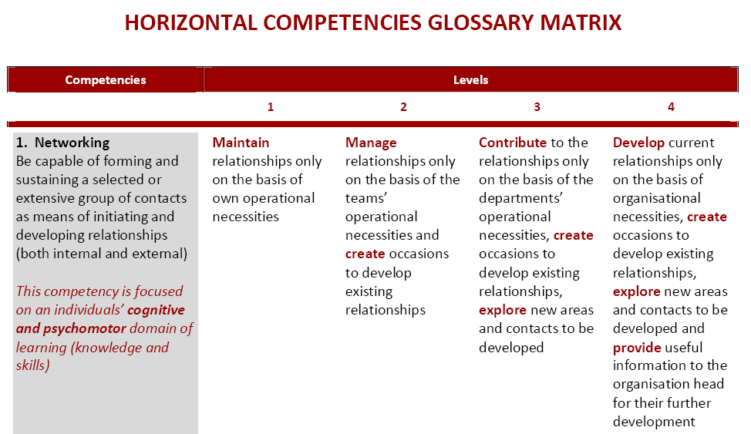

Slide 6
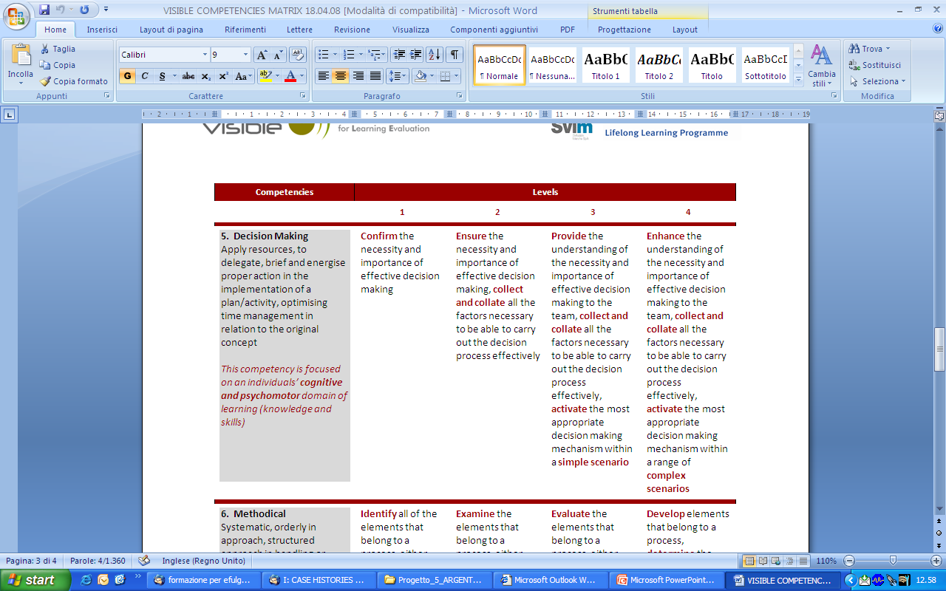
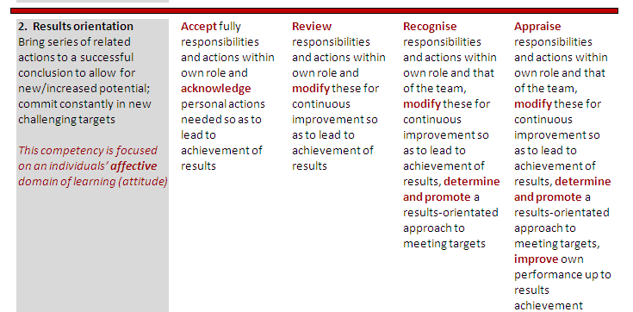

Slide 7
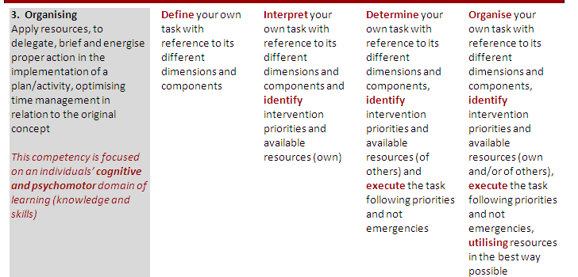

Slide 8
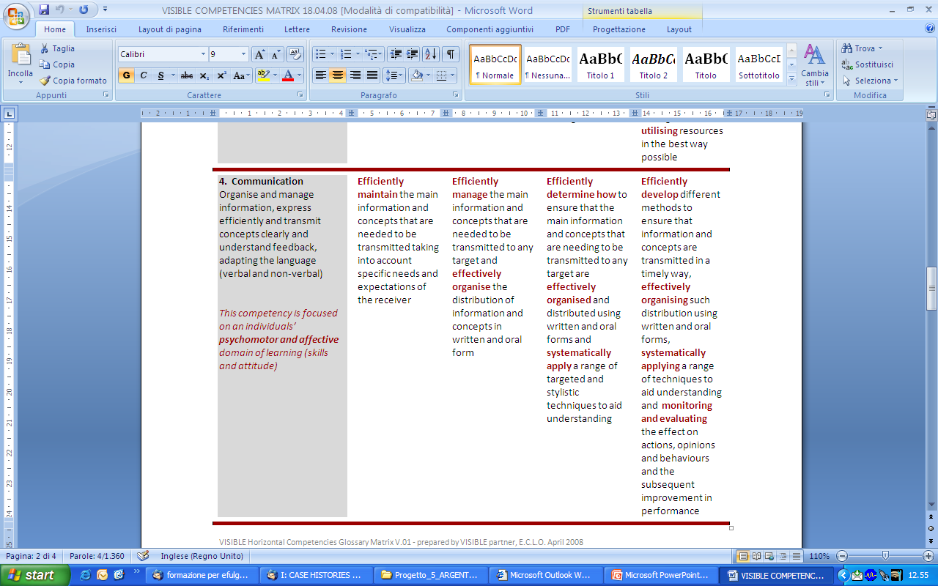

Slide 10
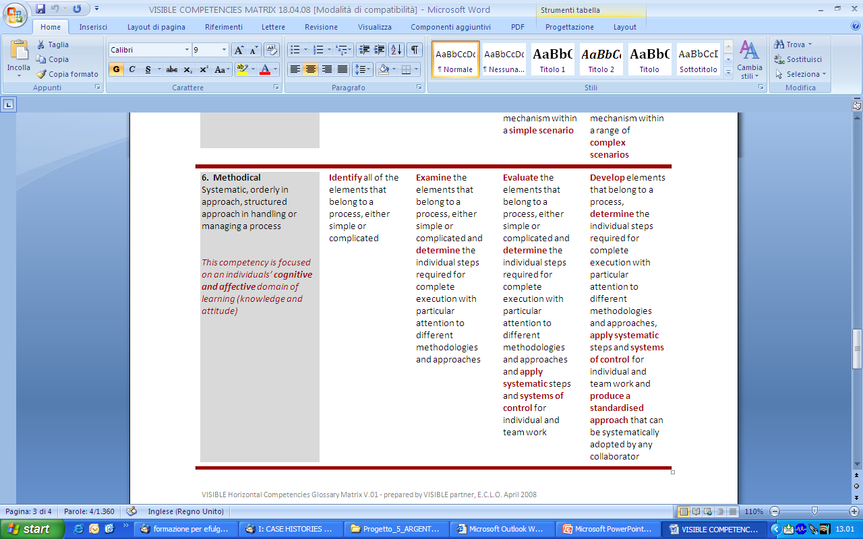

Slide 11
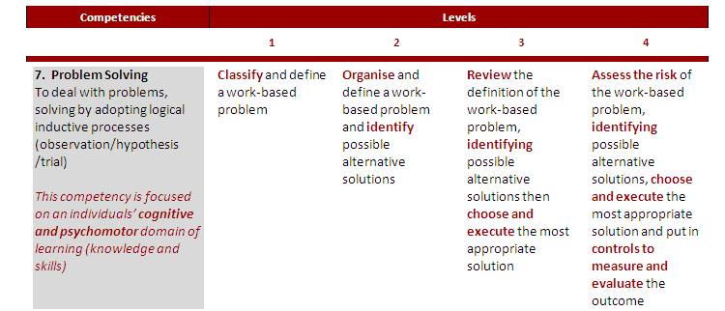

Slide 12
“VISIBLE” Case Histories
An opportunity to reflect upon a situation that occurred while the PM has been managing projects and then write about it so that it can provide a learning opportunity.
Be honest and thoughtful while writing. A difficult experience can sometimes provide more learning than an easy one.
Use as a basis for discussions with line managers to show how PM is working at levels 3 or level 4 in the competencies matrix.

Slide 13
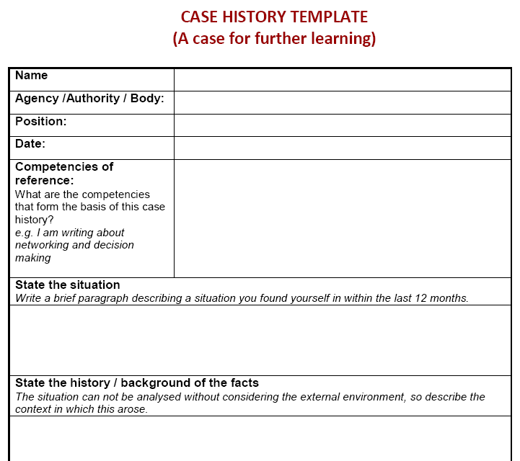

Slide 14
This is a reduced version of a presentation created by Sviluppo Marche SpA within a project co-funded by the European Union
p.celotti@t33.it

