Slide 1
Università degli Studi di Macerata
4 December 2012
Project Cycle Management for
International Development
Cooperation
Logical Framework tool
Teacher
Pietro Celotti

Slide 2
Proposal formulation
Proposal design is facilitated by the Logical Framework.
This is a matrix allowing to organise the different elements of a proposal:
    Intervention logic
    Verifiable indicators
    Sources of verification
    Assumptions

Slide 3
Proposal formulation
Logical Framework is a methodology allowing to check if the intervention is properly structured.
It supports the implementation of monitoring and evaluation actions.

Slide 4

Logical framework
 | Intervention logic | Verifiable indicators | Sources of verification | Assumptions
General objective
Project purpose
Results
Activities |  | MEANS | MEANS

Slide 5
LF description
The column Intervention logic indicates the contents of the project.
The column Indicators gives the tools to verify if the objectives are reached and the results achieved.
The column Sources of verification indicates what information have to be used in order to apply the indicators.
The column Assumptions includes the external factors affecting (positively or negatively) the project’s impementation.

Slide 6
Intervention logic
The following hierarchy is designed:
    GENERAL OBJECTIVE: long term benefits for the society.
    PROJECT PURPOSE: benefits for the project’s beneficiaries.
    RESULTS: concrete services/goods made available by the project.
    ACTIVITIES: how the project’s services/goods will be delivered.

Slide 7
Vertical logic
If-then logic:
    If the ressources are provided then the activities can be performed.
    If the activities are performed then the results are produced.
    If the results are produced then the project’s puropose is achieved.
    If the project’s purpose is achieved then the general objective is pursued.

Slide 8
Horizontal logic
Indicators specify how the achievement of objectives and results can be verified and measured.
They are established according to questions such as “How to realise if what I have planned has really happened or not?”
There are not indicators without sources of verification.

Slide 9
Intervention logic
General Objective Level
Infant and maternal mortality rates reduced
OUT
Project purpose level
Rates of infection among babies and infants reduced
Reduced incidence of acute birth complications
Rates of post-partum and neo-natal infection reduced
Results level
Increased N. of babies and infants vaccinated
Increased/earlier diagnosis of birth complications
Standards of hygiene and patient care improved
Attendance at rural clinics by mothers increased
Attendance at rural clinics by mothers increased
Sufficient drugs available
Mothers willing to attend clinics
Mothers willing to attend clinics
Improved staff skills
Increased and regular coverage by clinics
Increased and regular coverage by clinics
Sufficient drugs available
Activity level
1…..
2…..
3…..

Slide 10
Identifying the objective
Once the Problem and Objective Trees are designed and the possible strategies are identified, the project’s purpose (or specific objective) has to be chosen.
If only one specific objective or purpose is chosen, the project is clearer.

Slide 11
Results, activities, assumptions
Once the specific objective and the relevant strategy are chosen, the means-ends relations must be analised again.
“Results” and “Activities” have to be inserted in the Logical Framework.
The elements that we have not inserted are out of the project. They can be considered as “assumptions”.

Slide 12
Indicators and sources of verification
What have you learned from Alessandro Valenza’s lessons?

Slide 13
Assumptions
Assumptions are external factors, which will affect the project’s implementation and long-term sustainability but lie outside its control.
The probability and significance of these assumptions being met should be estimated as part of assessing the feasibility/riskiness of the project‏.

Slide 14
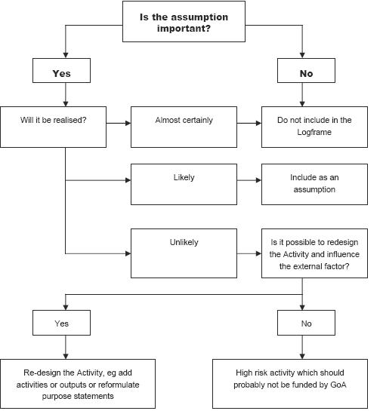
Assumptions

Slide 15
Our Logical Framework
Intervention logic
Indicators
Sources of indicators
Assumptions
General objective
To reduce infant and maternal mortality rates
Infant mortality rate reduced from x to y from year 201..
Motallity rate of pregnant/taking care of children women reduced from x to y from year 201..
Stats of Health Ministry (ex ante, in itinere, ex post)
Project purpose
To improve (1) pregnant/taking care of children women (2) infants and babies health situation in the region of ….
Rate of post-partum and neo-natal infections reduced from x to y in hospitals and clinics concerned from year 201..
Data provided by hospitals and clinics concerned (ex ante, in itinere and ex post)
Results
Regular system of vaccination of infants and babies in 2 hospitals and 3 clinics located in the region of …
Sufficient drugs available in 2 hospitals and 3 clinics in the region of …
Number of under 5 babies vaccinated in the region of increased from x% to y% from the year 201..
Data provided by the Health Ministry
Clinical data on vaccination provided every 3 months by hospitals and clinics concerned
Attendance at rural clinics by mothers inicreased
Activities
1. To renovate the hospital’s and clinic’s equipment
2. To provide hospitals and clinics with ambulances dedicated to vaccination
3. To empower the staff properly to use new equipments and solutions
4. To guarantee logistic for regular supply of drugs…
Technical assistance
Training
Supply of equipment
Supply of drugs
Mantainance of equipment is guaranteed by local experts/companies

Slide 16
LF represents the project in one page
p.celotti@t33.it

